Slide 2
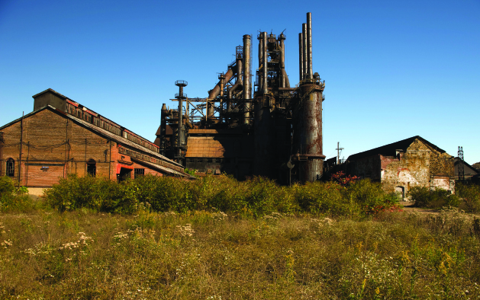
2
THE ECONOMIC PROBLEM
Notes:
Notes and teaching tips: 4, 5, 16, 20, 36, 61, 62, 65, 66, and 68.
To view a full-screen figure during a class, click the expand button.
To return to the previous slide, click the shrink button.
To advance to the next slide, click anywhere on the full screen figure.
Applying the principles of economics to interpret and understand the news is a major goal of the principles course. You can encourage your students in this activity by using the features called Economics in the News and Economics in Action.
(1) Before each class, scan the news and select two or three headlines that are relevant to your session today. There is always something that works. Read the headline and ask for comments, interpretation, discussion. Pose questions arising from it that motivate today’s class. At the end of the class, return to the questions and answer them with the tools you’ve been explaining.
(2) Once or twice a semester, set an assignment, for credit, with the following instructions:
(a) Find a news article about an economic topic that you find interesting.
(b) Make a short bullet-list summary of the article.
(c) Write and illustrate with appropriate graphs an economic analysis of the key points in the article.
Use the Economics in the News features in your textbook as models.

Slide 3
After studying this chapter, you will be able to:
Define the production possibilities frontier and use it to calculate opportunity cost
Define preferences and marginal benefit and describe an efficient allocation of resources
Explain how specialization and trade make resource use more efficient
Explain how current production choices expand future production possibilities, but change what we produce, and destroy and create jobs
Describe the economic institutions that coordinate decisions

Slide 4
Production Possibilities and Opportunity Cost
The production possibilities frontier (PPF) is the boundary between those combinations of goods and services that can be produced and those that cannot.
To illustrate the PPF, we focus on two goods at a time and hold the quantities of all other goods and services constant.
That is, we look at a model economy in which everything remains the same (ceteris paribus) except the two goods we’re considering.
Notes:
The production possibility frontier (PPF) is the first economic model the students see. Your first challenge is to ensure that the students understand the mechanics of the model. You can provide some help in the classroom but your main goal must be to get the student working—to develop good work habits. Encourage them to work the end-of-chapter problems, study guide questions, and to work the Practice Problems in MyLab Economics so that they are comfortable with the mechanics of this chapter.

Slide 5
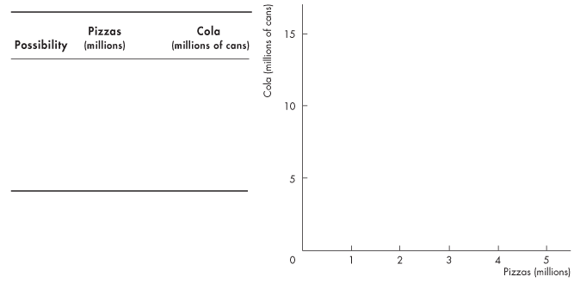
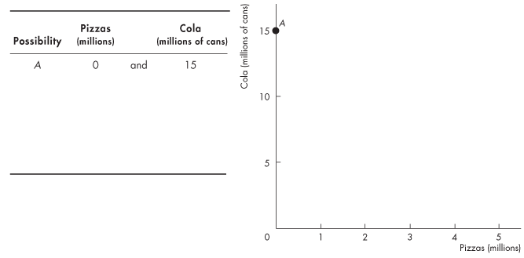
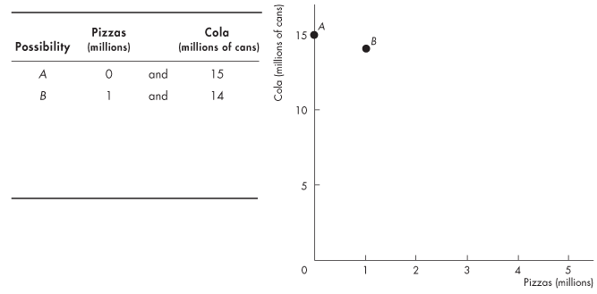
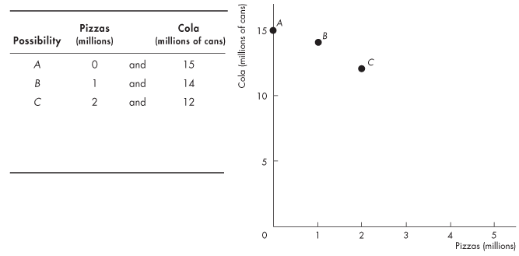
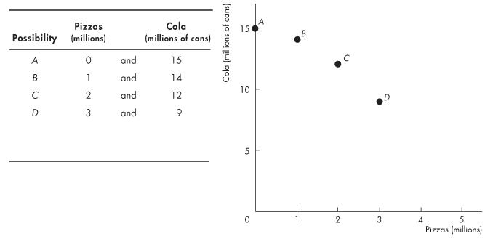
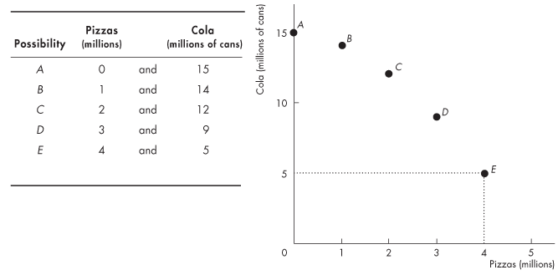
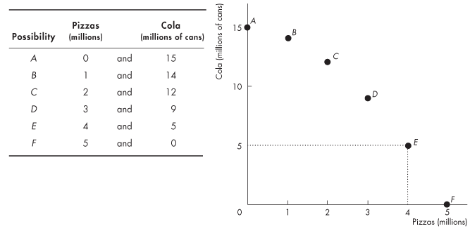
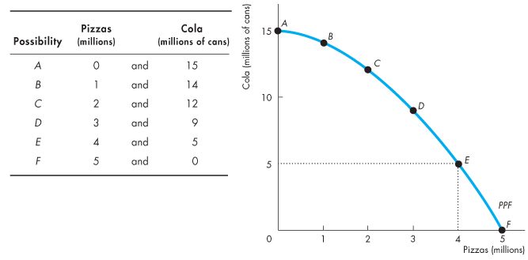
Production Possibilities and Opportunity Cost
Production Possibilities Frontier
Figure 2.1 shows the PPF for two goods: cola and pizzas.
Notes:
Your second challenge is to help the students begin to use the PPF model and to start thinking like economists. Thinking about everyday events in terms of graphs and tables of numbers is hard for most students. You can help them to appreciate economic models in general and the PPF model in particular by using the model to describe the tradeoff between studying and a social life faced every day by each student.
Why do some of the brightest students not get a 4.0 GPA? After sleeping, attending classes, and performing the mundane tasks of life, a student has 8 hours a day available for study and recreation. If the student spends all 8 hours studying, he/she will get a 4.0 GPA. But each hour of recreation lowers the GPA.
The Economics of Campus Life 101. First, assume a constant opportunity cost of recreation equal to a 0.333 drop in the GPA for each hour spent not studying. The highest GPA possible is 4.0, the lowest is 1.333, and the negatively sloped PPF curve is a straight line. Ask the students to draw the graph based on your description. Help them to interpret the PPF graph: the intercept points reveal the maximum GPA and the maximum recreation hours possible, and the negative slope quantifies the tradeoff the student faces. Points on the curve represent production efficiency and points inside the curve represent a misallocation of the student’s time where opportunities for increases in recreation and/or GPA points are wasted.
Then show that the opportunity cost of each additional hour of recreation (lost GPA points) is constant. Ask the students why.

Slide 6
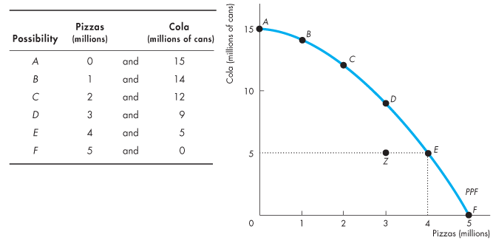
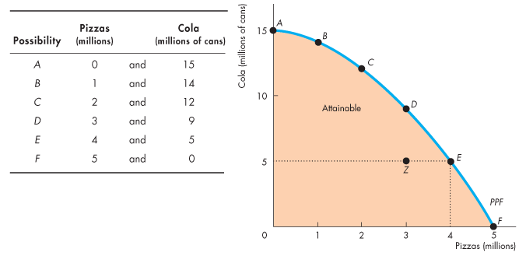
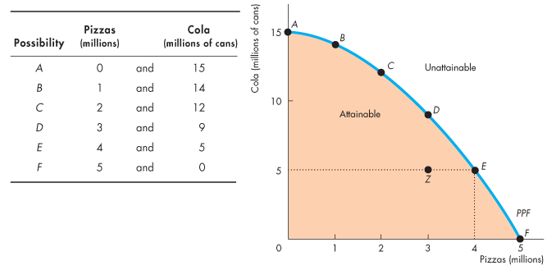

Slide 7
Production Possibilities and Opportunity Cost
Any point on the frontier such as E and any point inside the PPF such as Z are attainable.
Points outside the PPF are unattainable.

Slide 8
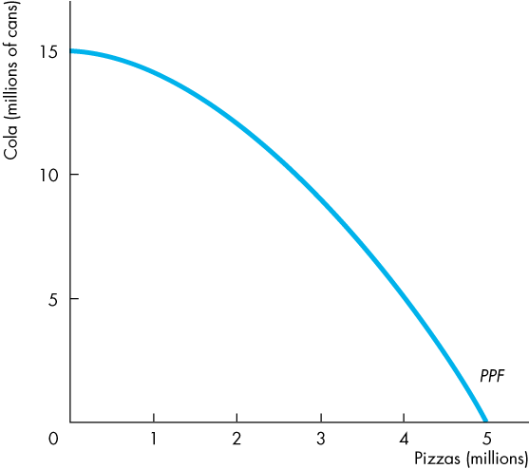
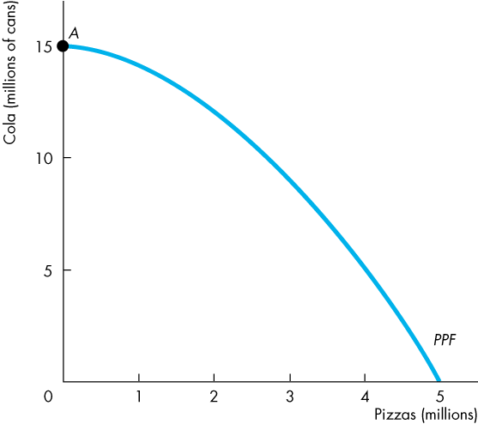
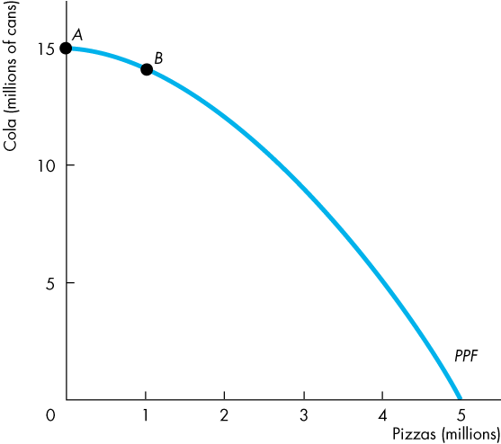
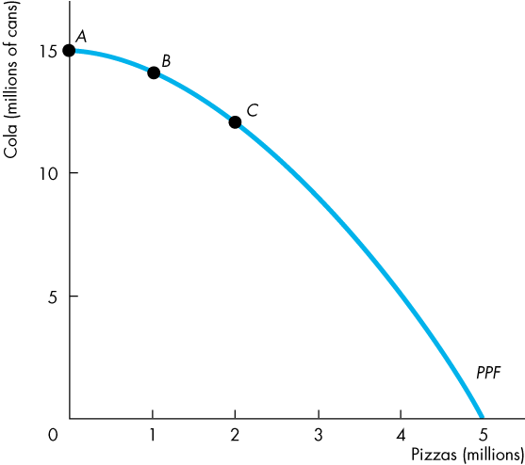
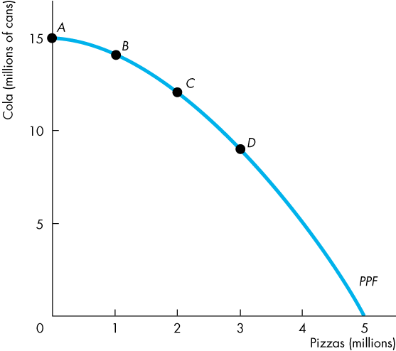
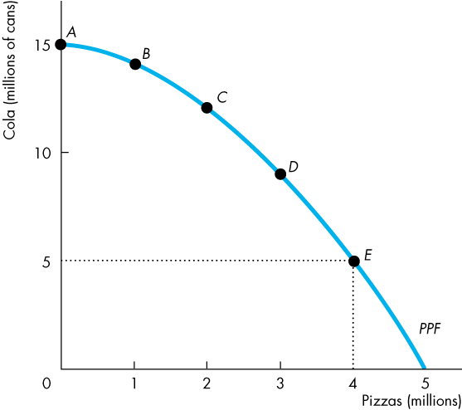
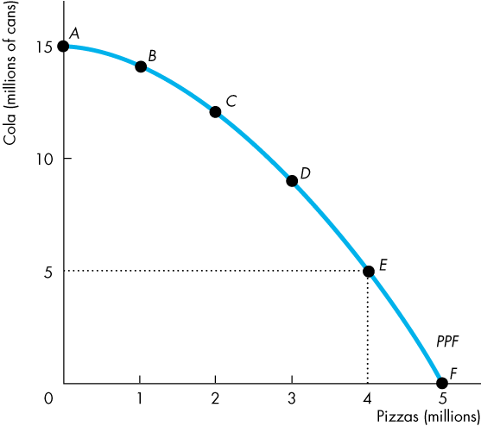
Production Possibilities and Opportunity Cost
Production Efficiency
We achieve production efficiency if we cannot produce more of one good without producing less of some other good.
All points on the PPF are efficient.

Slide 9
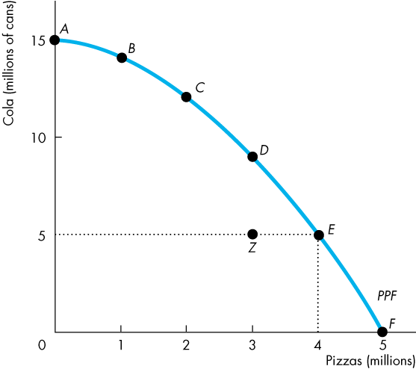
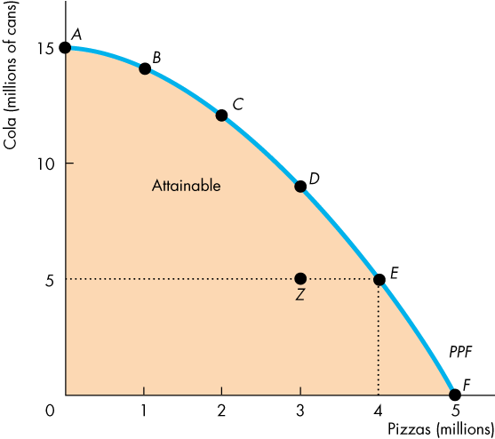
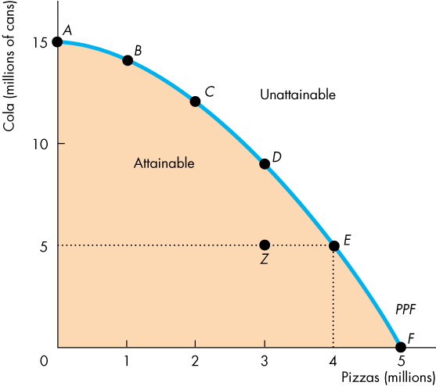

Slide 10
Production Possibilities and Opportunity Cost
Any point inside the frontier, such as Z, is inefficient.
At such a point, it is possible to produce more of one good without producing less of the other good.
At Z, resources are either unemployed or misallocated.

Slide 11
Production Possibilities and Opportunity Cost
Tradeoff Along the PPF
Every choice along the PPF involves a tradeoff.
On this PPF, we must give up some cola to get more pizzas or we must give up some pizzas to get more cola.

Slide 12
Production Possibilities and Opportunity Cost
Opportunity Cost
As we move down along the PPF,
we produce more pizzas, but the quantity of cola we can produce decreases.
The opportunity cost of a pizza is the cola forgone.

Slide 13
Production Possibilities and Opportunity Cost
In moving from E to F:
The quantity of pizzas increases by 1 million.
The quantity of cola decreases by 5 million cans.
The opportunity cost of the fifth 1 million pizzas is 5 million cans of cola.
One of these pizzas costs 5 cans of cola.

Slide 14
Production Possibilities and Opportunity Cost
In moving from F to E:
The quantity of cola increases by 5 million cans.
The quantity of pizzas decreases by 1 million.
The opportunity cost of the first 5 million cans of cola is 1 million pizzas.
One of these cans of cola costs 1/5 of a pizza.

Slide 15
Production Possibilities and Opportunity Cost
Opportunity Cost Is a Ratio
The opportunity cost of producing a can of cola is the inverse of the opportunity cost of producing a pizza.
One pizza costs 5 cans of cola.
One can of cola costs 1/5 of a pizza.

Slide 16
Production Possibilities and Opportunity Cost
Increasing Opportunity Cost
Because resources are not equally productive in all activities, the PPF bows outward.
The outward bow of the PPF means that as the quantity produced of each good increases, so does its opportunity cost.
Notes:
Classroom activity
Check out Economics in the News: Opportunity Cost of Kale

Slide 17
Using Resources Efficiently
All the points along the PPF are efficient.
To determine which of the alternative efficient quantities to produce, we compare costs and benefits.
The PPF and Marginal Cost
The PPF determines opportunity cost.
The marginal cost of a good or service is the opportunity cost of producing one more unit of it.

Slide 18
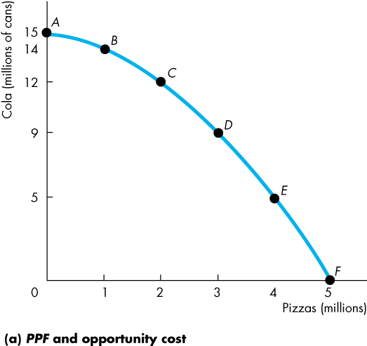
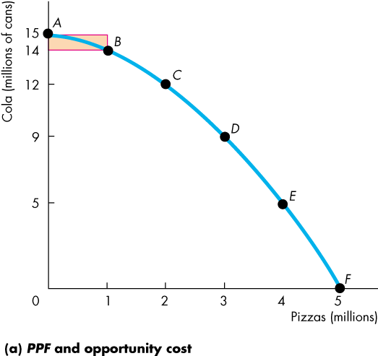
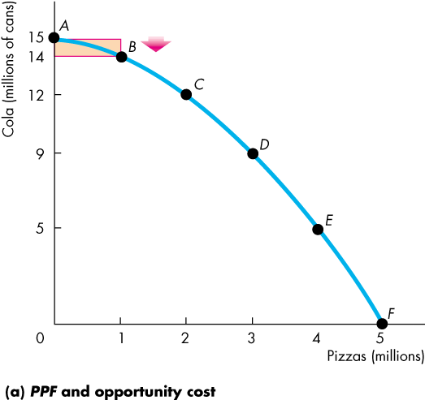
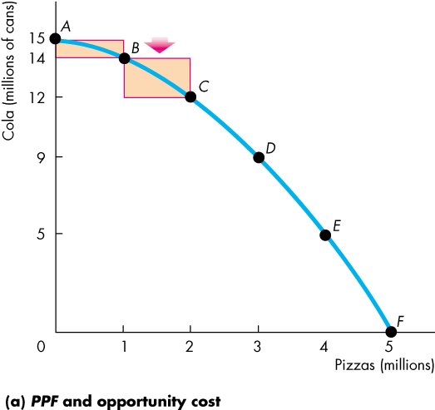
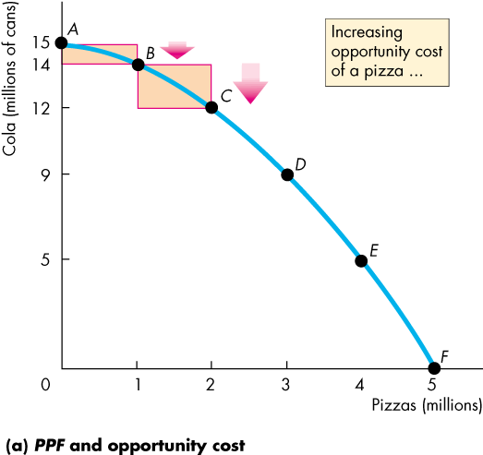
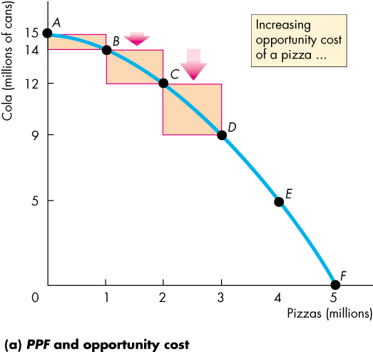
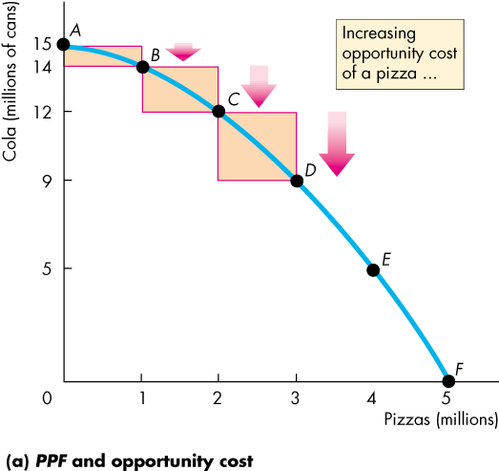
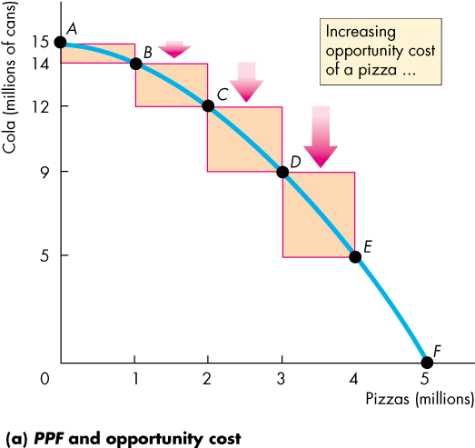
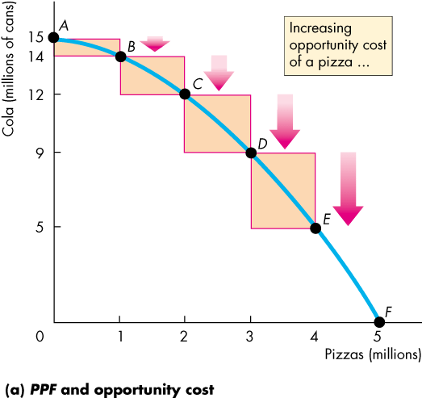
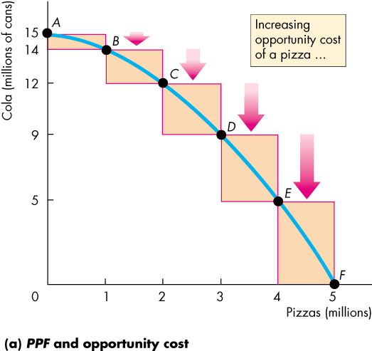
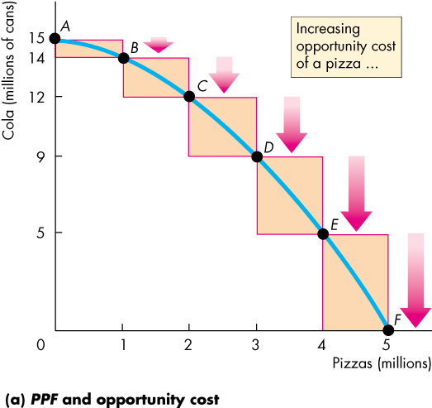
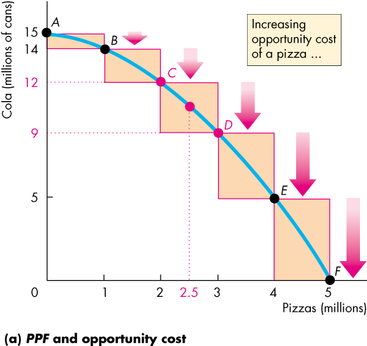
Using Resources Efficiently
Figure 2.2 illustrates the marginal cost of a pizza.
As we move along the PPF, the opportunity cost of a pizza increases.
The opportunity cost of producing one more pizza is the marginal cost of a pizza.

Slide 20
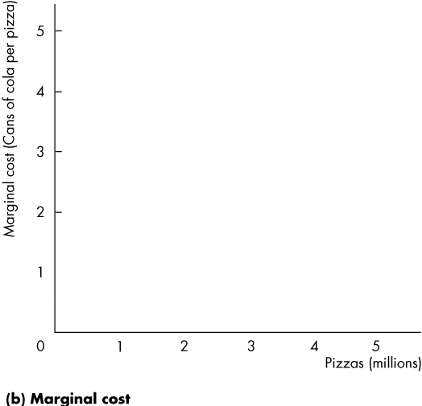
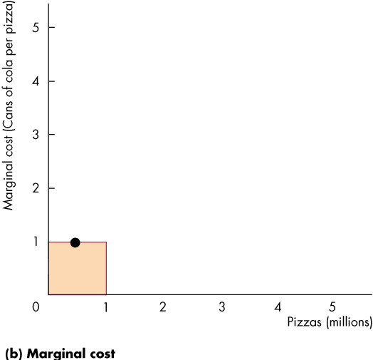
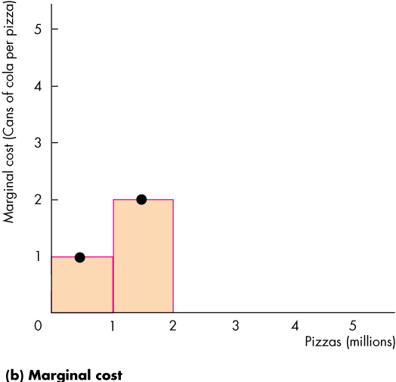
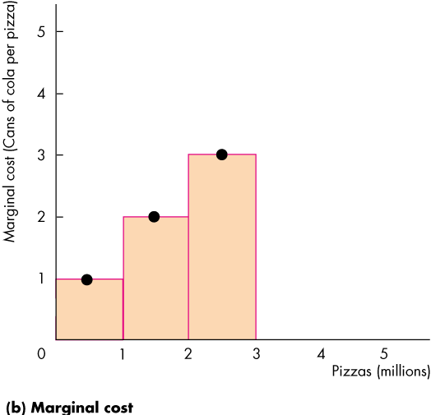
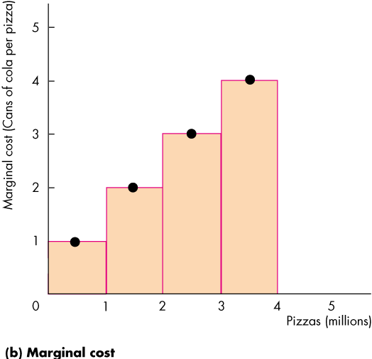
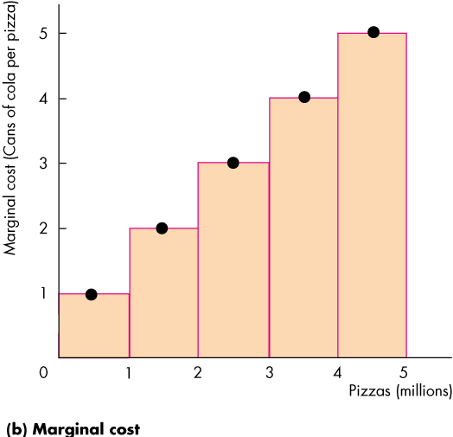
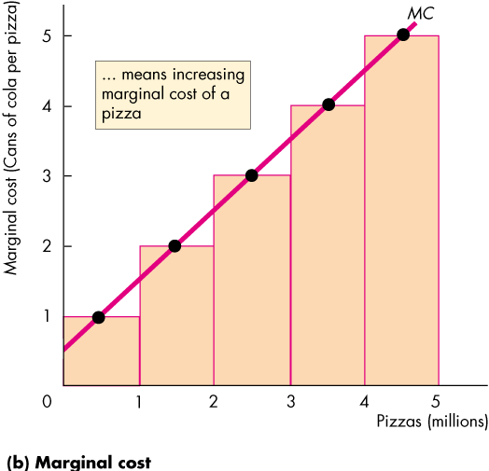
Using Resources Efficiently
In part (b) of Fig. 2.2, the bars illustrate the increasing opportunity cost of a pizza.
The black dots and the line MC show the marginal cost of producing a pizza.
The MC curve passes through the middle point of each bar.
Notes:
Students always wonder why MC passes through the middle point of the bars.
The height of each bar shows the cost of an average pizza in each of the 1 million pizza blocks. Focus on the 3rd 1 million pizzas. The opportunity cost of producing that 1 million pizzas is 3 million cans of cola. So in this range, the cost of an average pizza is 3 cans of cola.
The dot indicates that 3 cans of cola is the cost of the average pizza, which over this range is the 2.5 millionth pizza.

Slide 22
Using Resources Efficiently
Preferences and Marginal Benefit
Preferences are a description of a person’s likes and dislikes.
To describe preferences, economists use the concepts of marginal benefit and the marginal benefit curve.
The marginal benefit of a good or service is the benefit received from consuming one more unit of it.
We measure marginal benefit by the amount that a person is willing to pay for an additional unit of a good or service.

Slide 23
Using Resources Efficiently
It is a general principle that:
The more we have of any good, the smaller is its marginal benefit and …
the less we are willing to pay for an additional unit of it.
We call this general principle the principle of decreasing marginal benefit.
The marginal benefit curve shows the relationship between the marginal benefit of a good and the quantity of that good consumed.

Slide 24
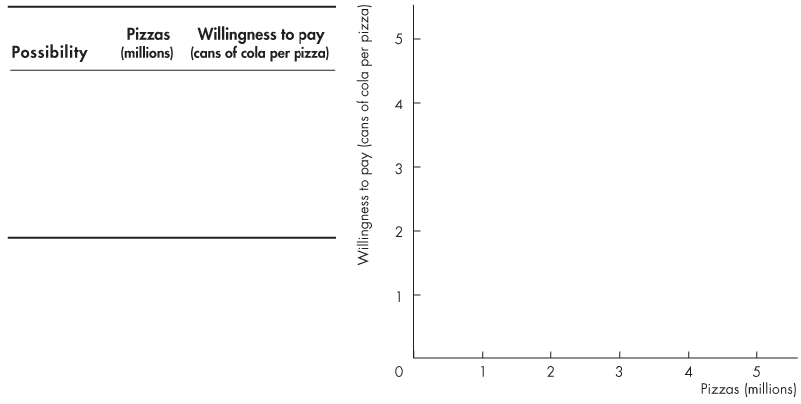
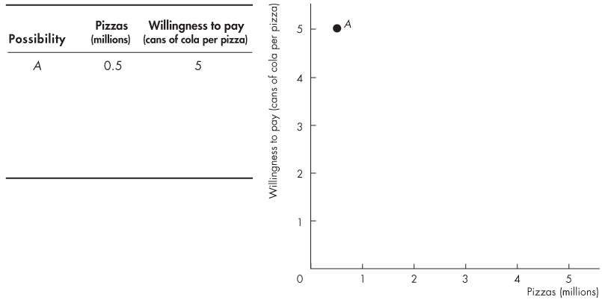
Using Resources Efficiently
At point A, with 0.5 million pizzas available, people are willing to pay 5 cans of cola for a pizza.
.

Slide 25
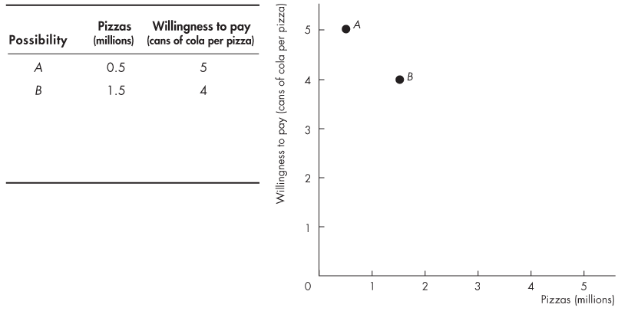
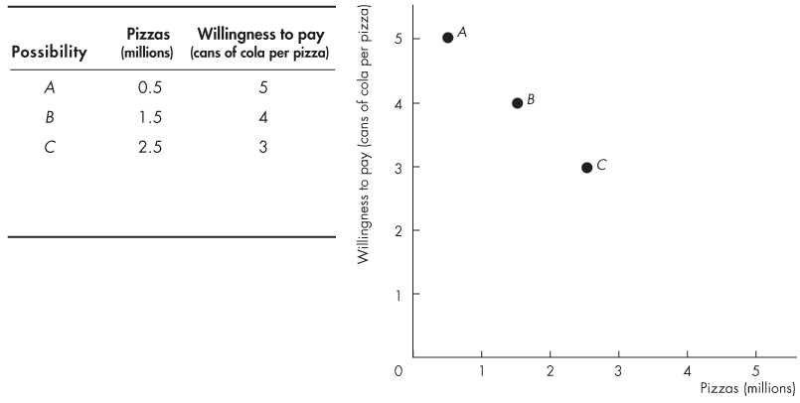
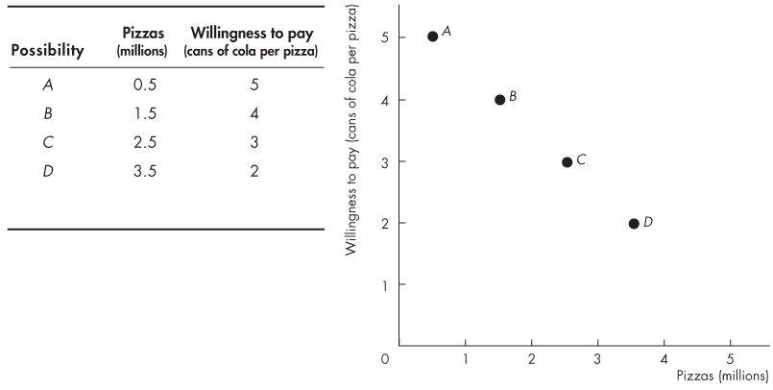
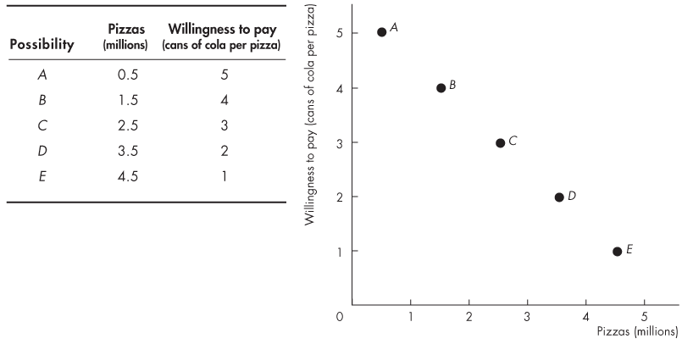
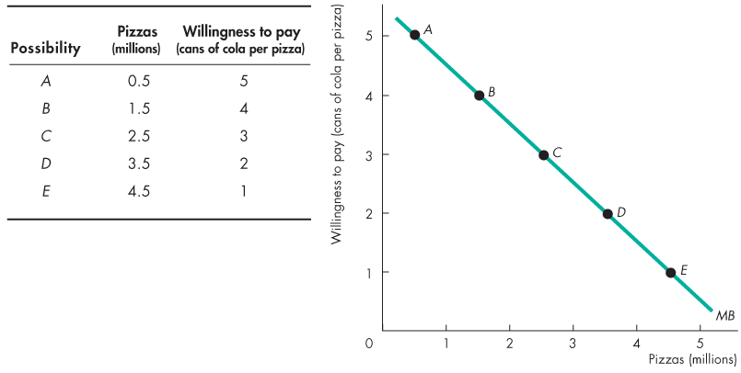
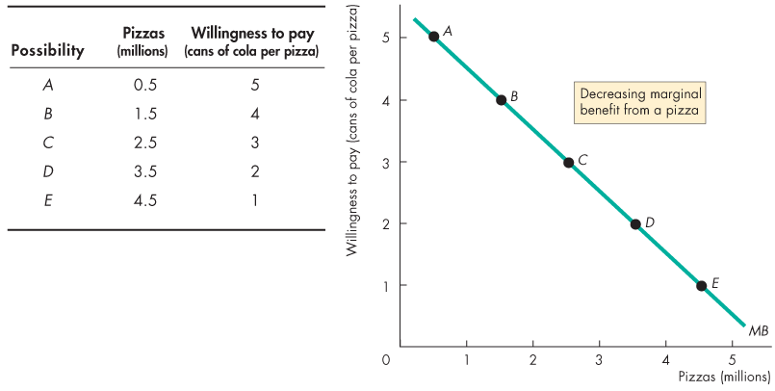

Slide 26
Using Resources Efficiently
At point B, with 1.5 million pizzas available, people are willing to pay 4 cans of cola for a pizza

Slide 27
Using Resources Efficiently
At point E, with 4.5 million pizzas available, people are willing to pay 1 can of cola for a pizza.

Slide 28
Using Resources Efficiently
The line through the points shows the marginal benefit from a pizza.

Slide 29
Using Resources Efficiently
Allocative Efficiency
When we cannot produce more of any one good without giving up some other good, we have achieved production efficiency.
We are producing at a point on the PPF.
When we cannot produce more of any one good without giving up some other good that we value more highly, we have achieved allocative efficiency.
We are producing at the point on the PPF that we prefer above all other points.

Slide 30
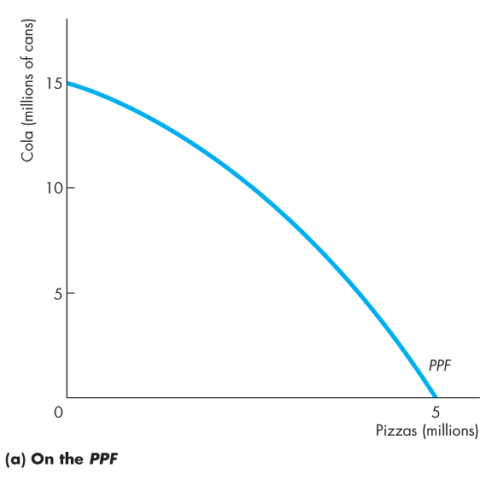
Using Resources Efficiently
Figure 2.4 illustrates allocative efficiency.
The point of allocative efficiency is the point on the PPF at which marginal benefit equals marginal cost.
This point is determined by the quantity at which the marginal benefit curve intersects the marginal cost curve.
The efficient quantity is 2.5 million pizzas.

Slide 32
Using Resources Efficiently
If we produce 1.5 million pizzas, marginal benefit exceeds marginal cost.
We get more value from our resources by producing more pizzas.
On the PPF at point A, we produce too few pizzas
We are better off moving along the PPF to produce more pizzas.

Slide 33
Using Resources Efficiently
If we produce 3.5 million pizzas, marginal cost exceeds marginal benefit.
We get more value from our resources by producing fewer pizzas.
On the PPF at point C, we produce too many pizzas.
We are better off moving along the PPF to produce fewer pizzas.

Slide 34
Using Resources Efficiently
On the PPF at point B, we are producing the efficient quantities of pizzas and cola.
If we produce exactly 2.5 million pizzas, marginal cost equals marginal benefit.
We cannot get more value from our resources.

Slide 36
Gains from Trade
Comparative Advantage and Absolute Advantage
A person has a comparative advantage in an activity if that person can perform the activity at a lower opportunity cost than anyone else.
A person has an absolute advantage if that person is more productive than others.
Absolute advantage involves comparing productivities while comparative advantage involves comparing opportunity costs.
Let’s look at Joe and Liz who operate smoothie bars.
Notes:
The gain from trade is a real eye-opener for students. Their first reaction is one of skepticism. Convincing students of the power of trade to raise living standards and the costs of trade restriction is one of the most productive things we will ever do.
Here are some ideas to drive home the idea of comparative advantage:
Why didn’t Billy Sunday do his own typing? Billy Sunday, an evangelist in the 1930s, was reputed to be the world’s fastest typist. Nonetheless, he employed a secretary who was a slower typist than he. Why? Because in one hour of preaching, Billy could raise several times the revenue that he could raise by typing for an hour. So Billy plays to his comparative advantage.
Why doesn’t Martha Stewart bake her own bread? Martha Stewart is probably a better cook than most people, but she is an even better writer and TV performer on the subject of food. So Martha plays to her comparative advantage and writes about baking bread but buys her bread.
Why doesn’t Vinnie Jones play soccer? Vinnie Jones is one of the world’s best soccer players (although now getting a bit old). But he stopped playing soccer and started making movies some years ago. Why? Because, as he once said, “You go to the bank more often when you’re in movies.” Vinnie’s comparative advantage turned out to be in acting.
The costs of trade restrictions need to be driven home. The 2002 steel tariff increase and the EU response is a good story to use.

Slide 37
Gains from Trade
Joe’s Smoothie Bar
In an hour, Joe can produce 6 smoothies or 30 salads.
Joe's opportunity cost of producing 1 smoothie is 5 salads.
Joe's opportunity cost of producing 1 salad is 1/5 smoothie.
Joe spends 10 minutes making salads and 50 minutes making smoothies, so he produces 5 smoothies and 5 salads an hour.

Slide 38
Gains from Trade
Liz's Smoothie Bar
In an hour, Liz can produce 30 smoothies or 30 salads.
Liz's opportunity cost of producing 1 smoothie is 1 salad.
Liz's opportunity cost of producing 1 salad is 1 smoothie.
Liz’s customers buy salads and smoothies in equal number, so she produces 15 smoothies and 15 salads an hour.

Slide 39
Gains from Trade
Figure 2.5 shows the production possibility frontiers.
In part (a), Joe’s opportunity cost of a smoothie is 5 salads. Joe produces at point A on his PPF.

Slide 41
Gains from Trade
In part (b), Liz’s opportunity cost of a smoothie is 1 salad. Liz produces at point A on her PPF.

Slide 42
Gains from Trade
Joe’s Comparative Advantage
Joe’s opportunity cost of a salad is 1/5 smoothie.
Liz’s opportunity cost of a salad is 1 smoothie.
Joe’s opportunity cost of a salad is less than Liz’s.
So Joe has a comparative advantage in producing salads.

Slide 43
Gains from Trade
Liz’s Comparative Advantage
Liz’s opportunity cost of a smoothie is 1 salad.
Joe’s opportunity cost of a smoothie is 5 salads.
Liz’s opportunity cost of a smoothie is less than Joe’s.
So Liz has a comparative advantage in producing smoothies.

Slide 44
Gains from Trade
Achieving the Gains from Trade
Liz and Joe produce the good in which they have a comparative advantage:
Liz produces 30 smoothies and 0 salads.
Joe produces 30 salads and 0 smoothies.

Slide 46
Gains from Trade
Liz and Joe trade:
Liz sells Joe 10 smoothies and buys 20 salads.
Joe sells Liz 20 salads and buys 10 smoothies.
After trade:
Liz has 20 smoothies and 20 salads.
Joe has 10 smoothies and 10 salads.

Slide 47
Gains from Trade
Gains from trade:
Liz gains 5 smoothies and 5 salads an hour
Joe gains 5 smoothies and 5 salads an hour

Slide 48
Gains from Trade
Figure 2.6 shows the gains from trade.
Joe’s opportunity cost of producing a salad is less than Liz’s.
So Joe has a comparative advantage in producing salad.

Slide 50
Gains from Trade
Liz’s opportunity cost of producing a smoothie is less than Joe’s.
So Liz has a comparative advantage in producing smoothies.

Slide 51
Gains from Trade
Joe specializes in producing salad and he produces 30 salads an hour at point B on his PPF.

Slide 52
Gains from Trade
Liz specializes in producing smoothies and produces 30 smoothies an hour at point B on her PPF.

Slide 53
Gains from Trade
They trade salads for smoothies along the red “Trade line.”
On the trade line, the price of a salad is 2 smoothies or the price of a smoothie is ½ of a salad.

Slide 54
Gains from Trade
Joe buys smoothies from Liz and moves to point C—a point outside his PPF.
Liz buys salads from Joe and moves to point C—a point outside her PPF.

Slide 55
Gains from Trade
The Liz-Joe Economy and its PPF
With specialization and trade both Liz and Joe get outside their PPFs.
If Liz and Joe are the only producers in the economy, what does the economy’s PPF look like?
Figure 2.7 on the next slide shows the construction of the economy’s PPF.

Slide 56
Gains from Trade
If both produce only salads, the economy produces 60 salads at point A.
If the economy starts to produce smoothies, Liz has the comparative advantage in smoothies and produces the first 30 smoothies at a cost of 1 salad per smoothie.
At point B, Liz produces 30 smoothies and Joe produces 30 salads.

Slide 58
Gains from Trade
For the economy to produce more than 30 smoothies, Joe will have to produce fewer salads and start producing smoothies.
Joe’s cost of producing a smoothie is 5 salads.
If all the economy’s resources are used to make smoothies, the economy produces at point C.
The outward-kinked curve is the Liz-Joe economy PPF.

Slide 59
Gains from Trade
Efficiency and Inefficiency
When both Liz and Joe specialize, they produce efficiently at point B on the economy’s PPF.
At all other points on the economy’s PPF, one person specializes and production is efficient.
Production at any point on the PPF is efficient.

Slide 60
Gains from Trade
But with no specialization, Joe and Liz produce at a point inside the economy’s PPF.
Production at point D is inefficient.

Slide 61
Economic Growth
The expansion of production possibilities—an increase in the standard of living—is called economic growth.
Two key factors influence economic growth:
Technological change
Capital accumulation
Technological change is the development of new goods and of better ways of producing goods and services.
Capital accumulation is the growth of capital resources, which includes human capital.
Notes:
You can have some fun and generate some discussion by getting the students to think about what life might be like after another 200 years of economic growth. Provide some numbers: In 2006, income per person in the United States was about $100 a day. In 1806 it was about 70¢ a day, and if the past growth rate prevails for another 200 years, in 2206 it will be $14,000 a day. Emphasize the magic of compound growth. If they think that $14,000 a day is a big income, get them to do a ballpark estimate of the daily income of Bill Gates (about $20 million!) Encourage a discussion of why scarcity is still present even at these large incomes.
Be sure to cover the “Standard of Living Tradeoff” idea that the students met in Chapter 1 and that they can now think about with the more powerful tool of the PPF.
If you wish, connect the discussion of efficiency with that of growth. Ask the students to explain what determines the efficient growth rate (not in text).

Slide 62
Economic Growth
The Cost of Economic Growth
To use resources in research and development and to produce new capital, we must decrease our production of consumption goods and services.
So economic growth is not free.
The opportunity cost of economic growth is less current consumption.
Notes:
Classroom activity
Check out Economics in Action: Hong Kong Catching Up to the United States

Slide 63
Economic Growth
Figure 2.8 illustrates the tradeoff we face.
We can produce pizzas or pizza ovens along PPF₀.
By using some resources to produce pizza ovens today, the PPF shifts outward in the future.

Slide 65
Economic Growth
Changes in What We Produce
Investment in capital and technology creates economic growth and increases income.
The model of specialization and trade explains the different patterns of production across countries.
Figure 2.9 illustrates how economic growth influences the pattern of production.
Notes:
Refer back to Figure 1.1 in Chapter 1 as introduction to this slide. Recap the comparison of what the three countries in the figure produce.

Slide 66
Economic Growth
Figure 2.9(a) compares low-income Ethiopia and China.
Figure 2.9(b) compares China and the rich United States.
Notes:
Classroom activity
Checkout Economics in the News: Production Possibilities in the Rust Belt

Slide 68
Economic Coordination
To reap the gains from trade, the choices of individuals must be coordinated.
To make coordination work, four complimentary social institutions have evolved over the centuries:
Firms
Markets
Property rights
Money
Notes:
The point of this short section is to lay the groundwork for the next chapter on demand and supply. You can cover it quickly or you can use it as a peg on which to hang a discussion of some of the big-picture of the underpinnings of our subject. Some examples follow:
The “Invisible Hand”: How self-interested individuals promote prosperity for all. Explain that in economics, we take human nature as given (in contrast to political science, philosophy and some other fields) and assume that people are self-interested. Note if you wish that self-interest does not mean selfish.
If everyone is self-interested, how are people encouraged to specialize and exchange to promote prosperity for all? Building on the Liz and Joe example in the chapter, you can explain how specialization and exchange achieves a higher standard of living that does self sufficiency. So self interest promotes specialization and exchange.
But for specialization and exchange to work, people must be able to trade. That is why property rights and markets are so crucial.
Property Rights and Markets: The key to promoting socially beneficial activity. To reap the gains from specialization, people need access to markets in which voluntary exchange can take place. Markets work only if property rights are established and enforced.

Slide 69
Economic Coordination
A firm is an economic unit that hires factors of production and organizes those factors to produce and sell goods and services.
A market is any arrangement that enables buyers and sellers to get information and do business with each other.
Property rights are the social arrangements that govern ownership, use, and disposal of resources, goods, or services.
Money is any commodity or token that is generally acceptable as a means of payment.

Slide 70
Economic Coordination
Circular Flows Through Markets
Figure 2.8 illustrates how households and firms interact in the market economy.
Factors of production, and …
goods and services flow in one direction.
Money flows in the opposite direction.

Slide 72
Economic Coordination
Coordinating Decisions
Markets coordinate individual decisions through price adjustments.

