Slide 1
RtoP: Case study: Rwanda

Slide 2
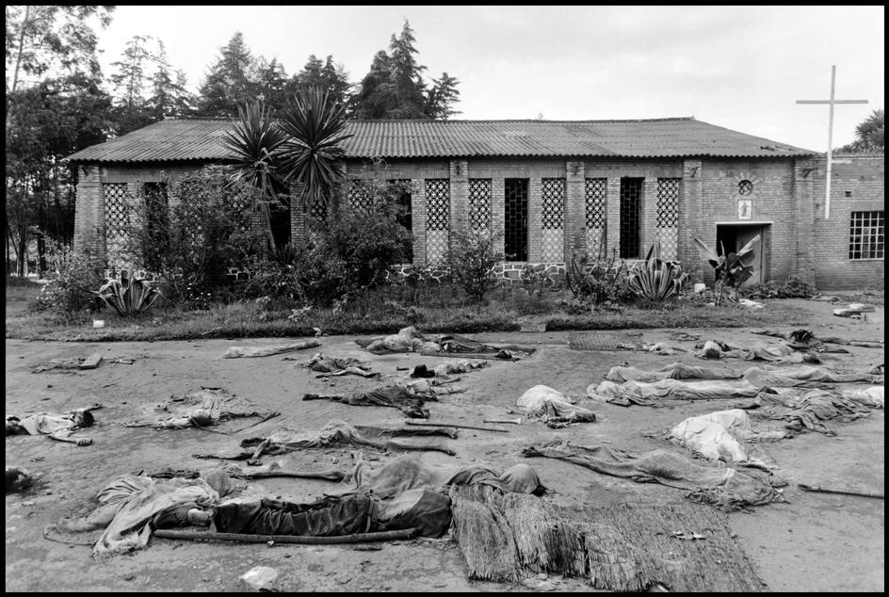
Case study: Rwanda 100 days of genocide

Slide 3
Case study: Rwanda
“Switzerland of Africa”
Hutu and Tutsi: close ethnic groups?
Hutu (current government, majority) - Rwandan Patriotic Front /RPF (Tutsi);
Small differences;
Tutsi – historical minority, but often with better education, social status (were ruling elites since 15th c.);
End of 19th c. – German’s control;
Beginning of the 20th c: Belgium’s protectorate;
Both tried to keep Tutsi as a ruling elites.

Slide 4
Case study: Rwanda
1940s: the Tutsi elites desired independence, and Belgium started to attract and support the Hutu, and the tension grew;
1962: Kingdom of Burundi and Republic of Rwanda? While Belgium left.

Slide 5
Why is France/Belgium often blamed?
Colonizers used resources;
Created infrastructure;
European systems od education;
Medicine: infant mortality dropped;
Demography increased (6 time within 50 years) and led to a collapse:
agrarian overpopulation among the Hutus;
To stop the Tutsi
after independence of R of Rwanda in 1960s the ethnic (?) clashes started: Hutu attacked the Tutsi, who refuged to neighboring states (Burundi and Uganda) and formed the partisan movement (“cockroaches”).

Slide 6
Rwanda: 1970s:
1970s: violence decreased:
Military coup moved J. Habyarimana as a leader (Hutu);
He wished to receive the financial assistance from the West, thus realized that Tutsi should not be oppressed;
The conflict was ‘frozen’ for 15 years;
But in Uganda the civil war broke out, and experienced refugee-partisans (Tutsi) in Uganda joined the National Army of Resistance and won;
They started to demand their come back to Rwanda.

Slide 7
Financial crisis of 1980s
- agrarian overpopulation;
- price collapse for coffee;
result: a ban to receive the Tutsi migrants and but lands (led to radicalization of them and creation of the “Rwanda Uprising Front”);
1990s: civil war: the Tutsi attacked Rwanda’s Hutu;
* Possible support of GB to the Tutsi;
Official military support of France to Rwanda’s official government;
France also placed troops for the “protection od its citizens”;
The Tutsi moved back to the partisan war which lasted for 2 years;

Slide 8
Case study: Rwanda
By 1991: Habyarimana becomes a President, and initiates reforms;
By 1993 – temporary peace, but the growing power of the Hutu radicals was spotted;
They demanded the “final solution” over the Tutsi question;
In April, 1994 the airplane with the president was hit, and soon the genocide starts;
Government becomes of Hutu at all levels;
Ethnic cleansings;
The Hutu radical temporary government, radio-station, media supported the mass killings;
Families, schools, psychiatric hospital, etc.;
Kegara river;

Slide 9
Case study: Rwanda
1994 speeds up mass killings;
3 months= more that 1 mln. people;
Some top officials also were killed;
Rwanda patriotic front takes over in July the situation in the cities and massacres were stopped;
Why Rwanda case was a corner stone for RtoP?

Slide 10
Case study: Rwanda and UNO
UNO was not participating, just observing; peacekeeping troops (Belgium);
Behavior of the UNO observer in earlier 1994 and UNO reaction;
After the genocide started, UNO has postponed solutions/decision making;
Many Hutu refuged from the country being afraid the counter-reaction;
1998: International Criminal Court over Rwanda case: investigations and interviews: “organized genocide”, T. Bagossora – life sentence.

