Slide 1
ECOLOGICAL DATA: BASICS of DESCRIPTIVE STATISTICS
Lecture #6
ECOLOGICAL DATA EVALUATION

Slide 2
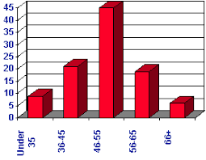
OUTLINE
1. Ecological data
2. Samples and populations
3. Types of data
4. Variables
5. Measures of Central Tendency
6. Measures of Dispersion
7. Linear model

Slide 3
Descriptive Statistics in Ecology
organizing, summarizing & describing data
sampling is important for ecological studies
testing ecological hypotheses
state your objective clearly
make conclusion (on air quality, pollutant’s toxicity, population changes, etc.)
ecological assessment helps make decisions in industrial, political, economic areas

Slide 5
Notes:
Infer – делать заключение, вывод

Slide 7
2
species (total)
species in each habitat
Notes:
contingency table - таблица статистической структуры изучаемой популяции, факторная таблица

Slide 8
3

Slide 9
4

Slide 10
5
Notes:
Snag – cук, сучок
Snag fall - лесоповал

Slide 11
6

Slide 12
Ecological Data… types of variables Independent vs Dependent
We are interested in relating independent variables to dependent ones
Independent variable is the variable that is changed or controlled in a scientific experiment to test the effects on the dependent variable:
“X” or “input” variable, or argument
Dependent variable is 'dependent' on the independent variable:
“Y”, “response” , “output” variable Y = f (X)

Slide 13
Measures of Central Tendency describe the ‘center’ of data
Mean
Arithmetic Average
Median
Middle Score
Mode
Most Frequently Occurring Score
Notes:
single value that is used to describe the “center” of the data.

Slide 14
Measures of Central Tendency
Mean
= 17.9 $
Daily Salary:
10$
11$
11$
15$
15$
15$
19$
20$
21$
21$
22$
22$
24$
25$
X =
∑ X n
251
(10+11+11+15+15+15+19+20+21+21+22+22+24+25) 14
X =

Slide 15
Measures of Central Tendency
Median
= 19 $/day
Daily Salary:
10$
11$
11$
15$
15$
15$
19$
20$
21$
21$
22$
22$
24$
Median is the "middle" value in the list of numbers arranged in order from least to greatest.
If there is an odd number of items in data set, the median is the middle number.

Slide 16
Measures of Central Tendency
Median
= 19.5 $/day
Daily Salary:
10$
11$
11$
15$
15$
15$
19$
20$
21$
21$
22$
22$
24$
25$
If there is an even number of items in data set, then the median is the average of two middle numbers.
(19 + 20) 2
= 19.5

Slide 17
Measures of Central Tendency
Mode
= 15 $/day
Daily Salary:
10$
11$
11$
15$
15$
15$
19$
20$
21$
21$
22$
22$
24$
25$
Mode is the value that occurs the most
Quick and easy to compute!

Slide 18
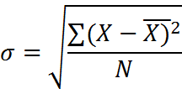
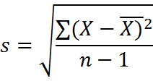
Measures of Dispersion
Describe distribution of data
Range - difference between the highest and lowest values
Variance – shows
how data are spread out:
Standard deviation – measure of spread about the mean
for population
for sample
Notes:
Variance - дисперсия

Slide 19
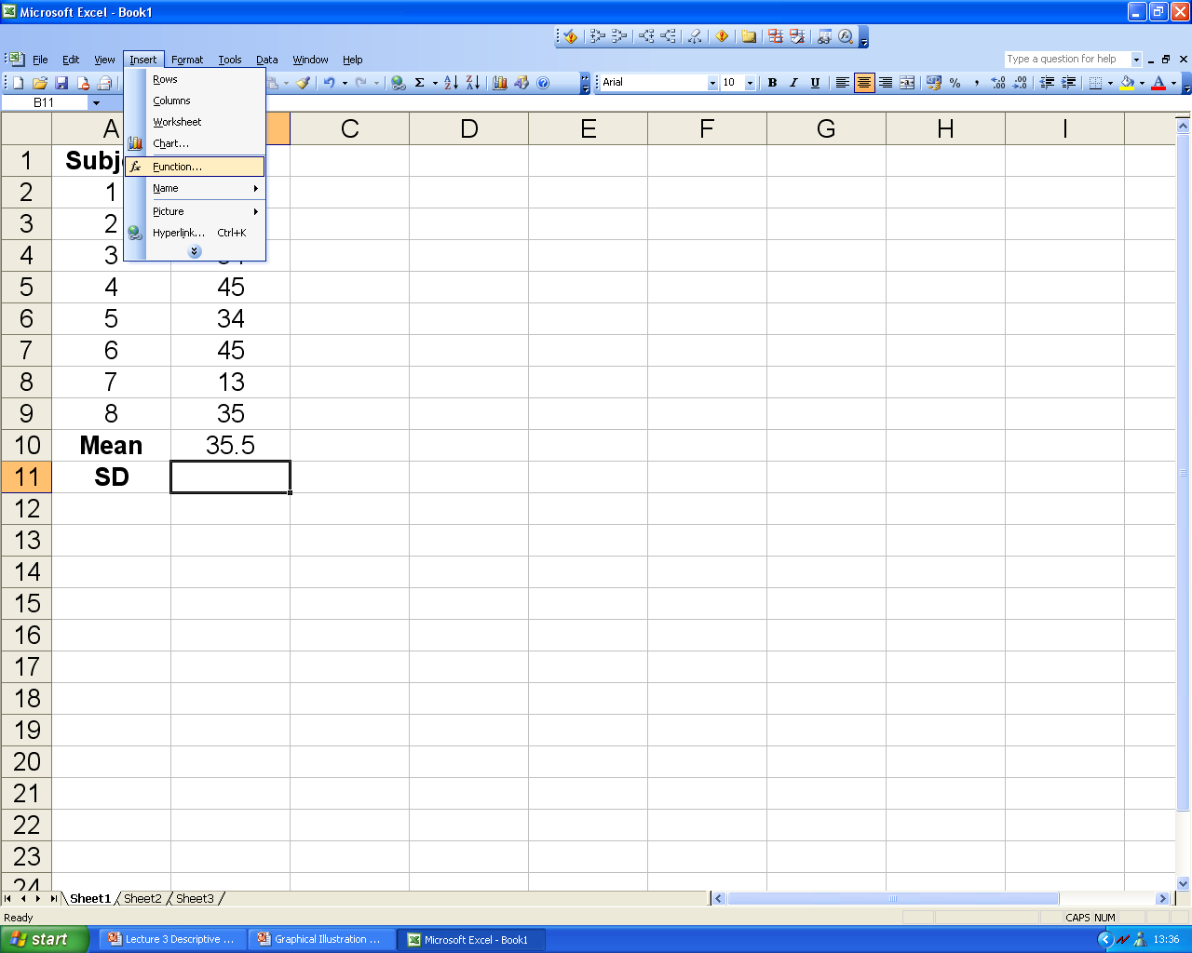
EXCEL: mean and standard deviation (1)

Slide 20
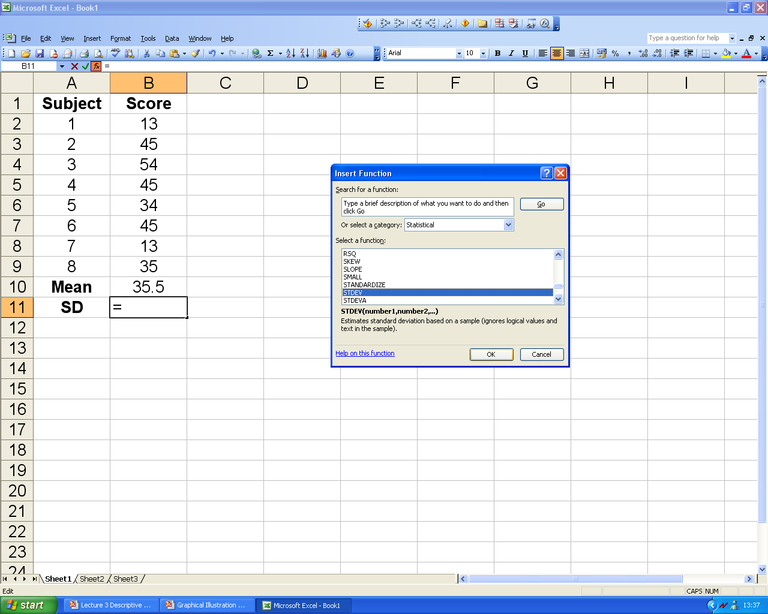
EXCEL: mean and standard deviation (2)

Slide 21
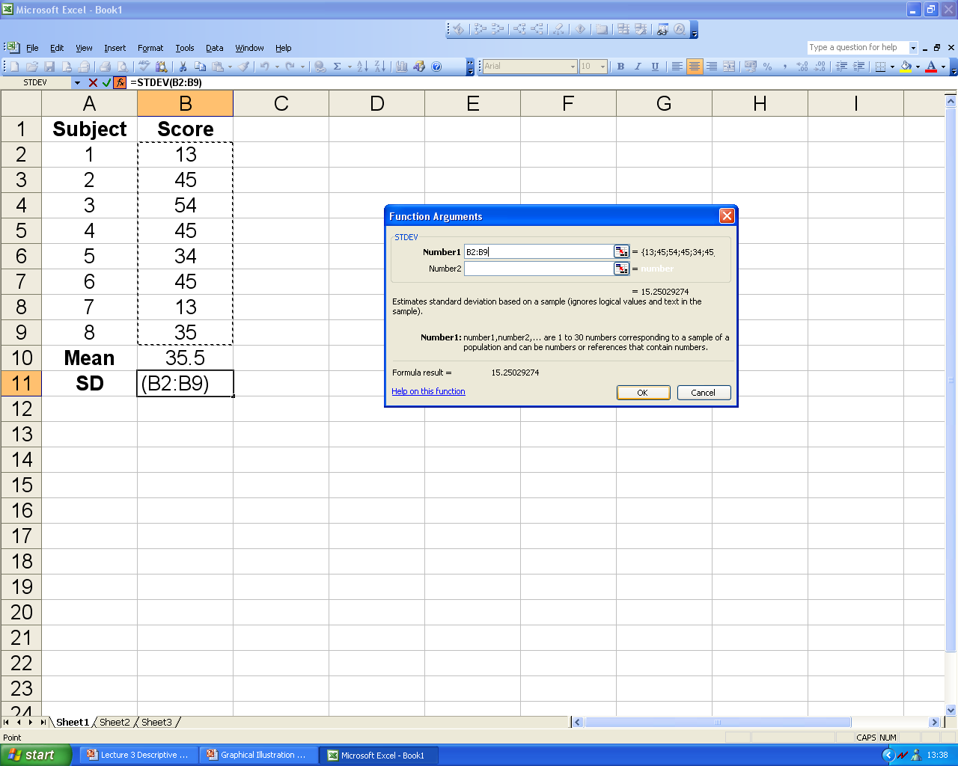
EXCEL: mean and standard deviation (3)

Slide 22
Standard Error
Standard error of a mean describes how good the estimate is.
SE of a mean =
The bigger sample size n, the lower SE
The more spread data make higher SE
Confidence Interval - 95% of all sample means are in it:
Notes:
Variance - дисперсия

Slide 23
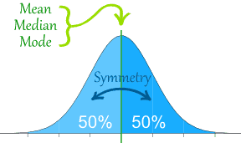
Normal Distribution Curve
Symmetrical about the mean, μ
Bell-shaped curve
Mean = Median = Mode
50% of the values less than the mean and 50% greater than the mean

Slide 24
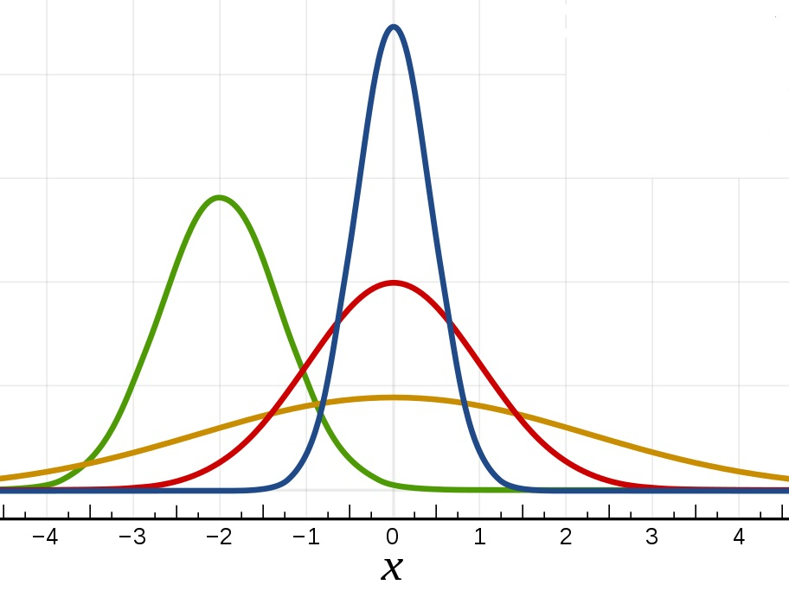
Examples of Normal Distribution
pH of water in lakes
Amount of nutrient in soil
Temperature (on certain day over # yrs)
Blood Pressure
Test Scores
Lifetimes of light bulbs

Slide 25
Notes:
Replication – копирование, повторяемость

Slide 26
Statistical methods

Slide 27
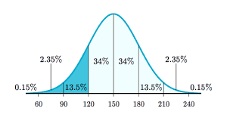
DON’T BE MEAN
BE ABOVE AVERAGE

