Slide 1
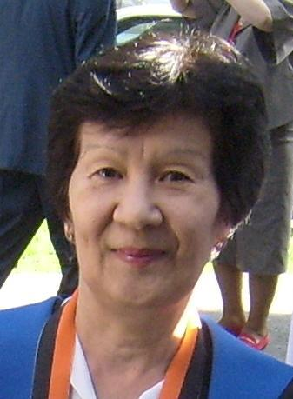
Aliya Nurtaeva, Ph.D.
Professor at KIMEP:
teaching Ecology, Math & Health courses
2007 – up to present
Moscow State University:
Honor Diploma + Candidate of Sciences degree
Kazakh State University – Docent, 15+ yrs teaching + R&D
Oklahoma State University – Ph.D. degree, teaching Science
New Hampshire Technical College – teaching Statistics
Southern New Hampshire University – teaching Mathematics
1999-2005 – VP R&D in X-Master, Inc.(NH, high tech)
2005-2007 – Armed Forces Radiobiology Research Institute at National Naval Medical Center, Washington DC
2007 – up to present – KIMEP University

Slide 2
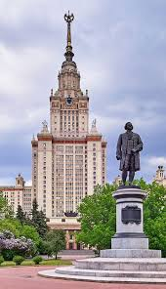
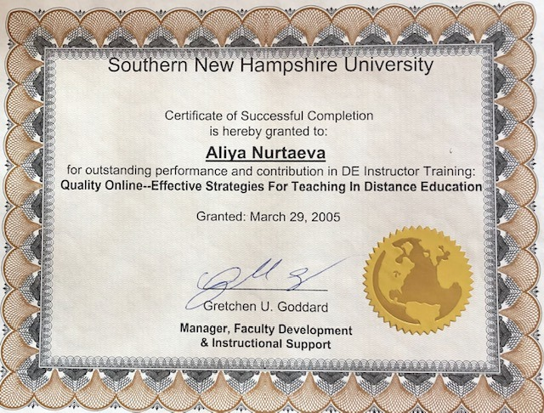
40+ yrs teaching experience at American, Kazakh & Russian universities - research in Ecology, Technology, Radiation Dosimetry

Slide 3
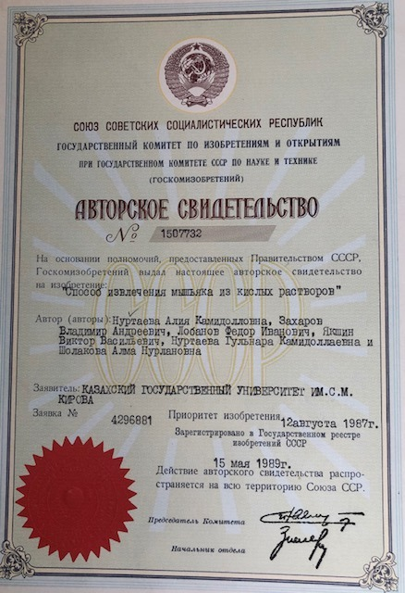
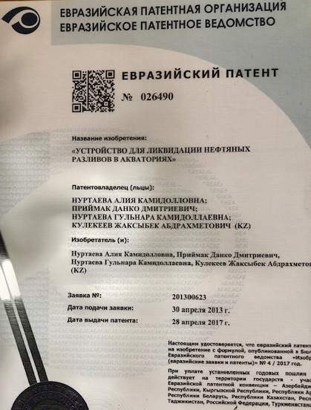
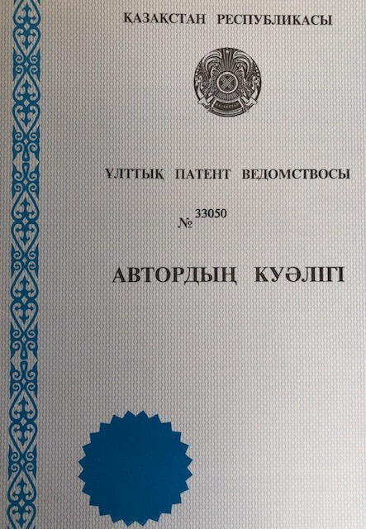
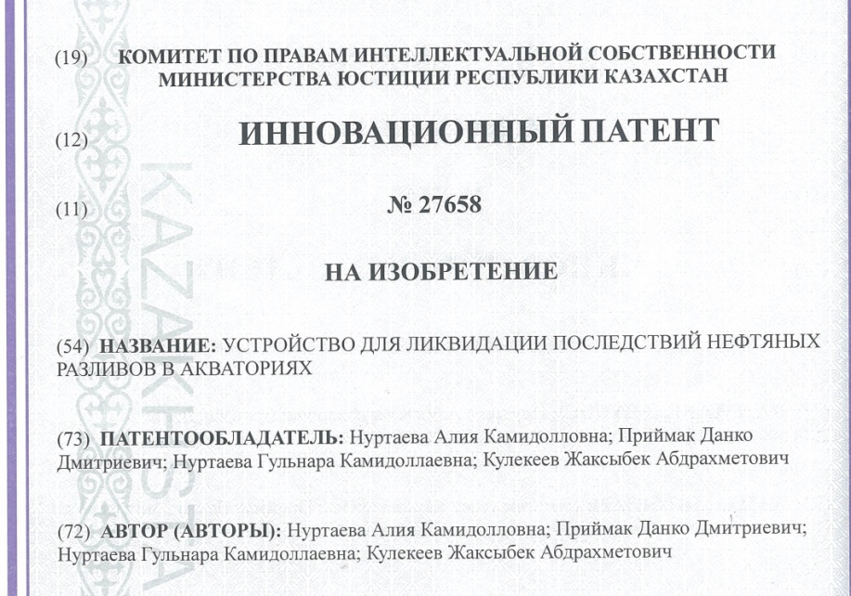
- 20 patents in Ecology/Technology, including international patents in Oil/Gas sector
If you have any idea, I can help you to get patent on your invention!

