Slide 1
ECN5355
Theory of Corporate Finance
Chapter 4
Financing Capacity
1
Notes:
1

Slide 2
Credit Rationing

Slide 3
Credit Rationing
Who can get credit and who cannot?
To which extent can a project be financed by external capital
In this chapter no difference between sources of finance (equity vs loans)

Slide 4
What determines “credit worthiness?”
Want to buy a house?
Bank will want to see your pay checks (i.e. to see if can you afford to pay back the loan).
Bank wants to know the quality of the house and then mortgage the property as collateral
Bank will (normally) still want to make sure that some equity is put up
To safeguard in case of market downturn?
To keep monthly payments lower?
To induce more careful behavior?

Slide 5
Theory of Credit Rationing
Asymmetric information problem
Imperfect monitoring of effort or imperfect knowledge of a vital property
Adverse selection and moral hazard problems
“before the contract is signed” or “after the contract is signed”
Tirole considers moral hazard simply as an incentive for misbehavior within a contractual relationship and reserves “asymmetric information” for the adverse selection problem

Slide 6
Moral Hazard Problems

Slide 7
Moral hazard problems
Agents adjust their behavior to the detriment of the principal once a contract is signed
Insurance contract → more risk taking
Labor contract → shirking
Credit contract → be less careful if the project is financed with somebody else’s money

Slide 8
The basic model of credit rationing under moral hazard
8

Slide 9
The credit contract
“Credit” contract:
Lender/investor
Borrower/entrepreneur
Project requires fixed investment I
Assets of the borrower: A < I
Project yields income R if successful and zero otherwise
Risk-free interest rate is zero (but the investor may charge positive interest to finance a risky project)

Slide 10
Behavior and outcomes
The probability of success, p, depends on the borrower’s behavior
p_{H} if good
p_{L} if bad
Δp=p_{H} – p_{L}.
Bad behavior results in private benefit B.
Less work effort, diversion of money for private use…
Net present value
p_{H}R – I if behavior is good (a)
p_{L} R – I + B if behavior is bad (b)
if (a) ≥ (b), the investor wants to behave

Slide 11
Motivating example 1: “Asset Stripping”
Investment into a production facility is worth $800,000
But the production facility (or part thereof) has a scrap value of $250,000 which the manager could sell off in the black market
Even if creditors hold a claim: can they actually enforce it?
11

Slide 12
Motivating example 2: Consumption on the job
Entrepreneur buys a country house on company expenses and spends his time entertaining celebrity visitors
If he did spend his time in the office rather than in the country house, chances of business success would be greater
12

Slide 13
Time Line
Loan Agreement
Moral Harzard
Investment
Outcome

Slide 14
The two fundamental conditions
Signing the contract, the lender expects not to make a loss
➔ Individual rationality constraint or participation constraint
the lender actually breaks even: we assume that the financial market is competitive
The entrepreneur is better off by behaving well than by behaving badly
➔ Incentive compatibility constraint

Slide 15
More assumptions
We assume that net present value p_{L} R – I + B if the entrepreneur behaves badly is negative
Creditor or borrower would lose money if the project is realized
so no loan will be given if it is clear that entrepreneur wants to behave badly
We assume that the borrower invests all his own assets A

Slide 16
Participation/individual rationality constraint
Let R_{l} be the return that goes to the lender
And R_{b} the return that goes to the borrower
We can focus on good behavior (because this will be the equilibrium), so zero profit condition for the lender (i.e. its participation or individual rationality constraint) implies p_{H}R_{l} = I – A (IR_{L}) with an implied interest rate of 1+i = 1/p_{H}

Slide 17
Example
Assume a project with an investment of $800,000 earns $1,000,000 with p_{H}=1 if the borrower behaves and p_{L}=0 if she does not.
If A = 0, how much does the investor/lender need to earn if the project is successful?
Answer: R_{l} = $800,000.
17

Slide 18
Remark
Generally we assume that the minimum A to arrange a loan contract is A^{min}>0.
(written in Tirole)
and that the borrower invests all her wealth if she has A>A^{min}
We can show that actually she is indifferent (as the borrower keeps any surplus and the bank’s expected gain is zero)
18

Slide 19
Borrower’s incentive compatibility constraint and pledgeable income
p_{H}R_{b} ≥ p_{L}R_{b}+B (IC_{b})
incentive compatibility constraint
Or R_{b} ≥ B/Δp
➔ make good behavior the outcome
So the “pledgeable” part of R is R – B/Δp.
And the expected pledgeable income is P = p_{H}(R – B/Δp) (I)

Slide 20
Distribution of R btw L and B
R
for the lender: R_{l}
for the borrower: R_{b}
Out of total revenue R, the borrower can maximally pledge what is left after taking
away the money that she needs to keep to fulfil her incentive compatibility constraint
20

Slide 21
Example: “Asset Stripping”
Assume the value of a firm as a going concern is $1,000,000.
R=1,000,000, p_{H}=1
But the production facility has a scrap value of $250,000 which the manager could sell off in the black market.
B=$250,000, p_{L}=0
So the manager cannot credibly pledge to the bank to pay more than $750,000 for a loan necessary to keep the firm going because she would be better off with asset stripping.
21

Slide 22
What if …
p_{H}=0.8?
p_{L} = 0 (naturally)
22

Slide 23
R = $1,000,000
Success
p_{H}=0.8
R_{b}:
0.8* R_{b} ≥250,000
nature
Keep it
(and behave)
pledgeable:
R – R‘_{b}
entrepreneur
failure
1 – p_{H}=0.2
0
Sell it (i.e., not behave)
B + p_{L} R_{b} =
$250,000 + 0
23

Slide 24
Feasible contracts
Lenders need to cover (on average) their initial outlay! Using (IR_{L}) and (I) we get P = p_{H}(R – B/Δp) ≥ I – A, (IR_{L}’)
the individual rationality (or participation) constraint of the lender in equilibrium.
So investment exceeding pledgeable expected income needs to be covered by own wealth A

Slide 25
Example continued (p_{H}=1)
With R_{b}≥250,000 we have R_{l}≤750,000.
From the lender’s participation constraint, 750,000 ≥ I – A
As the investment is 800,000, A ≥ 50,000.
Note that if the lender’s participation constraint is binding, the minimum wealth needed A^{min} is uniquely defined!
25

Slide 26
Results in short
(IC) constraint: R_{b} ≥ B/Δp
Using R = R_{b} + R_{l} we get R_{l} ≤ R – B/Δp
and, taking expectations
p_{H} R_{l} = p_{H}(R – B/Δp) =I – A
Moreover, from (IR_{L}) we get the critical value
A^{min} = I – p_{H}(R – B/Δp)
because (IC_{b}) holds as an inequality if A^{min}>0.
26

Slide 27
Interpreting results
27

Slide 28
Necessary wealth of borrower
Rewriting (IR_{L}), we get A^{min} = I – p_{H}R + p_{H}B/Δp
p_{H}B/Δp is the “agency rent” which the lender cannot get back from the agent
So A>0 ensures that the claim of the lender is not too large to get covered
28

Slide 29
Necessary wealth of borrower
Interpreting IR_{L}: A^{min} = I – p_{H}R + p_{H}B/Δp
so a highly profitable project with low B can be funded even without adding A
Recall that we focus on cases where A^{min}>0.
29

Slide 30
Example again
In our case, if the scrap value is less than $200,000, the borrower can pledge to return the full sum of the initial investment to the investor, so A=0.
30

Slide 31
Necessary wealth of borrower
Interpreting IR_{L}: A^{min} = I – p_{H}R + p_{H}B/Δp
if B is high relative to R – I
a large proportion has to be financed by own financial means
31

Slide 32
Necessary wealth of borrower
Interpreting IR_{L}: A^{min} = I – p_{H}R + p_{H}B/Δp
or lending occurs through unofficial channels with unlawful enforcement
reducing the value of B
32

Slide 33
Surplus of the borrower
As lenders break even (p_{H}R_{l} = I – A), the borrower keeps the entire NPV of the project as surplus or utility: U_{b} = p_{H}R_{b} – A = p_{H}R – I
At A^{min} (with A^{min} > 0) this exactly equals the agency rent minus A^{min} (in this case, p_{H}R_{b} = p_{H}B/Δp)
and as A > A^{min}, the same applies: p_{H}R_{b} increases to compensate the borrower

Slide 34
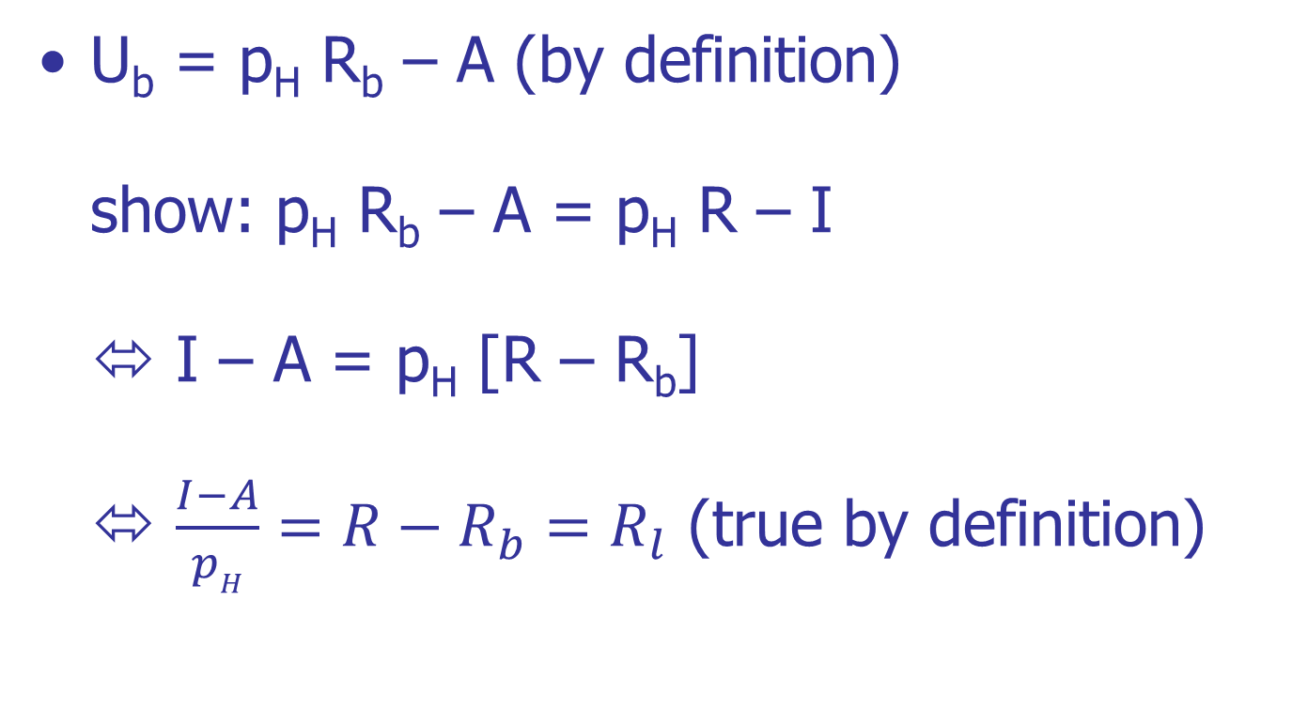
Surplus of the borrower - Derivation
34

Slide 35
Credit Rationing
A firm is credit rationed if it has too little cash on hand, i.e. A < A^{min}.
Its agency cost p_{H} B/Δp is too high.
Defining the likelihood ratio Δp/p_{H}, i.e. the proportional increase in success if the borrower behaves (or, correspondingly, the decrease in success if he misbehaves).
The greater the likelihood ratio, the smaller the agency cost (“better performance measurement”)
The greater the private benefit, the greater the agency cost.

Slide 36
Round-up
36

Slide 37
Results in short
Incentive compatibility constraint R_{b} ≥ B/Δp (IC_{b})
Observing R = R_{b} + R_{l} and the requirement that on average lenders need to break even we get their rationality constraint p_{H} R_{l} = p_{H}(R – B/Δp) ≥ I – A (IR_{L})
With critical value of wealth A^{min} = I – p_{H}R + p_{H}B/Δp
37

Slide 38
Results in short
Borrower realizes NPV of the project as surplus or utility: U_{b} = p_{H}R_{b} – A = p_{H}R – I
At A^{min} (with A^{min} > 0) this exactly equals the agency rent minus A^{min} Because
A^{min}= I – p_{H}R + p_{H}B/Δp
⇒p_{Η}R – Ι = p_{H}B/Δp – A^{min}
38

Slide 39
Further Issues
39

Slide 40
Debt or Equity?
Natural to interpret this model in terms of debt, i.e. the borrower owes a fixed payment and goes bankrupt if she cannot pay (i.e. R = 0)
Alternatively, the investor and the borrower may sign an equity contract which pays R_{l} and R_{b} if successful and nothing if not.
40

Slide 41
Dilution and Over-borrowing
Why are there covenants in debt contract which forbid further debt issues?
Lenders want to avoid more senior debt or debt claims which eat into their own share
But they may also worry about incentives
So we start from the assumption that existing investors keep their share
41

Slide 42
Dilution and Over-borrowing
Deepening investment
costs J
increases probability of success by τ in all cases.
and increases private benefit B’>B
assume that investment is inefficient, i.e. J > τR
42

Slide 43
Dilution and Over-borrowing
If borrower behaves, initial investors gain by τ R_{l}.
but because inefficient either new investors or the borrower must lose
so no contract is possible
therefore, if the investment takes place at all it must result in misbehaviour!
43

Slide 44
Time Line
Loan Agreement: B borrows I – A with R_{l} and R_{b}
Deepening Investment J with Rb divided: R_{l}‘and R_{b}’
Moral Harzard now with B’>B
Outcome

Slide 45
Overborrowing
borrower allocates her share between herself (R_{b}’) and new lenders (R_{l}’)
R_{b}’+R_{l}’ = R_{b} ➔ R_{b}’ = R_{b} – R_{l}’
New lenders’ zero profit condition
(p_{L}+τ) R_{l}’ = J ➔ R_{l}’ = J/(p_{L}+τ)
The borrower gains if
(p_{L}+τ)R_{b}’ + B’ > p_{H}R_{b}
45

Slide 46
Conclusion
Overborrowing threatens to upset the calculation of the initial investors:
The new investors enter on the expectation of a low probability of success
Leaving the initial investors exposed, even if their claims have the same (or even higher) seniority
But how plausible is this?
Doubling down on investment that goes badly as the personal stakes grow higher is something that behavioral science suggests that people do

