Slide 1
ECN2102 macroeconomics (3 Credits/5 ECTS) Training (Chapter 13)
Week 14 (Session 36)
Instructor: Eldar Madumarov
November 22, 2023

Slide 2
Outline
Training (Chapter 13)

Slide 3
Training (Chapter 13)
1) The Laffer curve shows that increasing ________ increases ________ when ________ low.
A) tax rates; tax revenue; tax rates are
B) potential GDP; tax revenue; tax revenue is
C) tax revenue; potential GDP; tax revenue is
D) None of the above answers is correct.

Slide 4
Training (Chapter 13)
2) A decrease in the income tax rate
A) increases the tax wedge.
B) decreases potential GDP.
C) increases the supply of labor.
D) decreases the demand for labor.

Slide 5
Training (Chapter 13)
3) A fall in income that results in a decrease in tax revenues is an example of ________.
A) needs-tested tax programs
B) automatic fiscal policy
C) discretionary fiscal policy
D) a recession

Slide 6
Training (Chapter 13)
4) When the economy grows, ________ increase because real GDP ________.
A) structural deficits; decreases
B) tax revenues; increases
C) tax revenues; decreases
D) recognition lags; increases

Slide 7
Training (Chapter 13)
5) Which of the following relationships is correct?
A) actual budget deficit = structural deficit + cyclical deficit
B) actual budget deficit = structural deficit - cyclical deficit
C) cyclical deficit = actual budget deficit + structural deficit
D) cyclical surplus = actual budget deficit - cyclical deficit

Slide 8
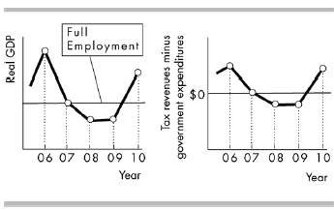
Training (Chapter 13)

Slide 9
Training (Chapter 13)
6) Economic data for a mythical economy in the years 2006-2010 are summarized in the figure above. Assume that the spending formulas and tax schedules are identical for all years. When the economy is at full employment, the government has a
A) procyclical policy.
B) budget deficit.
C) balanced budget.
D) budget surplus.

Slide 10
Training (Chapter 13)
7) Economic data for a mythical economy in the years 2006-2010 are summarized in the figure above. Assume that the spending formulas and tax schedules are identical for all years. When the economy is above full employment, the government has a
A) procyclical policy.
B) budget surplus.
C) budget deficit.
D) balanced budget.

Slide 11
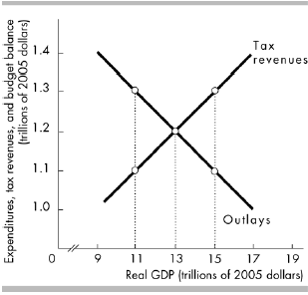
Training (Chapter 13)

Slide 12
Training (Chapter 13)
8) The figure above shows tax revenues and government expenditures in the economy of Meadowlake. Potential GDP is $13 trillion. If real GDP is $13 trillion, then the government has a ________.
A) balanced budget
B) cyclical surplus
C) structural surplus
D) cyclical deficit

Slide 13
Training (Chapter 13)
9) The figure above shows tax revenues and government expenditures in the economy of Meadowlake. Potential GDP is $15 trillion. If real GDP is $11 trillion, then the government has a ________.
A) structural surplus
B) cyclical surplus
C) cyclical deficit
D) structural deficit

Slide 14
Training (Chapter 13)
10) Suppose that real GDP equals potential GDP, but the government believes that the economy is in a below full-employment equilibrium. As a result, the government increases its expenditure on goods and services. In response to the government’s fiscal policy,
A) aggregate demand will increase.
B) potential GDP decreases.
C) an equilibrium with real GDP less than potential GDP will occur.
D) None of the above answers is correct..

Slide 15
Training (Chapter 13)
11) The use of fiscal policy is limited because
A) time lags associated with fiscal policy may cause the policy to take effect too late to solve the problem it was supposed to address.
B) the President may have different goals than Congress.
C) the economy is almost always at full employment.
D) there is never a long enough time lag.

Slide 16
Training (Chapter 13)
12) A country reports that its government outlays total $1.8 trillion and its receipts total $1.6 trillion. Does the country have a budget surplus or deficit and what is the surplus or deficit?
12) The country has a budget deficit.
The deficit equals $0.2 trillion.

