Slide 1
Basics of Ecology 1
Lecture 1
Ecological Data Evaluation
GEN/PAD2030.2

Slide 2
What does this course cover?
Basic principles of ecology
Methods that ecologists use
Experiments, models, observations
Graphical presentation of ecological data
Interpretation of ecological data

Slide 3
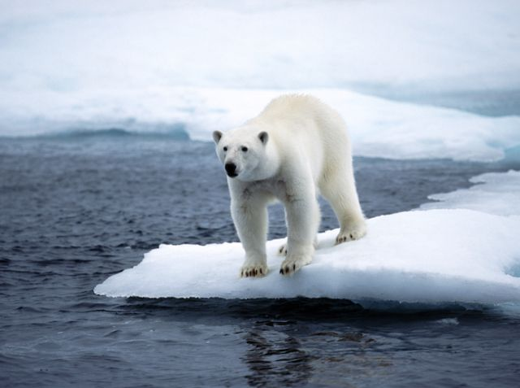
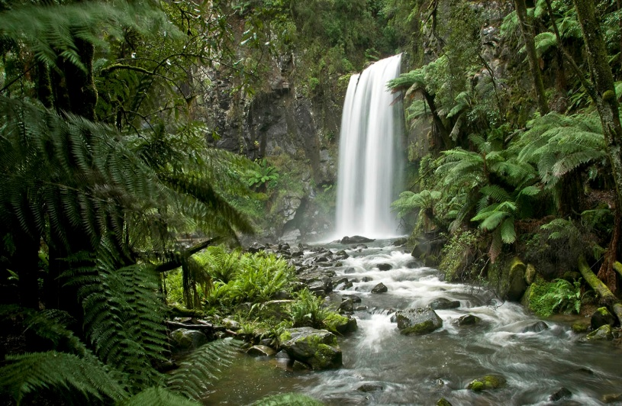
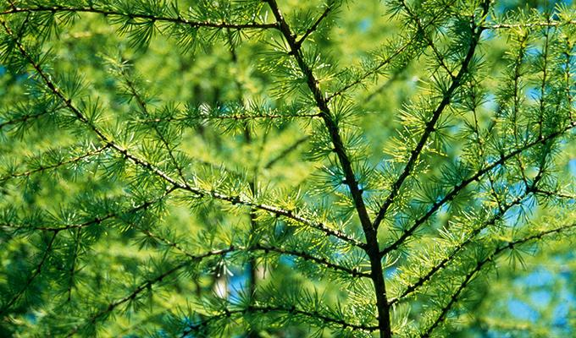
Ecology
Environment is everything that surrounds an organism (group of organisms).
Ecology is the study of the relationships between organisms and their environment .
1869 - Heckel introduced the term ecology (oikos- "house or home“, study of the home)

Slide 4
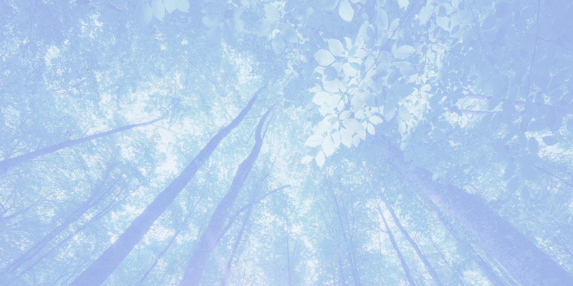
4 Laws of Ecology Barry Commoner
Everything is connected to everything else
2) Everything must go somewhere
3) Nature knows best
4) There is no such thing as a free lunch
Barry Commoner – American biologist,1917-2012
Notes:
Barry Commoner 1917 – 2012, American biologist, college professor and politician. He was among the founders of the modern environmental movement.

Slide 5
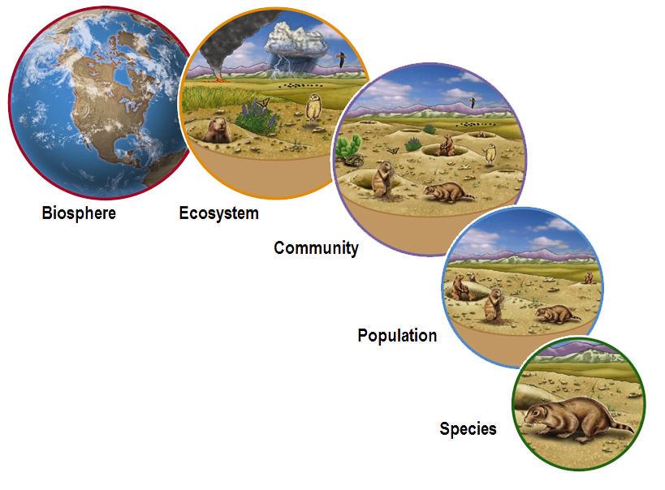
From single Species to Biosphere

Slide 6
Biological structure of the Environment
Species – a certain type of organisms that can interbreed and produce offspring
Population – group of individuals of the same species living in a given area
Community – interacting groups of different species living in a certain area
Ecosystem – biological community along with its physical environment .They interact in an exchange of matter and energy.
Biosphere – layer of the Earth containing all living organisms

Slide 7
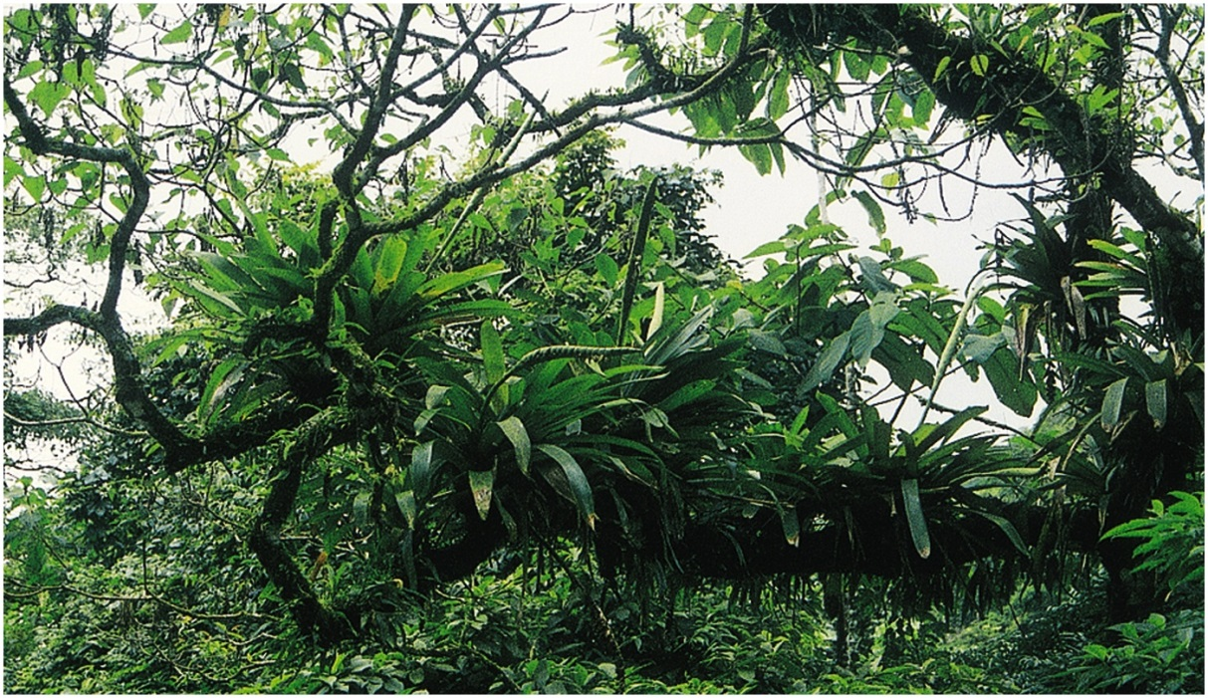
Different organisms play different ecological roles
All species are either
Autotrophs or Heterotrophs
Plants, algae Animals, Fungi, Bacteria
Notes:
Bacteria

Slide 8
Different groups of organisms play different ecological roles
SUN
Photoautotrophs
Inorganic carbon
Dead organic matter
Inorganic & organic nutrients
Heterotrophs
(Decomposers)

Slide 9
Different groups of organisms play different ecological roles
SUN
Plants
Photoautotrophs
Inorganic carbon
Dead organic matter
Inorganic nutrients
Animals, Fungi, Bacteria
Heterotrophs
(Decomposers)

Slide 10
Autotrophs vs. Heterotrophs
Autotrophs
make their own food,
so they are called
PRODUCERS
Heterotrophs –
get their food from
another sources, so they are
CONSUMERS

Slide 11
Energy Flow in trophic levels
Food chain /web shows eating relationships
Omnivores eat both plants and animals.
Notes:
Food chains and food webs describe the eating relationships between species in an ecosystem
Trophic level—each level in a food chain
Herbivores - organisms that eat only plants;
Carnivores - organisms that eat only animals;
Omnivores - organisms that eat both plants and animals.
Detritivores: consume organic matter such as animal carcasses, leaf litter, feces (detritus): snails, crabs, clams, worms, termites, beetles, snails
Decomposer: Fungus or bacterium that breaks dead organic material into smaller molecules and uses some of the product for E. Some of the material goes back into the Earth.

Slide 12
Food web

Slide 13
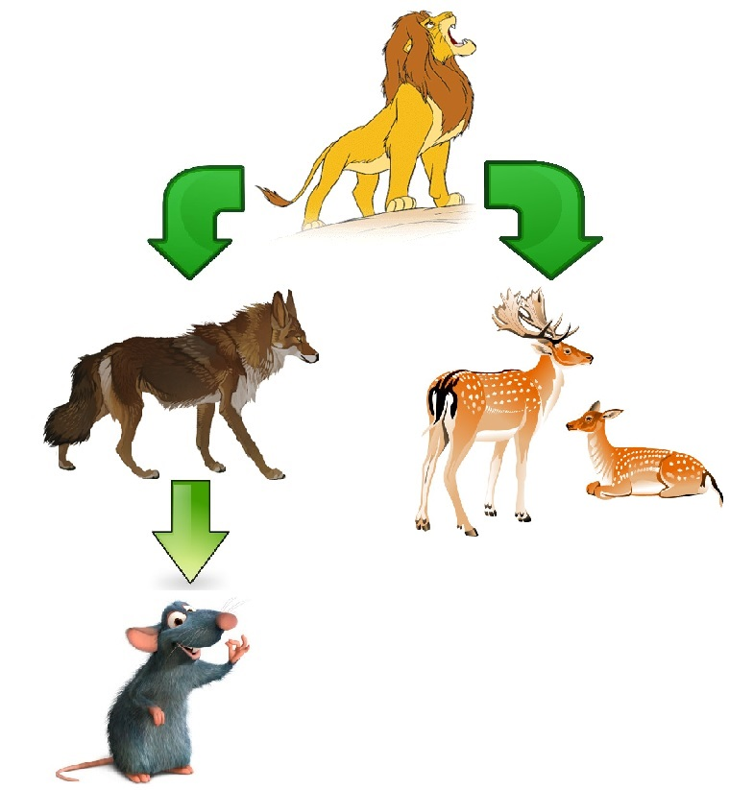
Breaking Food Chains
How Humans Can Affect Food Chain?
What would happen if you eliminate
mouse?
coyote?
lion?
a
13
Notes:
JacksHouse.gif – see in lecture folder

Slide 14
Properties of matter
Matter is anything that has mass and takes up space
Conservation of matter: it is recycled endlessly, does not disappear.
Everything goes somewhere
BIOGEOCHEMICAL CYCLES: total amount of matter being cycled is constant.
Carbon, water, nitrogen cycles
Notes:
Matter itself is not created or destroyed as it's used, and theoretically, it can be recycled endlessly.

Slide 15
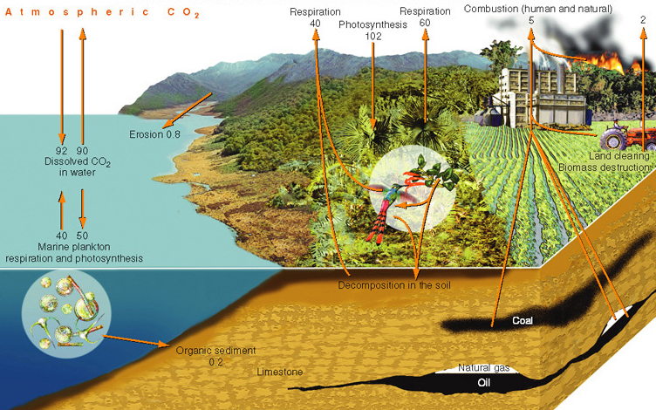
Carbon Cycle

Slide 16
Chemical Reactions in Living Things
Photosynthesis is a process used by plants to convert inorganic material into organic material using light.
Carbon dioxide + water (in the presence of sunlight) produces glucose + oxygen.
6CO₂ + 6H₂O + E (sunlight) → C₆H₁₂O₆ + 6O₂
Enzymes contained in living organisms act as biocatalysts speeding up chemical reactions.

Slide 17
Photosynthesis

Slide 18
Respiration
Respiration is the process that uses oxygen to break down large, organic molecules into smaller inorganic molecules (releases energy organisms can use).
Glucose + oxygen produces carbon dioxide + water + energy
C₆H₁₂O₆ + 6O₂ → 6CO₂ + 6H₂O + E

Slide 19
Respiration

Slide 20
Energy: properties
Energy is the capacity to do work.
Maintenance of living systems requires energy
Energy cannot be recycled, subject to losses from the system.
Most energy used in ecosystems is solar energy.
Plants convert solar E to chemical E
Kinetic and potential E.

Slide 21
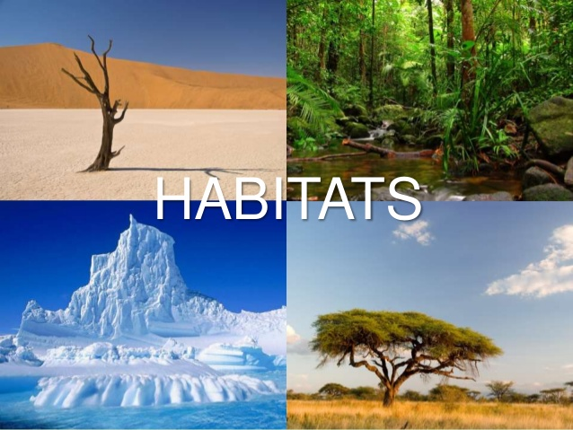
Habitat - the place or set of environmental
conditions in which a particular organism lives

Slide 22
Who Lives Where, and Why? Generalists vs. Specialists
2 basic strategies for surviving
- in a broad range of environmental conditions: "generalists“.
- in a narrow set of environmental conditions: "specialists."

Slide 23
LIMITING FACTORS
The geographical range of a species is not always limited by the presence of barriers that prevent its spread.
It is often limited by a particular factor in the environment that limits it ability to survive, grow or reproduce – These are Limiting Factors

Slide 24
Limiting factors: ABIOTIC (physical) and BIOTIC (live)
Abiotic Factors
Temperature, Pressure, Wind,
Moisture, Salinity
Light availability /day length
pH, C02, O2, availability of N, P, K, Ca.
Biotic Factors
Competition, Predation
Diseases
Food availability
Species density
Notes:
BIOTIC - живой

Slide 25
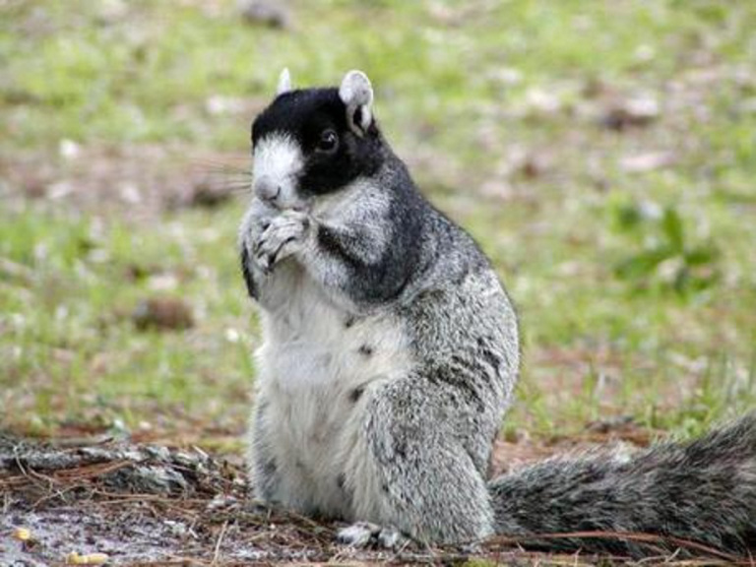
Ecological niche
is the role played by a species in a biological community.
Niche defines:
- way of obtaining food;
- relationships w /other species
- services to the community.

Slide 26
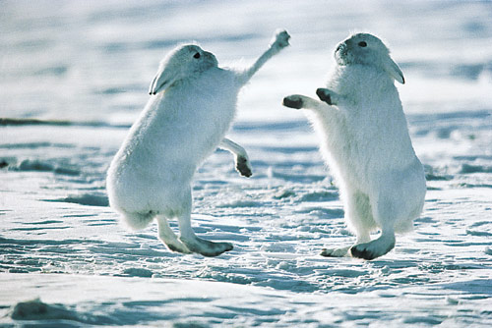
Species Interactions
Most obvious are Predation and Competition - antagonistic relationships

Slide 27
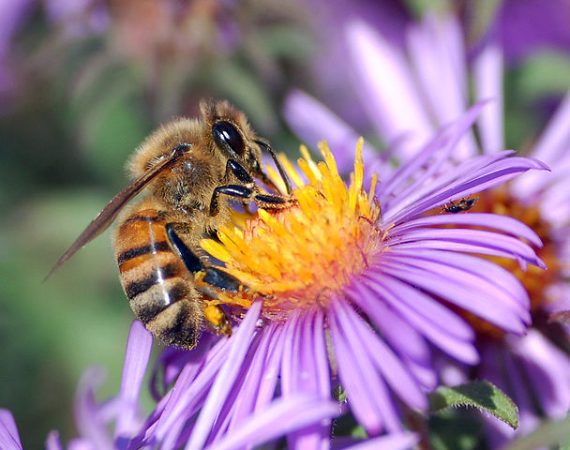
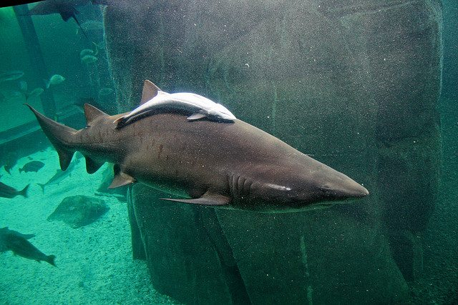
Symbiosis: coexistence of 2 species
3 types of symbiosis:
Commensalism - one member benefits, while the other is neither benefited nor harmed
Mutualism - both members of the partnership benefit;
Parasitism - a form of predation where one species benefits and the other is harmed
Notes:
Symbiosis is "the intimate living together of members of 2 different species." 3 types of symbiosis:
Commensalism is a type of species interaction in which one member of the interaction benefits and the other neither gains nor loses: barnacle (казарка, морская уточка) riding on a turtle shell. The barnacle benefits: place to anchor and live. The turtle is indifferent to the barnacle.
Mutualism: is the relationship between red alder (ольха) and the tiny soil bacteria Frankia that forms nodules in the alder's roots – N-fixing bacteria. Frankia produces N that the alder needs, and the bacteria receives food, from the alder.
Parasitism is another type of symbioses: an intestinal fluke that lives within the organism using the organism's food and energy to its benefit and the host's detriment. Harm to the host because the parasite is robbing it of food.

Slide 28
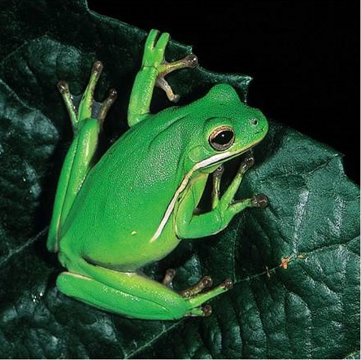
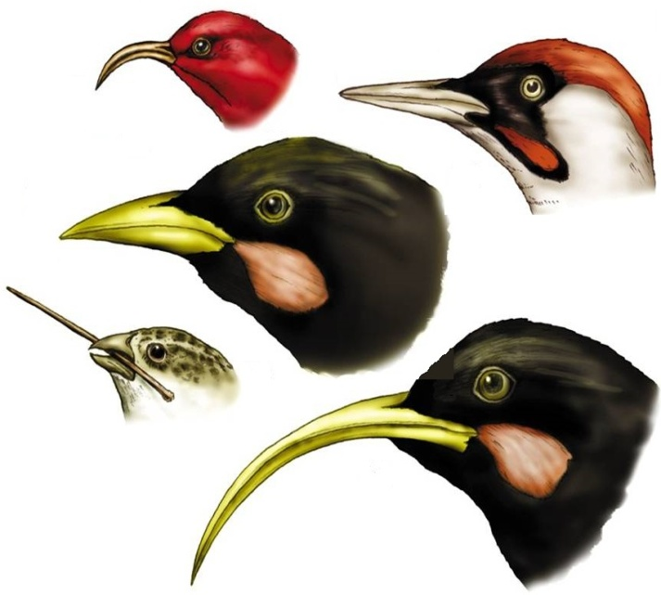
Adaptation and Natural Selection
Adaptation - physical or behavioral trait that helps a species survive.
Natural selection - the organisms best adapted to their environment tend to survive and less adapted tend to be eliminated. Charles Darwin

Slide 29
Defensive Mechanisms
Poison arrow frog: strong neurotoxin in its skin.

Slide 30
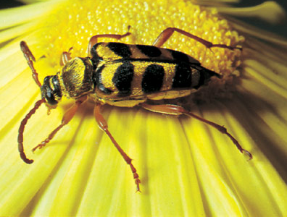
Batesian Mimicry
Notes:
Harmless species resembles dangerous species

Slide 31
Community Properties
Environmental resistance - factors that tend to reduce population growth rates
Productivity - rate of biomass production by the community
Primary productivity – by plants
Net productivity - primary productivity minus the energy lost in respiration
Productivity depends on light, temperature, moisture, and nutrient availability.
Notes:
Communities are characterized by:
primary productivity, which is defined as the raw amount of biomass production, or how much solar energy is converted into chemical E thru photosynthesis. For instance, the primary productivity of something like a wheat field would be centered mostly around the growth of the wheat.

Slide 32
Communities in Transition
Ecological succession - the process by which
ecosystems change and develop over time:
organisms occupy a site and change environmental
conditions
Primary succession - occurs when a community begins to develop on a site previously unoccupied by living organisms
after earthquake
Secondary succession - occurs when an existing community is disrupted and a new one subsequently develops at the site
after forest fire
Notes:
is the gradual process by which ecosystems change and develop over time. Nothing remains the same and habitats are constantly changing.

Slide 33
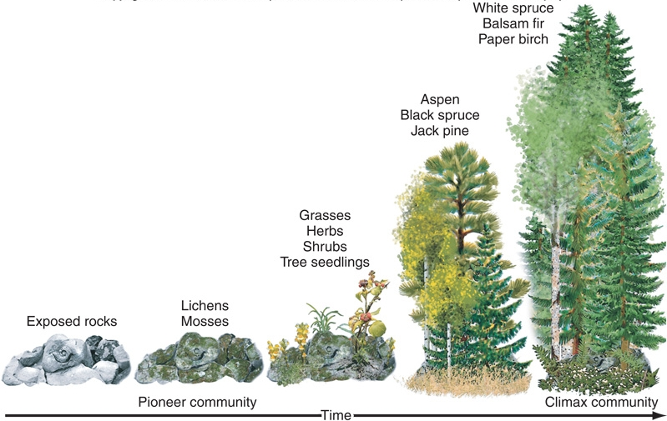
Primary Succession
Primary
Succession
on Land
Notes:
This slide shows primary succession on exposed rocks such as after a volcanic eruption or landslide.

Slide 34
Properties of Ecosystems
Stability (or homeostasis)
- a dynamic equilibrium among the physical
and biological factors in an ecosystem
Resiliency - ability to recover from disturbance
Inertia - resistance to perturbations
Renewal - ability to repair damage after disturbance

Slide 35
QUESTIONS ?

