Slide 1
ECN2102 macroeconomics (3 Credits/5 ECTS) Training (Chapter 4)
Week 3 (Session 7)
Instructor: Eldar Madumarov
September 6, 2024

Slide 2
Outline
Review Questions
Training (Chapter 4)

Slide 3
Review Questions
1. Define GDP and distinguish between a final good and an intermediate good. Provide examples.

Slide 4
Review Questions
2. Why does GDP equal aggregate income and also equal aggregate expenditure?

Slide 5
Review Questions
3. What’s the distinction between gross and net?

Slide 6
Review Questions
4. Distinguish between real GDP and potential GDP and describe how each grows over time.

Slide 7
Review Questions
5. How does the growth rate of real GDP contribute to an improved standard of living?

Slide 8
Review Questions
6. What is a business cycle and what are its phases and turning points?

Slide 9
Review Questions
7. What is PPP and how does it help us to make valid international comparisons of real GDP?

Slide 10
Review Questions
8. Explain why real GDP might be an unreliable indicator of the standard of living?

Slide 11
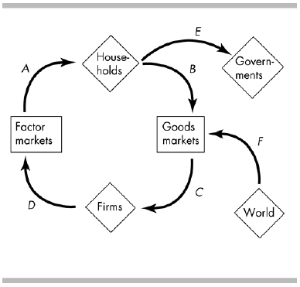
Training (Chapter 4)

Slide 12
Training (Chapter 4)
1) In the above figure, flow B represents ________.
A) household purchases of goods and services
B) household borrowing
C) firms’ payments for labor services
D) household income

Slide 13
Training (Chapter 4)
2) In the above figure, flow B represents households’ ________.
A) income
B) saving
C) consumption expenditures
D) investment

Slide 14
Training (Chapter 4)
3) In the above figure, household income is shown by flow
A) A.
B) B.
C) C.
D) F.

Slide 15
Training (Chapter 4)
4) In the above figure, consumption expenditure is shown by flow
A) A.
B) B.
C) C.
D) F.

Slide 16
Training (Chapter 4)
5) Two methods of measuring GDP are
A) the saving approach and the investment approach.
B) the income approach and the receipts approach.
C) the income approach and the expenditure approach.
D) the goods approach and the services approach.

Slide 17
Training (Chapter 4)
6) In the equation, GDP = C + I + G + X - M, G refers to
A) local, state, and federal government spending for all purposes.
B) local, state, and federal government expenditure on goods and services, but does not include
transfer payments.
C) the taxes and expenditures of all government units.
D) federal government expenditures plus all transfer payments.

Slide 18
Training (Chapter 4)
7) Normally in the United States the relationship between nominal and real GDP for a given year is
A) real GDP is greater than nominal GDP because of price increases.
B) nominal GDP is greater than real GDP because of price decreases.
C) nominal GDP equals real GDP.
D) nominal GDP is greater than real GDP because of price increases.

Slide 19
Training (Chapter 4)
8) Assume a small nation has the following statistics: its consumption expenditure is $15 million, investment is $2 million, government purchases of goods and services is $1 million, exports of goods and services to foreigners is $1 million, and imports of goods and services from foreigners is $1.5 million. Calculate this nation’s GDP.

Slide 20
Training (Chapter 4)
Answer:
8) The nation’s GDP equals the sum of consumption expenditure, investment, government purchases of goods and services, and net exports of goods and services, where net exports of goods and services equals of goods and services exports minus imports of goods and services. So, GDP = $15 million + $2 million + $1 million + $1 million - $1.5 million = $17.5 million.

Slide 21
Training (Chapter 4)
9) On January 1, 2010, United Delivery had trucks valued at $1.3 million. During 2010, United Delivery purchased new trucks valued at $500,000. If the value of the trucks on December 31, 2010 was $1.5 million, what is the amount of its net investment and its depreciation during 2010?

Slide 22
Training (Chapter 4)
Answer:
9) Net investment is the change in the capital stock from one period to the next. For United Delivery, net investment equals $1.5 million - $1.3 million = $200,000. Net investment also equals gross investment minus depreciation, so depreciation equals gross investment minus net investment. Gross investment, the total amount spent on new capital equipment, was $500,000. Net investment was calculated to be $200,000. Therefore depreciation equals $500,000 - $200,000 = $300,000.

Slide 23
Training (Chapter 4)
10) Using a graph, draw and label the phases and turning points of the business cycle.

Slide 24
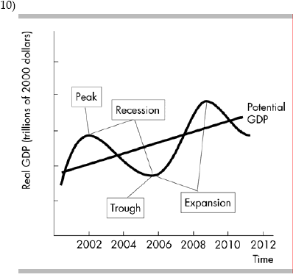
Training (Chapter 4)

