Slide 1
ECN2102 macroeconomics (3 Credits/5 ECTS) Training (Chapter 15)
Week 16 (Session 42)
Instructor: Eldar Madumarov
December 4, 2024

Slide 2
Outline
Training (Chapter 15)

Slide 3
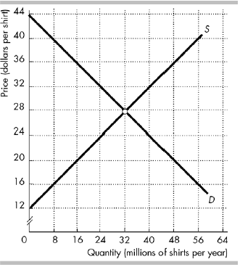
Training (Chapter 15)
The figure shows the market for shirts in the United States, where D is the domestic demand curve and S is the domestic supply curve. The world price is $20 per shirt.

Slide 4
Training (Chapter 15)
1) In the figure above, with international trade Americans buy ________ million shirts per year.
A) 24
B) 48
C) 32
D) 16

Slide 5
Training (Chapter 15)
2) In the figure above, with international trade ________ million shirts per year are produced in the United States.
A) 16
B) 20
C) 32
D) 48

Slide 6
Training (Chapter 15)
3) In the figure above, with international trade the United States ________ million shirts per year.
A) exports 32
B) imports 48
C) exports 16
D) imports 32

Slide 7
Training (Chapter 15)
4) A tariff is a
A) tax on an exported good or service.
B) tax on an imported good or service.
C) subsidy on an imported good.
D) subsidy on an exported good.

Slide 8
Training (Chapter 15)
5) A major purpose of tariffs is to
A) discourage exports.
B) encourage exports.
C) encourage imports.
D) discourage imports.

Slide 9
Training (Chapter 15)
6) Tariffs and import quotas differ in that
A) one is legal, while the other is not.
B) one is a form of trade restriction, while the other is not.
C) one is imposed by the government, while the other is imposed by the private sector.
D) one is a tax, while the other is a limit.

Slide 10
Training (Chapter 15)
7) Suppose the country of Atlantica imposes a tariff on foreign-produced cars. As a result of the tariff,
A) there is an increase in the number of imported cars.
B) tariff revenue collected by the government in the Atlantica increases.
C) the gains from trade rise.
D) there are more efficient trade agreements between Atlantica and its trade partners.

Slide 11
Training (Chapter 15)
8) Reducing a tariff will ________ the domestic production of the good and ________ the total domestic consumption of the good.
A) increase; increase
B) decrease; increase
C) decrease; decrease
D) increase; decrease

Slide 12
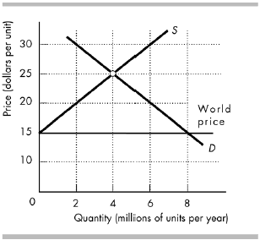
Training (Chapter 15)

Slide 13
Training (Chapter 15)
9) The above figure shows the domestic supply of and domestic demand for an imported good. The world price is $15 per unit.
a) At the world price of $15 per unit, what is the domestic consumption and domestic production?
b) At the world price of $15 per unit, what is the quantity imported?
c) If the government imposes a tariff of $5 per unit, what is the domestic consumption and domestic production?
d) With the $5 per unit tariff, what is the quantity imported?
e) How much revenue does the government collect with a tariff of $5 per unit?

Slide 14
Training (Chapter 15)
9)
a) Domestic consumption is 8 million units per year and domestic production is 0.
b) The quantity imported is 8 million units per year.
c) Domestic consumption is 6 million units per year and domestic production is 2 million units per year.
d) The quantity imported is 4 million units per year.
e) The government collects $5 per unit imported and 4 million units are imported, so the government’s revenue from the tariff is $5 × 4 million = $20 million per year.

