Slide 1
Chapter 13 Balance of Payments, Debt, Financial Crises, and Stabilization Policies

Slide 2
Outline
The Balance of Payments Account
Financing and Reducing Payments Deficit
The Debt Crisis of the 1980s
Attempts at Alleviation: Macroeconomic Instability, IMF Stabilization Policies, and their Critics
“Odious Debt” and Its Prevention
Resolution and Continued Vulnerabilities

Slide 3
13.1 International Finance and Investment: Key Issues for Developing Countries
How major debt crises emerged during the 1980s
Financial Crisis

Slide 4
13.2 The Balance of Payments Account
General considerations:
Balance of Payments (BOP)
Current Account
Surplus and Deficit
Capital Account

Slide 5
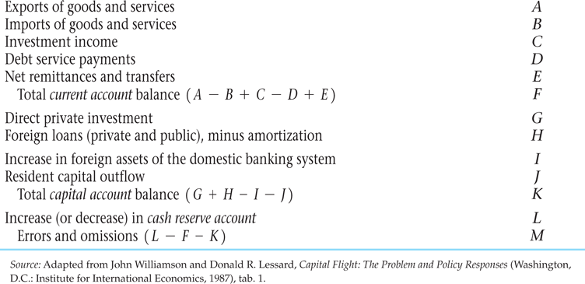
Table 13.1 A Schematic Balance of Payments Account

Slide 6
13.2 The Balance of Payments Account (cont’d)
General considerations (cont’d)
Cash Account or International Reserve Account
Three forms:
Hard currency
Gold
Deposits with IMF

Slide 7
Table 13.2 Credits and Debits in the Balance of Payments Account

Slide 8
13.2 The Balance of Payments Account (cont’d)
A hypothetical illustration: deficits and debts
Current Account
Capital Account

Slide 9
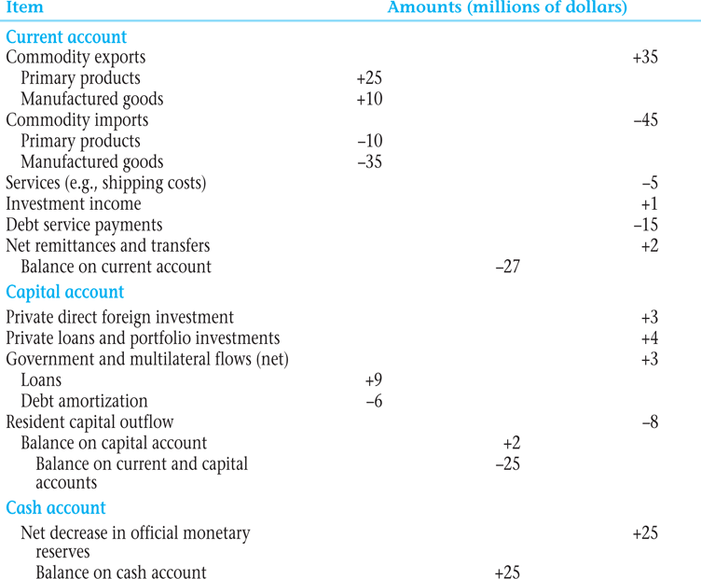
Table 13.3 A Hypothetical Balance of Payments Table for a Developing Nation

Slide 10
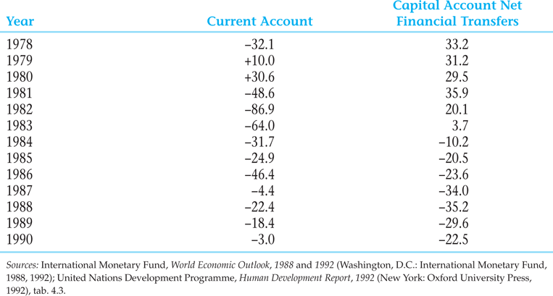
Table 13.4 Before and After the 1980s Debt Crisis: Current Account Balances and Capital Account Net financial Transfers of Developing Countries, 1978-1990 (billions of dollars)

Slide 11
13.2 The Balance of Payments Account (cont’d)
A hypothetical illustration: deficits and debts (cont’d)
Inflow
Outflow
Amortization

Slide 12
13.3 The Issue of Payments Deficits
Some initial policy issues
International reserves
Restrictive fiscal and monetary policies:
Structural adjustment
Stabilization policies
Special drawing rights (SDRs)

Slide 13
13.3 The Issue of Payments Deficits (cont’d)
Trends in the Balance of Payments

Slide 14
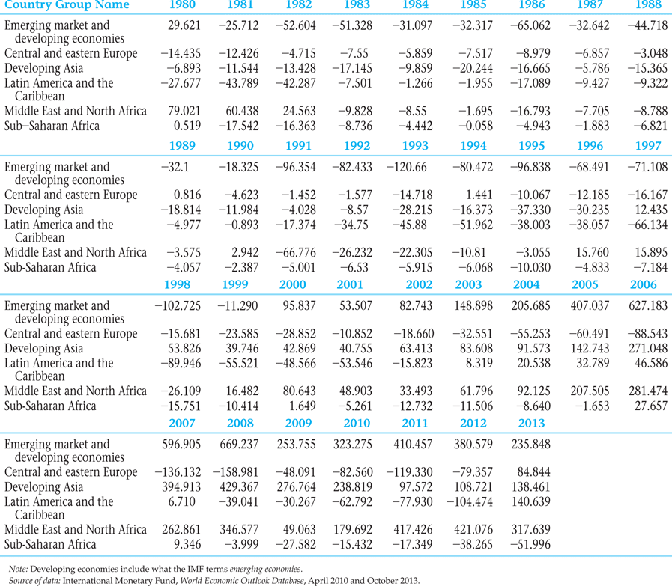
Table 13.5 Developing Country Payments Balances on Current Account, 1980–2009 (billions of dollars)

Slide 15
13.4 Accumulation of Debt and Emergence of the Debt Crisis in the 1980s
Background and analysis
External debt
Debt service
Basic transfer

Slide 16
13.4 Accumulation of Debt and Emergence of the Debt Crisis in the 1980s (cont’d)
Net capital inflow, F_{N}, is
(13.1)
Basic transfer, BT, is
(13.2)
Where d is percent increase in total debt
D is total debt
r is the average interest rate

Slide 17
13.4 Accumulation of Debt and Emergence of the Debt Crisis in the 1980s (cont’d)
Origins of the 1980s Debt Crisis
OPEC oil price increase
Increased borrowing
Excess of imports
Lagging exports

Slide 18
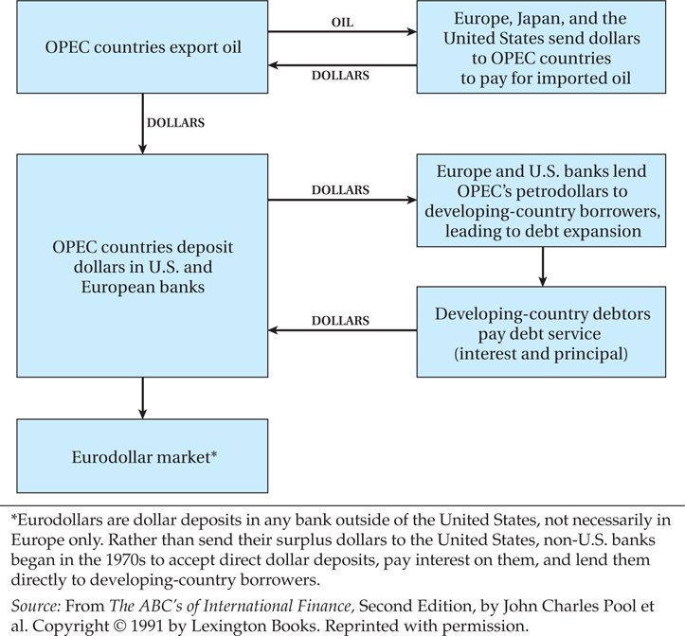
Figure 13.1 The Mechanics of Petrodollar Recycling

Slide 19
13.4 Accumulation of Debt and Emergence of the Debt Crisis in the 1980s (cont’d)
Origins of the Debt Crisis (cont’d)
Debt-servicing obligations
Debt-service payments
Debt-servicing difficulty
Oil shocks

Slide 20
13.4 Accumulation of Debt and Emergence of the Debt Crisis in the 1980s (cont’d)
Origins of the Debt Crisis (cont’d)
Developing countries’ two options:
Curtail imports and restrictive fiscal and monetary measures
More external borrowing

Slide 21
13.5 Attempts at Alleviation: Macroeconomic Instability, Classic IMF Stabilization Policies, and Their Critics
The IMF stabilization program
Macroeconomic instability
Stabilization policies
Four basic components of IMF stabilization program:
Liberalization of foreign exchange and imports control
Devaluation of the official exchange rate
Stringent domestic anti-inflation program
Opening up of the economy to international commerce

Slide 22
13.5 Attempts at Alleviation: Macroeconomic Instability, Classic IMF Stabilization Policies, and Their Critics (cont’d)
The IMF stabilization program (cont’d)
Such policies can be politically unpopular because they hurt the lower- and middle-income groups.
Less radical observers view the IMF as neither a developmental nor an antidevelopmental institution.
See Box 13.1

Slide 23
13.5 Attempts at Alleviation: Macroeconomic Instability, Classic IMF Stabilization Policies, and Their Critics (cont’d)
The IMF stabilization program (cont’d)
Tactics for debt relief:
Debtors’ cartel
Restructuring
Brady Plan
Debt for equity swaps
Debt for nature swaps
Debt repudiation
For the case of Mexico, see Box 13.3

Slide 24
“Odious Debt” and Its Prevention
What is odious debt?
Sovereign debt used by an undemocratic government in a manner contrary to the interests of its people should be deemed invalid
See Box 13.4

Slide 25
Resolution of 1980s-1990s Debt Crises and Continued Vulnerabilities
Highly indebted poor countries (HIPCs)
Some progress but vulnerabilities remain

Slide 26
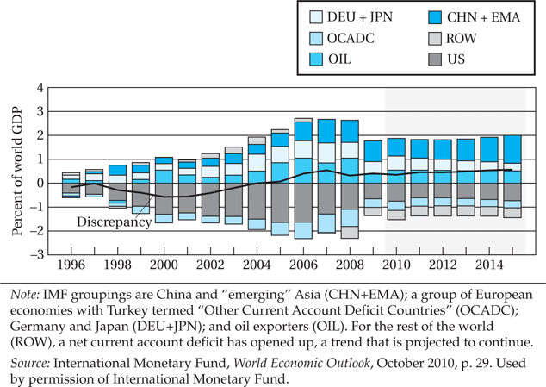
Figure 13.2 Global Imbalances

Slide 27
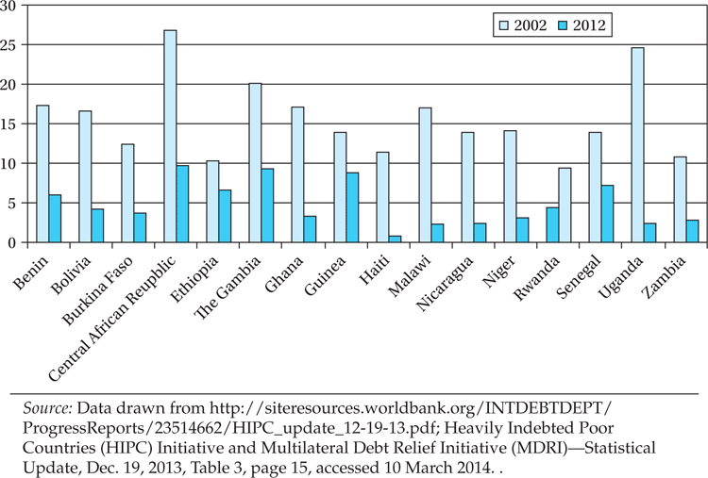
Figure 13.3 Debt Service Ratios for Selected HIPC Countries, 2002 and 2012

Slide 28
13.6 The Global Financial Crisis and the Developing Countries
Causes of the crisis and challenges to lasting recovery
Economic impacts on developing countries
Economic growth
Exports
Foreign investment inflows
Developing-country stock markets
Aid

Slide 29
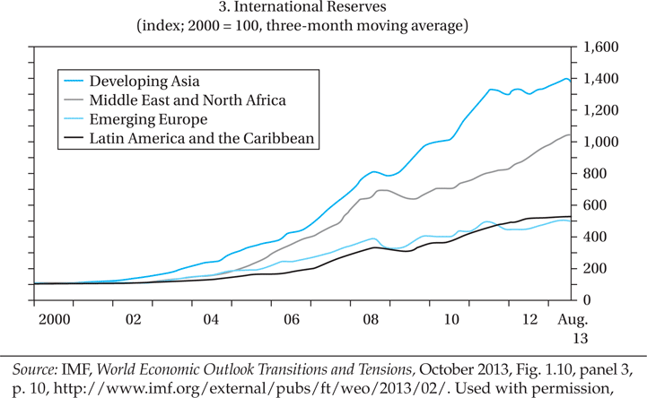
Figure 13.4 International Reserves (Index 2000 = 100, three-month moving average)

Slide 30
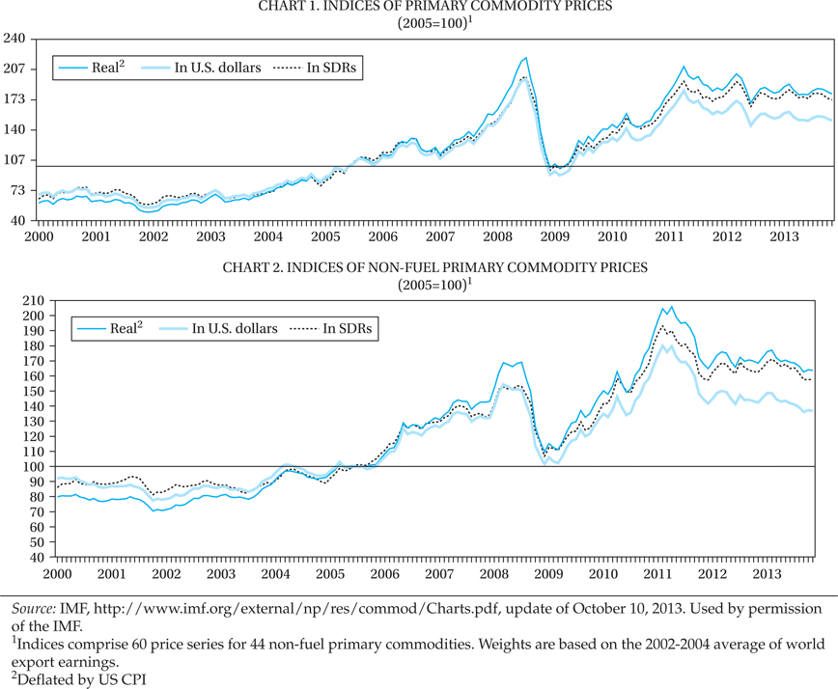
Figure 13.5 Indices of Commodity Prices (Total and Non-Fuel), 2000–2013

Slide 31
13.6 The Global Financial Crisis and the Developing Countries (cont’d)
Economic impacts on developing countries
Distribution of influence among developing countries
Worker remittances
Poverty
Health and education
General policy framework

Slide 32
13.6 The Global Financial Crisis and the Developing Countries (cont’d)
Differing impacts across developing regions
China and the exchange rates controversy
East Asia and Southeast Asia except China
India
Latin America
Africa

Slide 33
13.6 The Global Financial Crisis and the Developing Countries (cont’d)
Prospects for recovery and stability
Opportunities as well as dangers?

Slide 34
Concepts for Review
Amortization
Balance of payments
Basic transfer
Brady plan
Capital account
Capital flight
Cash account
Conditionality
Current account
Debt-for-equity swap
Debt-for-nature swap
Debtors’ cartel
Debt repudiation
Debt service
Deficit

Slide 35
Concepts for Review (cont’d)
Euro
External debt
Hard currency
Highly indebted poor countries (HIPCs)
International reserve account
International reserves
Macroeconomic instability
Odious debt
Restructuring
Special drawing rights (SDRs)
Stabilization policies
Structural adjustment loans
Surplus

