Slide 1
ECN2102 macroeconomics (3 Credits/5 ECTS) Training (Chapter 14)
Week 15 (Session 37)
Instructor: Eldar Madumarov
November 29, 2024

Slide 2
Outline
Questions (Chapter 14)
Training (Chapter 14)

Slide 3
Questions (Chapter 14)
1. What are the objectives of monetary policy?

Slide 4
Questions (Chapter 14)
2. Are the goals of monetary policy in harmony or in conflict
(a) in the long run and
(b) in the short run?

Slide 5
Questions (Chapter 14)
3. What is the core inflation rate and how does it differ from the overall CPI inflation rate?

Slide 6
Questions (Chapter 14)
4. What happens when the central bank buys or sells securities in the open market?

Slide 7
Questions (Chapter 14)
5. Do interest rates fluctuate in response to the central bank’s actions?

Slide 8
Questions (Chapter 14)
6. How do the central bank’s actions change the exchange rate of the country?

Slide 9
Training (Chapter 14)
1) When the output gap is positive, it represents ________ gap, and when it is negative, it represents
________ gap.
A) an inflationary; an employment
B) an inflationary; a recessionary
C) a recessionary; an inflationary
D) an employment; an unemployment

Slide 10
Training (Chapter 14)
2) The output gap is the
A) percentage deviation of real GDP from potential GDP.
B) percentage increase in the economic growth rate of real GDP.
C) difference in graduation levels between high school and college.
D) difference between actual inflation and core inflation.

Slide 11
Training (Chapter 14)
3) Equilibrium in the market for bank reserves determines the
A) federal funds rate.
B) exchange rate.
C) 30-year Treasury bond rate.
D) inflation rate.

Slide 12
Training (Chapter 14)
4) By using open market operations, the Federal Reserve
A) adjusts the supply and demand of reserves to keep the federal funds interest rate equal to its target.
B) controls banks’ demand for reserves, thereby keeping the federal funds rate equal to its target.
C) adjusts the supply of reserves to keep the federal funds interest rate equal to its target.
D) adjusts the demand of reserves to keep bank rates in line with the federal funds rate target.

Slide 13
Training (Chapter 14)
5) To increase the quantity of money in the economy, the Federal Reserve is likely to
A) sell government securities in an open market operation.
B) lower tax rates
C) buy government securities in an open market operation.
D) print more money and give it to the banks.

Slide 14
Training (Chapter 14)
6) If the Fed wants to increase the quantity of money, it can
A) increase the government budget deficit.
B) purchase U.S. government securities.
C) lower income tax rates.
D) raise the exchange rate.

Slide 15
Training (Chapter 14)
7) When the Fed raises the federal funds rate,
A) consumption increases.
B) net exports increase.
C) the value of the dollar rises on the foreign exchange market.
D) the value of the dollar falls on the foreign exchange market.

Slide 16
Training (Chapter 14)
8) Suppose that initially real GDP equals potential GDP. Then an increase in aggregate demand occurs. According to the Taylor rule, the Fed should ________ the federal funds rate by ________ government securities in the open market.
A) raise; selling
B) lower; selling
C) lower; buying
D) raise; buying

Slide 17
Training (Chapter 14)
9) A rise in the federal funds rate
A) lowers the long-term real interest rate.
B) does not change the long-term real interest rate.
C) may raise or lower the long-term real interest rate, depending on whether the demand for loanable funds curve has a negative or a positive slope.
D) raises the long-term real interest rate.

Slide 18
Training (Chapter 14)
10) The Taylor rule
A) ignores price level stability to focus on responding to fluctuations in real GDP.
B) focuses on only fluctuations in real GDP.
C) is the rule actually followed by the Fed.
D) shows how the Fed could set the federal funds rate.

Slide 19
Training (Chapter 14)
11) Suppose the equilibrium real interest rate is 2 percent per year, inflation is 2.5 percent and the output gap is 1 percent. Using the Taylor rule, what is the federal funds rate?
A) 3.5 percent
B) 3 percent
C) 5.5 percent
D) 5.25 percent

Slide 20
Training (Chapter 14)
12) Suppose the inflation rate is 3 percent and the output gap is -1 percent. Assuming the equilibrium real interest rate is 2 percent, using the Taylor rule, what target should the Fed set for the federal funds rate?
A) 1 percent
B) 4 percent
C) 5 percent
D) 6 percent

Slide 21
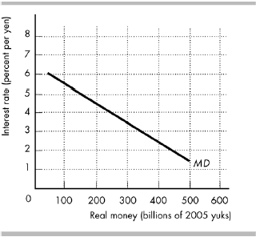
Training (Chapter 14)

Slide 22
Training (Chapter 14)
13) The figure above shows the demand for money in Kiteland.
a) If the Kiteland Central Bank has set the quantity of money so that the equilibrium interest rate is 4 percent, draw the supply of money curve.
b) Suppose that Kiteland’s Central Bank wants to raise the interest rate by 1 percentage point. By how much must it change the quantity of real money?
c) In order to change the quantity of money to raise the interest rate by one percentage point, if the Central Bank uses an open market operation, does it make an open market purchase or an open market sale? Explain your answer.

Slide 23
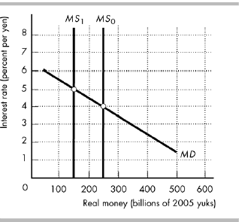
Training (Chapter 14)

Slide 24
Training (Chapter 14)
a) See the figure above. When the supply of money is 250 billion yuks, or MS₀, the interest rate is 4 percent
b) See the figure above. To raise the interest rate from 4 percent to 5 percent, the Central Bank decreases the supply of money from 250 billion yuks, MS₀, to 150 billion yuks, MS₁. So the Central Bank decreases the quantity of real money by 100 billion yuks.
c) The Central Bank conducts an open market sale. As it does so, the bank reserves decrease, the banks cut their lending until the amount of loans is consistent with the new level of reserves. As bank loans decrease, the quantity of money decreases.

