Slide 1
Theories & Hypotheses
Week 2

Slide 2
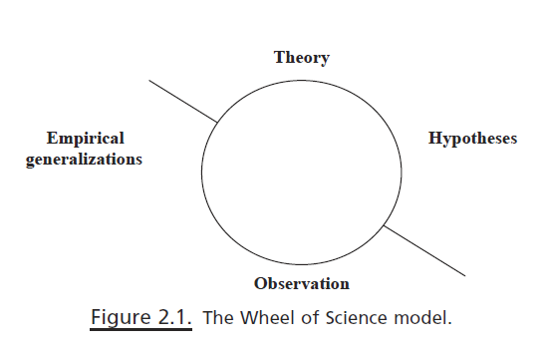
The wheel of science model
Deductive Science begins with theory, statements that explain the patterns we observe
Inductive science – to begin with our observation to conclude what those observations mean for the whole

Slide 3
What are theories?
Theory is the basic building block of social science, helping to structure the ways in which we view how and why things work together
Its task is to link concepts (education, healthcare, religion, state, etc.)
Theory asks the ‘Why?’ question
Theory makes assumptions about human nature and then offers us general explanations of a variety of social behaviors given certain social conditions
Thus, theories explains and predicts (ex. Speed limit > road mortality)
Theories should be parsimonious: explaining the most phenomena with the least amount of theoretical assumptions
Theories must be tested empirically to remain useful: If something cannot be observed using the five senses, then it is not within the purview of social science but perhaps of philosophy or religion

Slide 4
What are hypotheses?
Hypotheses are the second step of wheel of science model
Hypotheses follow from theories, stating relationships between two or more concepts in such a way that they can be empirically tested
Theory states: Social class affects voting behavior.
Hypotheses state how above concepts work together: Those with higher social class will be more likely to participate in politics.
Relationships work in positive and negative direction
Relationships between concepts must be measurable and posses directionality (positive or negative impact)
Social class > ‘subjective class identification’ from 2010 General Social Survey (GSS)
Participation in politics > ‘asking respondents whether they voted in presidential/parliamentary elections’

Slide 5
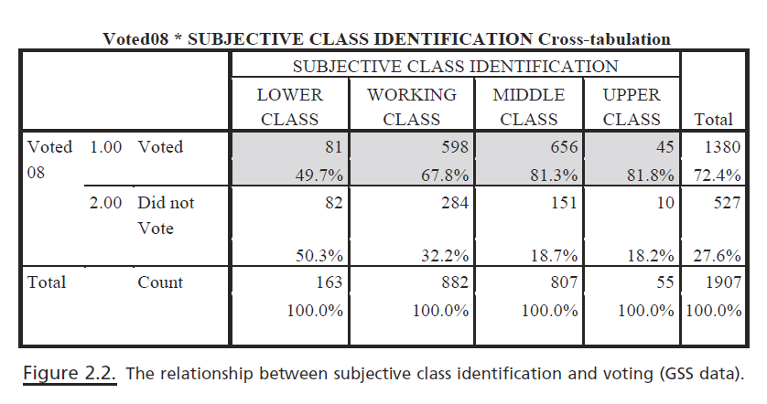
Testing hypothesis

Slide 6
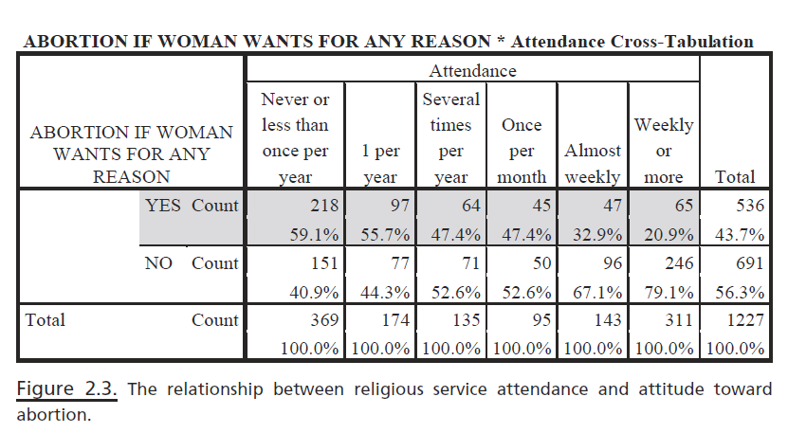
Religious participation – attitude to abortion
Hypothesis: As religious participation increases, support for abortion decreases.
Hypothesis: As religious participation decreases, support for abortion increases.

Slide 7
Operationalization
Transforming variables into something measureable
Concept > variable > indicators
Variables must be exhaustive and mutually exclusive
Exhaustive: have answer categories that allow accounting for every person
Mutually exclusive: no one person can fit into more than one category
Example: What is your religious preference?
Protestant
Catholic
Jewish
Muslim
None
Other____________

Slide 8
Survey data
National
Kazakhstan Youth Survey (2016): http://projects.ff.uni-mb.si/cepss/index.php/youth-studies/
Central Asia Barometer: http://www.centralasiabarometer.org/
Eurasia Barometer: http://office.eurasiabarometer.org/
General Social Survey of the Russian Federation and Central Asia (1992): https://www.icpsr.umich.edu/icpsrweb/ICPSR/studies/6499
International
World Values Survey: http://www.worldvaluessurvey.org/wvs.jsp
Varieties of Democracy (V-Dem): https://www.v-dem.net/en/data/data-version-8/
Eurobarometer: https://www.gesis.org/eurobarometer-data-service/search-data-access/data-access/
UK General Household Survey: https://data.gov.uk/dataset/138ca035-a90c-4e37-80f5-4c73eeb6ae04/general-household-survey

Slide 9
Single or Multiple Indicators
Some variables are straightforward (single)
Eg. Sex, family size
Others are not (multiple)
Eg. Religiosity, academic performance, corruption
Social scientists make several observation of same variables, combine them and create a composite measurement of variable > index
Eg. 0-10 Democracy Index (https://infographics.economist.com/2018/DemocracyIndex/)

Slide 10
Criteria of Measurement Quality
Precision and Accuracy
Eg. 1. A woman is 43 yrs old vs. A woman in her fourties
Eg. 2. A person was born in Ushtobe, Almaty district vs. born in Almaty district
Reliability: quality of measurement method that suggests that the same data would have been collected each time in repeated observation of the same phenomenon
Validity: a measure which accurately reflects the concept it is intended to measure
Face validity
Criterion-related validity

Slide 11
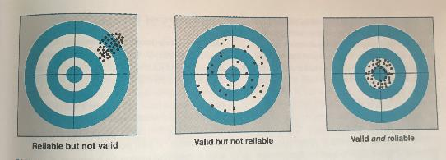

Slide 12
Ethics of measurement
Operationalizing concepts should be meet ethical standards
Eg. ‘pro-abortion’ or ‘pro-choice’
Eg. 2. US invasion of Iraq in 2003 framed as:
‘unprovoked invasion of sovereign nation’
‘retaliation for the September 11, 2001’
‘defensive act against perceived threat’
‘war on terror’

Slide 13
Written assignment
Following are two options for assignment to be submitted next class. 1) Define and operationalize your concepts from the last written assignment. If you have not done it, then pick a social science concept such as liberalism or alienation and operationalize it. 2) How does the General Social Survey (GSS) operationalize one of the following terms (choose one): a) social trust b) prejudice c) altruism

