Slide 1
Strategea Branding
February 21
Choosing Brand Elements
to Build Brand Equity
Dr. Zafar Ahmed
Founder and CEO
AGBA

Slide 2
Learning Objectives
What we'll learn:
1. Identify the different types of brand elements.
2. List the general criteria for choosing brand elements.
3. Describe key tactics in choosing different brand
elements.
4. Explain the rationale for “mixing and matching”
brand elements.
5. Highlight some of the legal issues surrounding brand
elements.

Slide 3
Energizer Bunny
A brand symbol like
the Energizer Bunny
can reinforce key brand
associations
and be
used in a variety of
different
communication
applications.
Source: Paul Martinka/
Polaris/Newscom

Slide 4
Strategea Branding
Memorability
Meaningfulness
Likability
Transferability
Adaptability
Protectability
CRITERIA FOR CHOOSING BRAND ELEMENTS

Slide 5
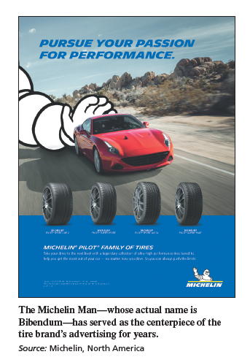
MICHELIN MAN

Slide 6
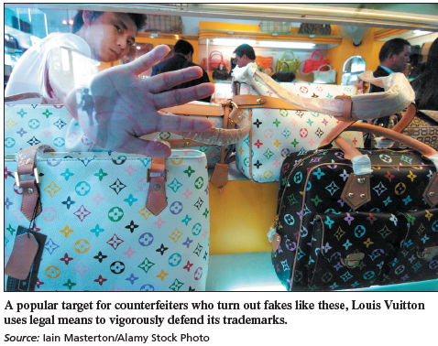
THE SCIENCE OF BRANDING 4-1
Counterfeit Business Is Booming

Slide 7
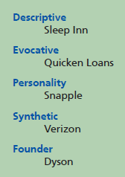
OPTIONS AND TACTICS FOR BRAND ELEMENTS
Brand Names
Naming Guidelines
Brand Awareness.
Simplicity and Ease of Pronunciation
and Spelling.
Familiarity and Meaningfulness.
Differentiated, Distinctive, and Unique.
Brand Associations.

Slide 8
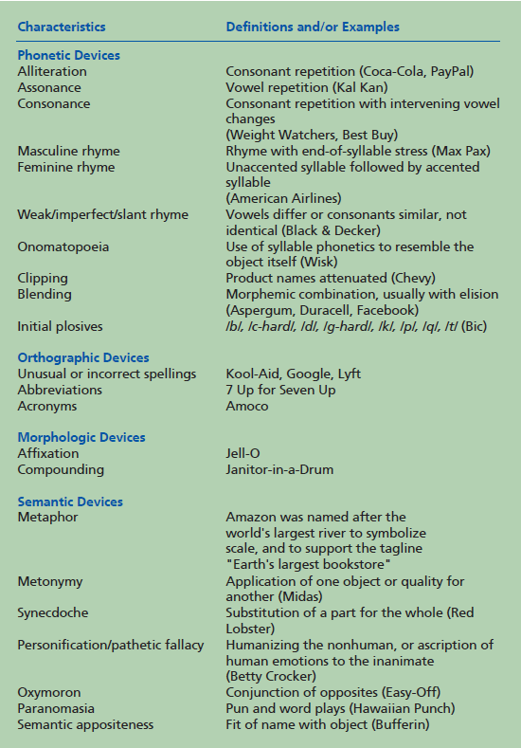
FIGURE 4-5
Brand Name Linguistic
Characteristics

Slide 9
Naming Procedures.
Define objectives.
Generate names
Screen initial candidates.
Study candidate names.
Research the final candidates.
Select the final name.
9

Slide 10
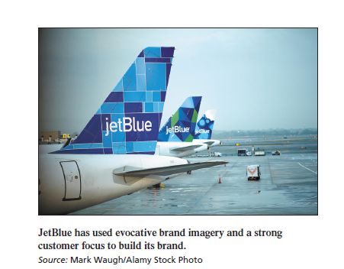
JETBLUE
JETBLUE
Traditionally, airlines use descriptive names that evoke specific geographic origins, like American, or broad geographic
reach, like United.

Slide 11
Branding
LOUIS VUITTON VERSUS LOUIS VUITON DAK, case p 124
URLs
Logos and Symbols
Characters
domain names
Benefits.
Characters represent a special type of brand symbol

Slide 12
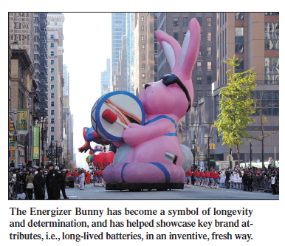
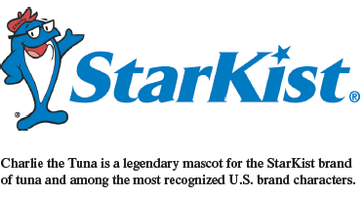
BRANDING BRIEF 4-1
StarKist’s Charlie the Tuna
Benefits
Cautions.
Slogans
Benefits. Some slogans help build brand awareness by playing off
the brand name in some
way, as in “The Citi Never Sleeps.”
Benefits. Some slogans help build brand awareness by playing off the brand name in some
way, as in “The Citi Never Sleeps.”

Slide 13
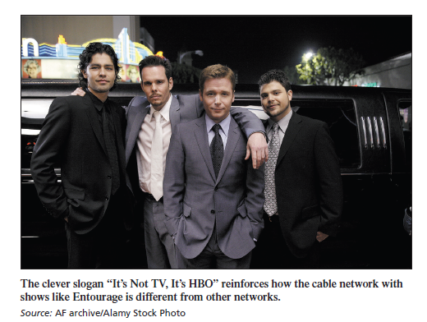
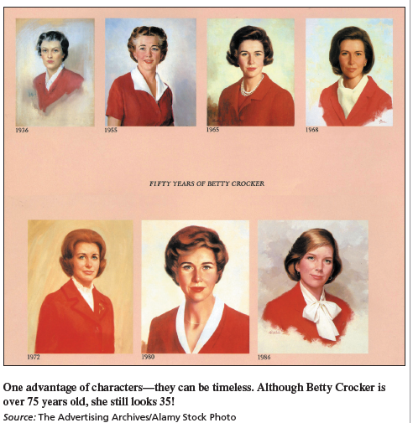

Slide 14
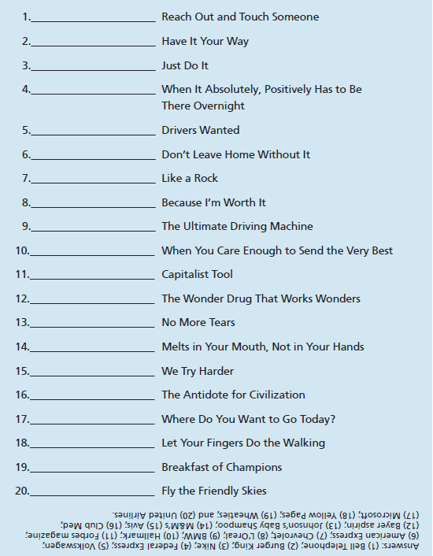
BRANDING BRIEF 4-2
Updating Betty Crocker
Project 3
Designing Slogans.
Updating Slogans.
FIGURE 4-7
Famous Slogans Quiz

Slide 15
Identify the brand.
Convey descriptive and persuasive information.
Facilitate product transportation and protection.
Assist in at-home storage.
•Aid product consumption.
Packaging

Slide 16
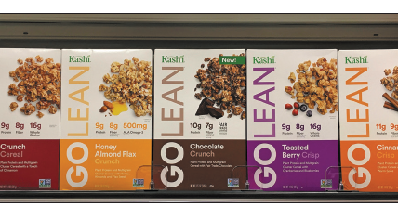
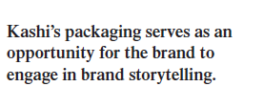
Packaging the Right Content.
Kashi
Chipotle
Snickers

Slide 17
Packaging the Right Content.
Packaging at the Point of Purchase
Packaging Innovations
Package Design
Packaging Changes.

Slide 18
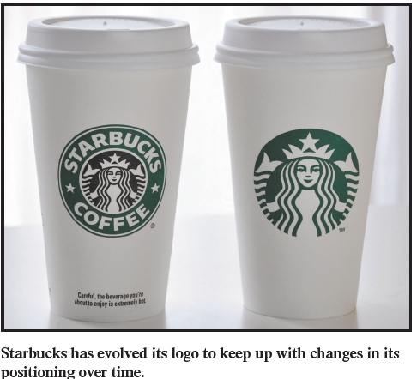
PUTTING IT ALL TOGETHER
When changing a well-received or even iconic brand
element—a character, logo, or packaging—two issues are key.

Slide 19
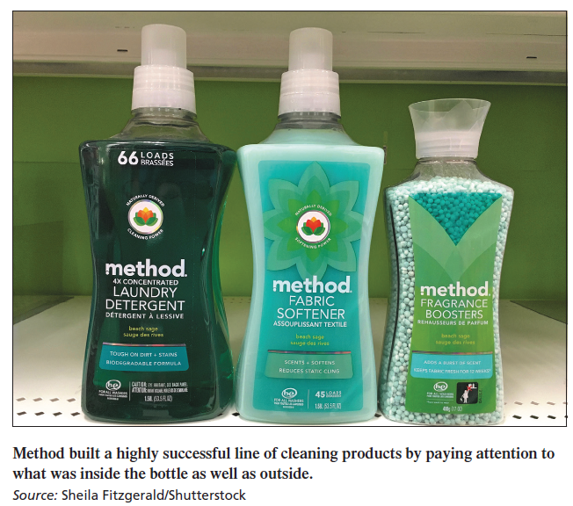
Values and Pillars
Celebrating its tenth anniversary in 2011 and still one of the fastest-growing companies in the United
States, Method Products is the brainchild of former high school buddies Eric Ryan and Adam Lowry.

Slide 20
Thank you!
Q&A

