Slide 2
13
FISCAL POLICY
Notes:
Notes and teaching tips: 12, 19, 25, 29, 48, 51, 59, and 60.
To view a full-screen figure during a class, click the expand button.
To return to the previous slide, click the shrink button.
To advance to the next slide, click anywhere on the full screen figure.
Applying the principles of economics to interpret and understand the news is a major goal of the principles course. You can encourage your students in this activity by using the two features: Economics in the News and Economics in Action.
(1) Before each class, scan the news and select two or three headlines that are relevant to your session today. There is always something that works. Read the headline and ask for comments, interpretation, discussion. Pose questions arising from it that motivate today’s class. At the end of the class, return to the questions and answer them with the tools you’ve been explaining.
(2) Once or twice a semester, set an assignment, for credit, with the following instructions:
(a) Find a news article about an economic topic that you find interesting.
(b) Make a short bullet-list summary of the article.
(c) Write and illustrate with appropriate graphs an economic analysis of the key points in the article.
Use the Economics in the News features in your textbook as models.

Slide 3
After studying this chapter, you will be able to:
Describe the federal budget process and the recent history of outlays, receipts, deficits, and debt
Explain the effects of fiscal policy on potential GDP and economic growth
Explain how fiscal policy choices redistribute benefits and burdens across generations
Explain how fiscal stimulus is used to speed recovery from recession

Slide 4
The Federal Budget
The federal budget is the annual statement of the federal government’s outlays and tax revenues.
The federal budget has two purposes:
To finance federal government programs and activities
To achieve macroeconomic objectives
Fiscal policy is the use of the federal budget to achieve macroeconomic objectives, such as full employment, sustained economic growth, and price level stability.

Slide 5
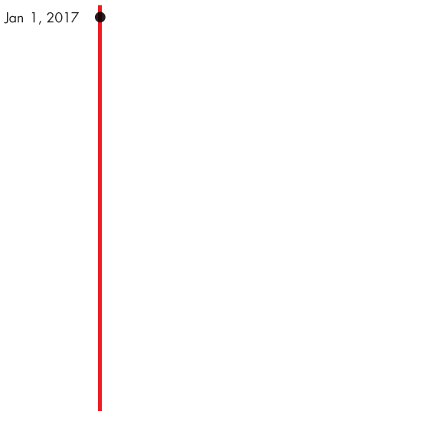
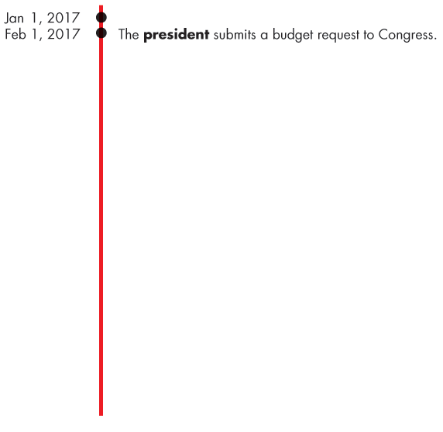
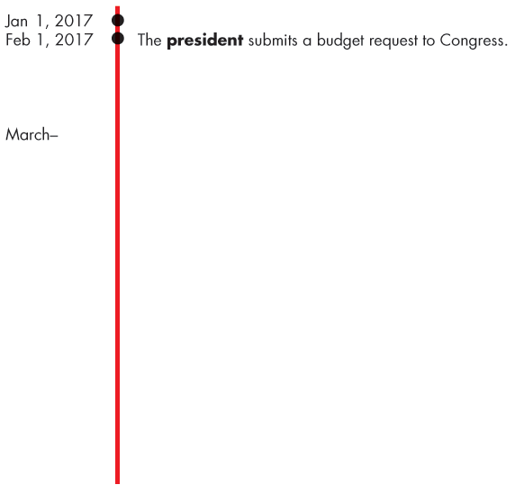
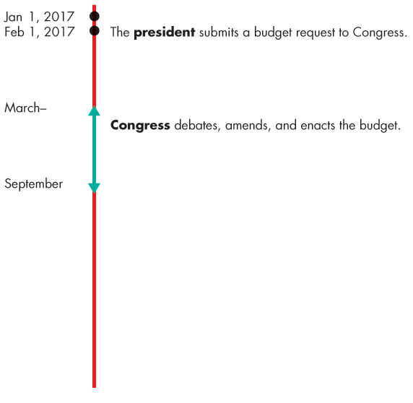
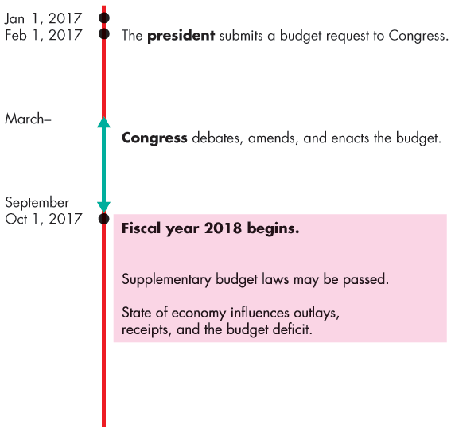
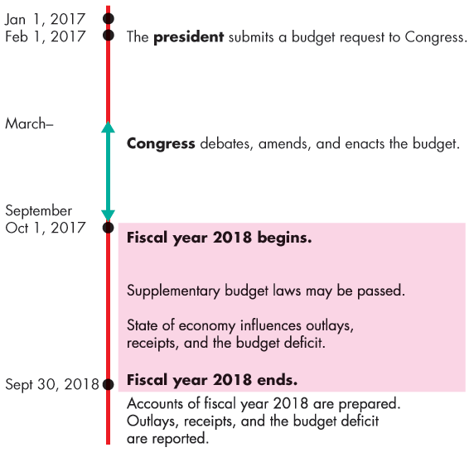
The Federal Budget
The Institutions and Laws
The President and Congress make fiscal policy.
Figure 13.1 shows the budget timeline for Fiscal 2018.

Slide 7
The Federal Budget
Employment Act of 1946
Fiscal policy operates within the framework of the Employment Act of 1946 in which Congress declared that
. . . it is the continuing policy and responsibility of the Federal Government to use all practicable means
. . . to coordinate and utilize all its plans, functions, and resources
. . . to promote maximum employment, production, and purchasing power.

Slide 8
The Federal Budget
The Council of Economic Advisers
The Council of Economic Advisers monitors the economy and keeps the President and the public well informed about the current state of the economy and the best available forecasts of where it is heading.
This economic intelligence activity is one source of data that informs the budget-making process.

Slide 9
The Federal Budget
Highlights of the 2018 Budget
The projected fiscal 2018 Federal Budget has receipts of $3,654 billion, outlays of $4,094 billion, and a projected deficit of $440 billion.
Receipts come from personal income taxes, Social Security taxes, corporate income taxes, and indirect taxes.
Personal income taxes are the largest source of receipts.
Outlays are transfer payments, expenditure on goods and services, and debt interest.
Transfer payments are the largest item of outlays.

Slide 10
The Federal Budget
Surplus or Deficit
The federal government’s budget balance equals receipts minus outlays.
If receipts exceed outlays, the government has a budget surplus.
If outlays exceed receipts, the government has a budget deficit.
If receipts equal outlays, the government has a balanced budget.
The projected budget deficit in fiscal 2018 is $440 billion.

Slide 11
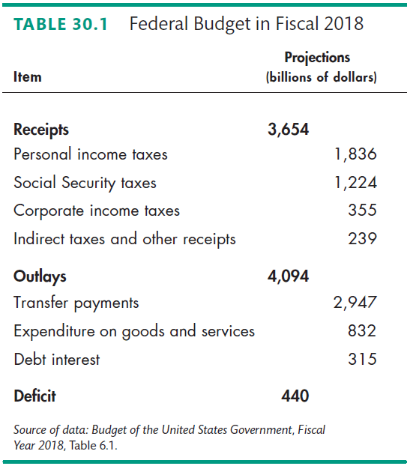
The Federal Budget

Slide 12
The Federal Budget
The Budget in Historical Perspective
Figure 13.2 shows the government’s receipts, outlays, and budget balance as a percentage of GDP.
Except for four years around 2000, the budget has been in a persistent deficit.
In 2008, the budget deficit was large and peaked at almost 10 percent of GDP and remained above 8 percent for the next two years.
Notes:
Classroom activity
Check out Economics in Action: The U.S. Budget in Global Perspective

Slide 13
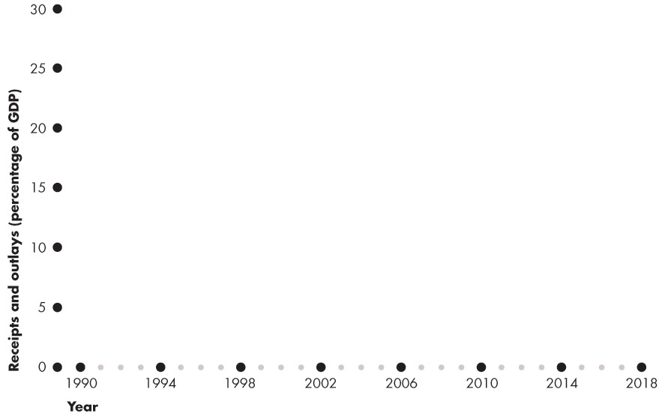
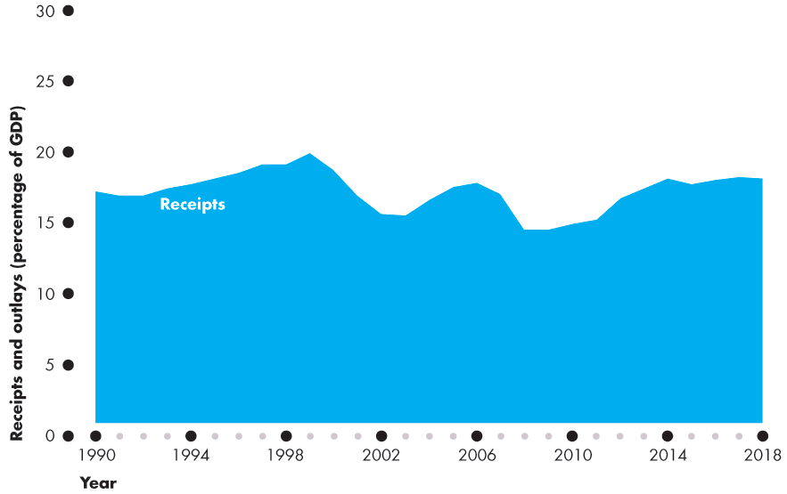
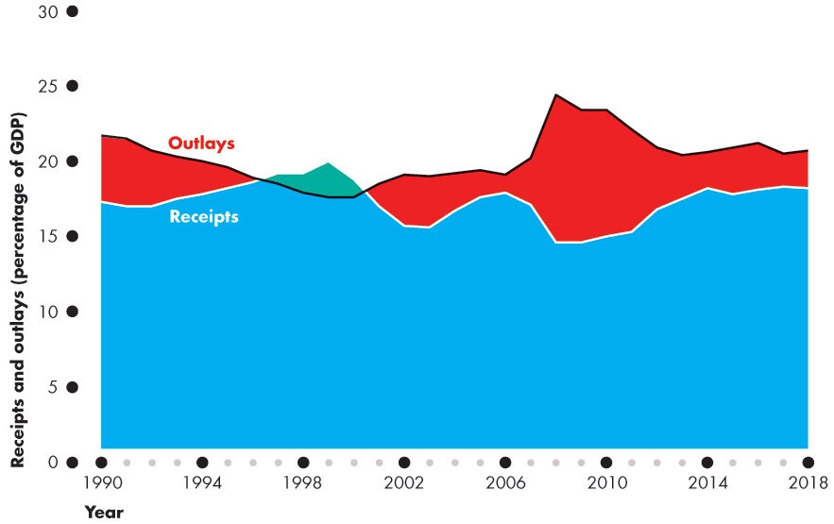
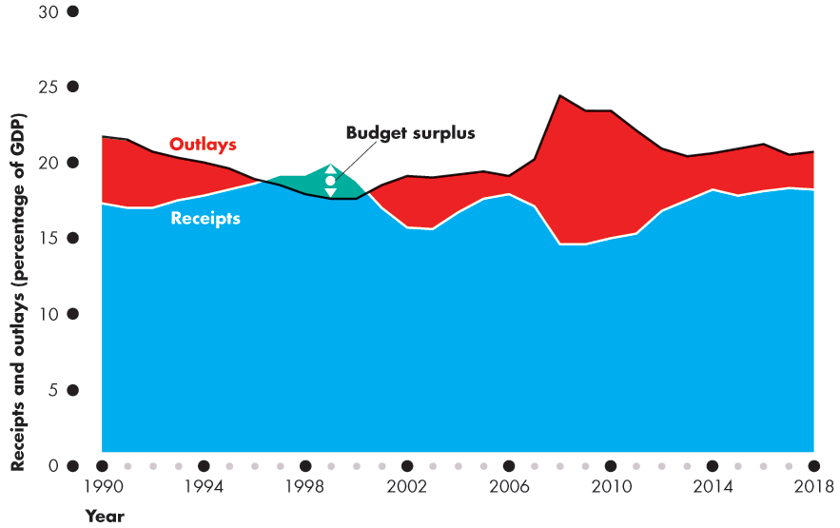
The Federal Budget
Figure 13.2 shows receipts, outlays, and the budget deficit when outlays exceed receipts and the budget surplus when receipts exceed outlays.

Slide 15
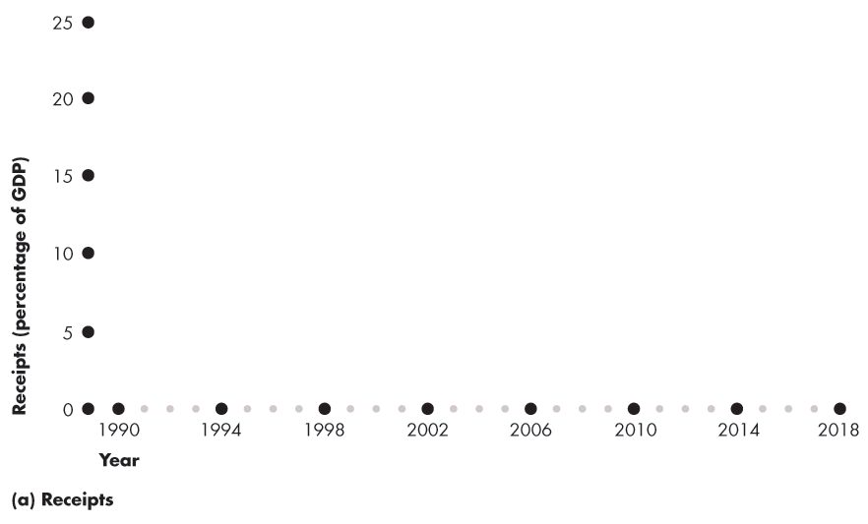
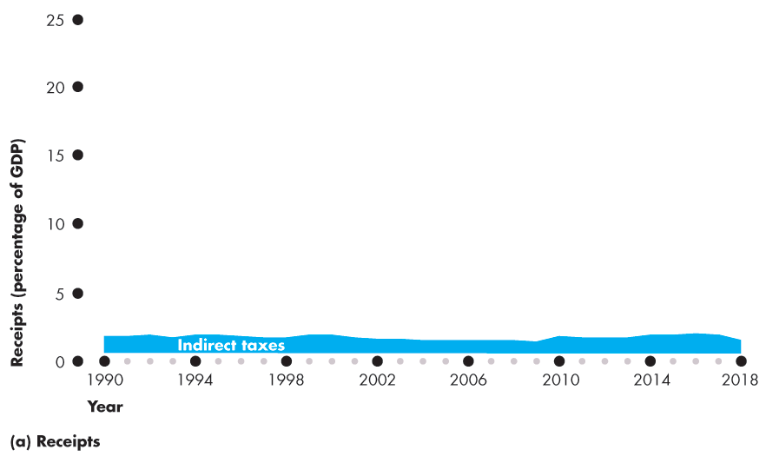
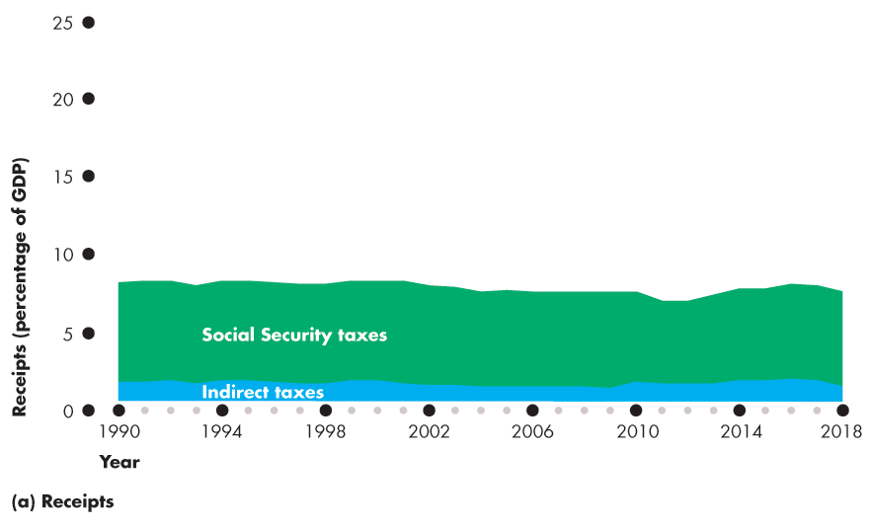
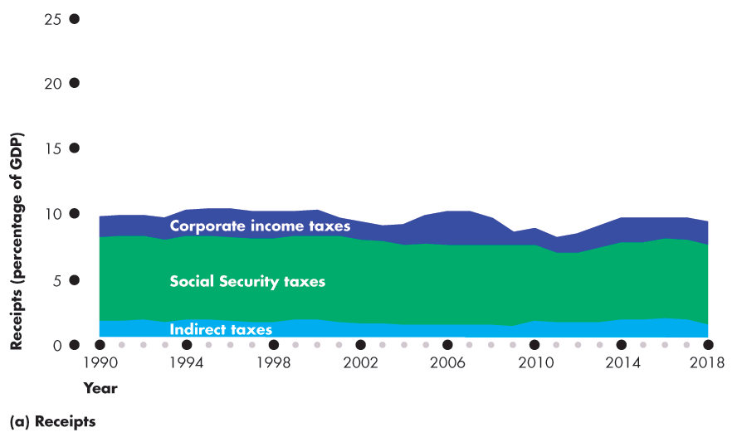
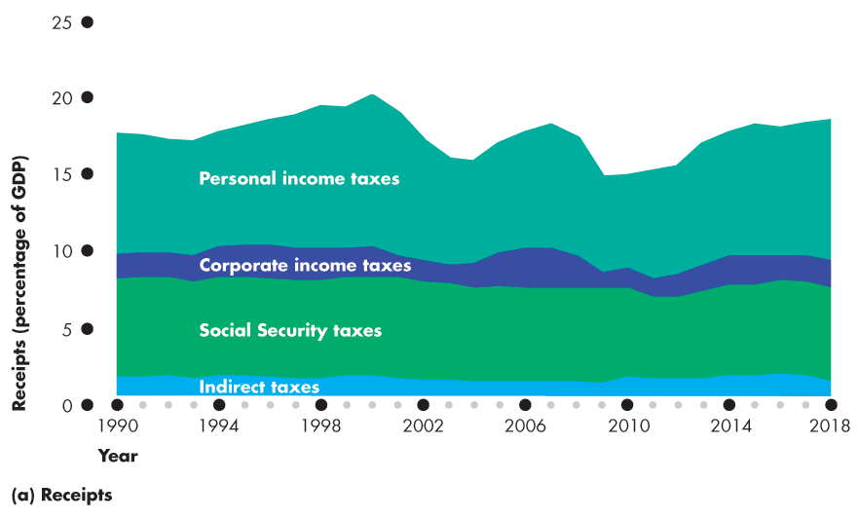
The Federal Budget
Receipts
Figure 13.3(a) shows receipts as a percentage of GDP.

Slide 17
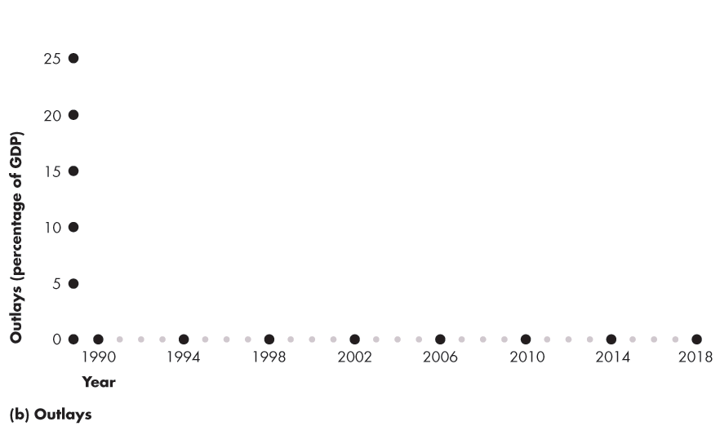
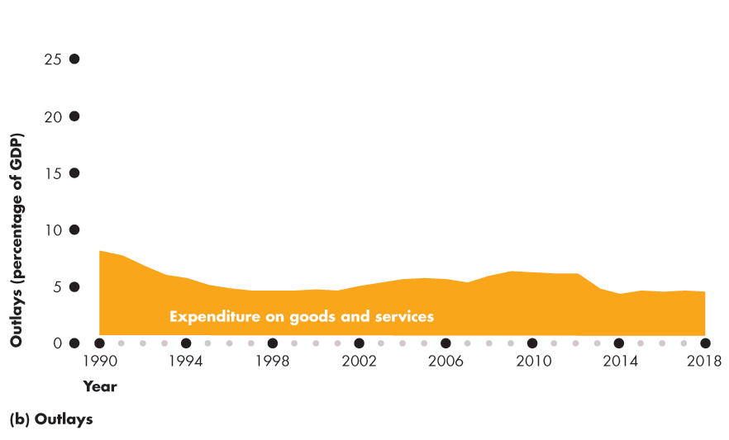
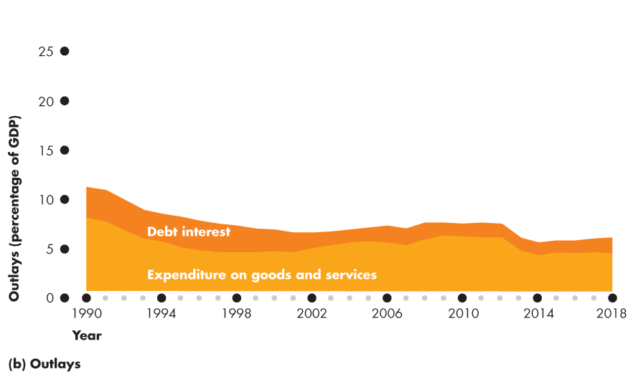
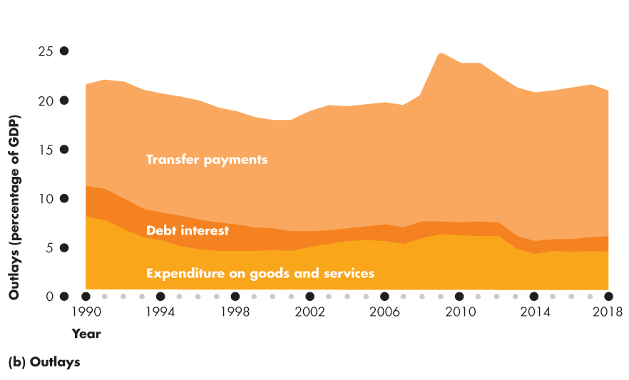
The Federal Budget
Outlays
Figure 13.3(b) shows outlays as a percentage of GDP.

Slide 19
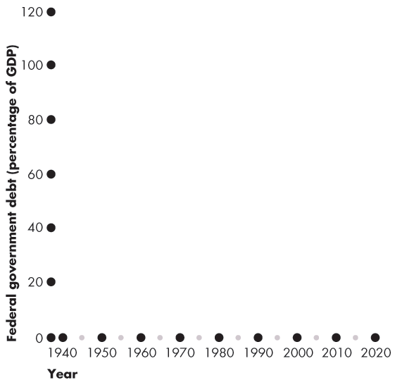
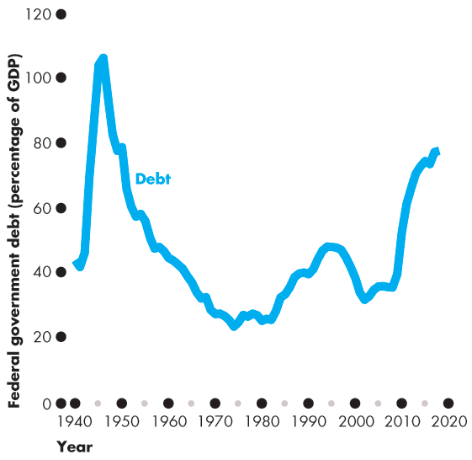
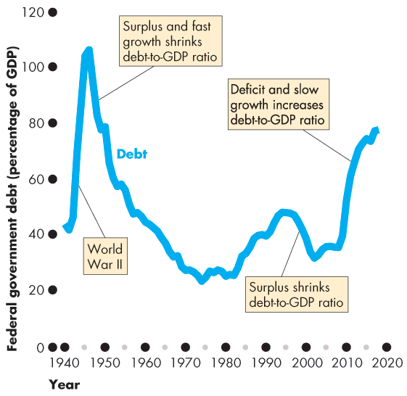
The Federal Budget
Budget Balance and Debt
Government debt is the total amount that the government has borrowed.
It is the sum of past deficits minus past surpluses.
Figure 13.4 shows the federal government’s gross debt ...
and net debt.
Notes:
Deficit and debt. Many students need help with the distinction between the deficit and the debt (and with what happens to the debt when there is a surplus). Use the student loan or credit card analogy. Explain that the budget balance—the deficit or surplus—is just like a personal budget balance—the amount that a student borrows or pays back during a given year. The debt—the amount owed by the government—is like the balance on a student loan or credit card account. Students (usually) have a budget deficit and increasing debt. And graduates with a job (usually) have a budget surplus and decreasing debt.
Does the debt matter? You can have endless fun debating this question. If you do engage your students in this question, you will want to point them to thinking about:
1. The distinction between domestically held debt and foreign held debt.
2. No matter how much the government owes every single year, Y = C + I + G + X – M, so the resources available depend on productive capacity, not on paper claims.

Slide 21
The Federal Budget
State and Local Budgets
The total government sector includes state and local governments as well as the federal government.
In Fiscal 2018, when federal government outlays were about $4,094 billion, state and local outlays were a further $3,600 billion.
Most of state expenditures were on public schools, colleges, and universities ($1,400 billion); local police and fire services; and roads.

Slide 22
Supply-Side Effects of Fiscal Policy
Fiscal policy has important effects on employment, potential GDP, and aggregate supply—called supply-side effects.
An income tax changes full employment and potential GDP.

Slide 23
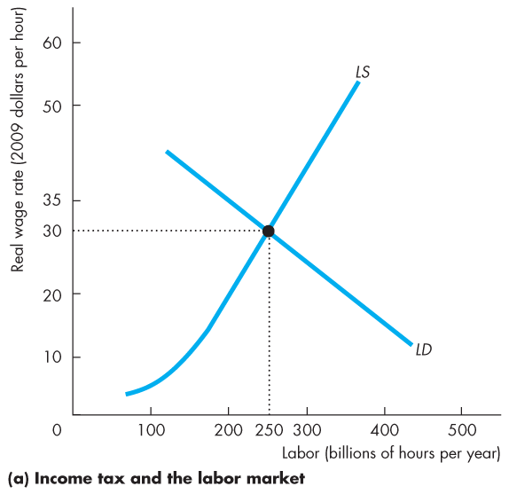
Supply-Side Effects of Fiscal Policy
Full Employment and Potential GDP
Figure 13.5 illustrates full employment and potential GDP.
Equilibrium employment is full employment and ...
the real GDP produced by the full-employment quantity of labor is potential GDP.

Slide 24
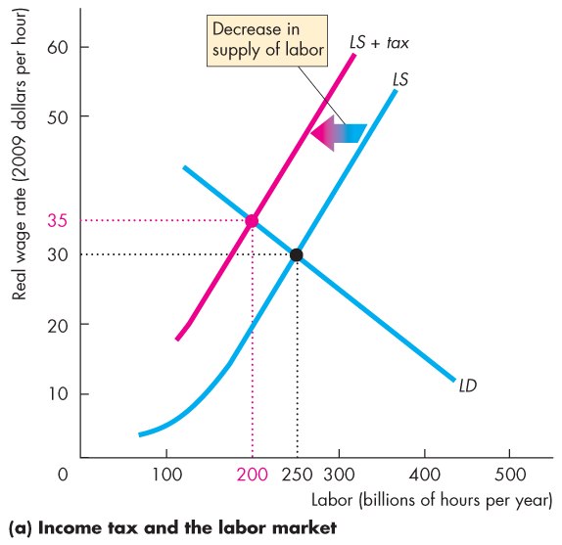
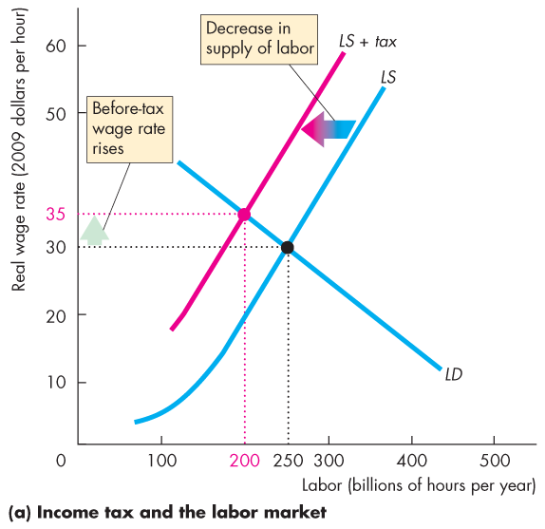
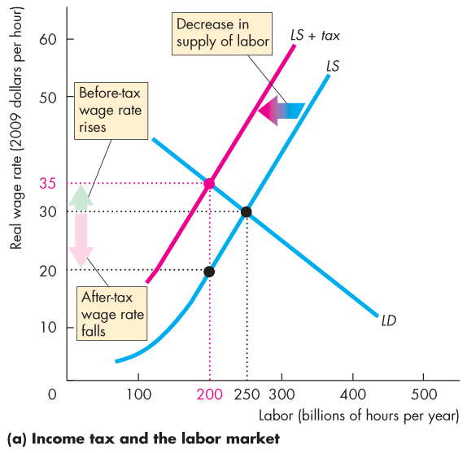
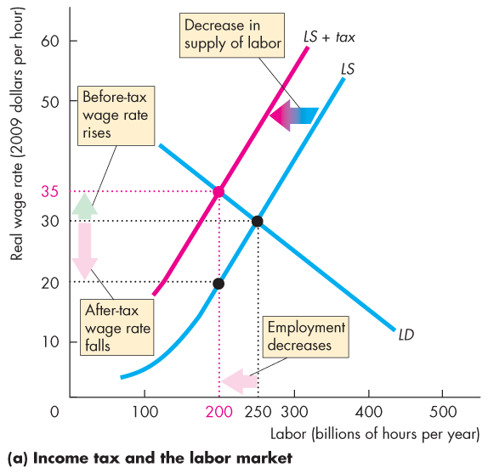
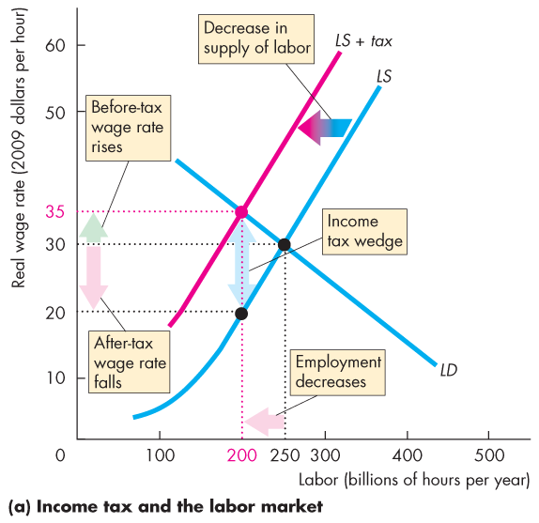

Slide 25
Supply-Side Effects of Fiscal Policy
The Effects of the Income Tax
Figure 13.5(a) illustrates the effects of an income tax in the labor market.
The supply of labor decreases because the tax decreases the after-tax wage rate.
Notes:
This section builds on the micro chapters that discuss the effects of taxes. If your students have not yet done a micro course and you want to cover this material, you’ll need to take it slowly and carefully.

Slide 26
Supply-Side Effects of Fiscal Policy
The before-tax real wage rate rises, but the after-tax real wage rate falls.
The quantity of labor employed decreases.
The gap created between the before-tax and after-tax wage rates is called the tax wedge.

Slide 27
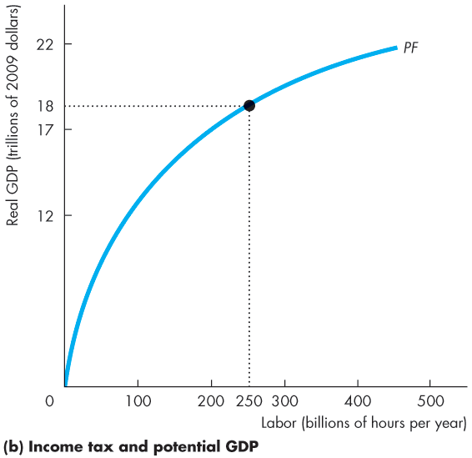
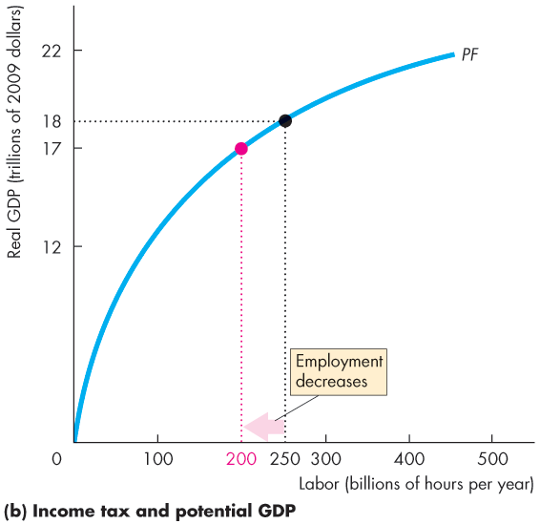
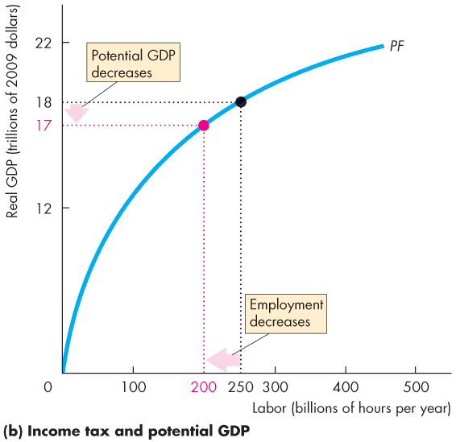
Supply-Side Effects of Fiscal Policy
When the quantity of labor employed decreases, …
potential GDP decreases.
The supply-side effect of a rise in the income tax decreases potential GDP and decreases aggregate supply.

Slide 29
Supply-Side Effects of Fiscal Policy
Taxes on Expenditure and the Tax Wedge
Taxes on consumption expenditure add to the tax wedge.
The reason is that a tax on consumption raises the prices paid for consumption goods and services and is equivalent to a cut in the real wage rate.
If the income tax rate is 25 percent and the tax rate on consumption expenditure is 10 percent, a dollar earned buys only 65 cents worth of goods and services.
The tax wedge is 35 percent.
Notes:
Classroom activity
Check out Economics in Action: Some Real-World Tax Wedges

Slide 30
Supply-Side Effects of Fiscal Policy
Taxes and the Incentive to Save and Invest
A tax on capital income lowers the quantity of saving and investment and slows the growth rate of real GDP.
The interest rate that influences saving and investment is the real after-tax interest rate.
The real after-tax interest rate subtracts the income tax paid on interest income from the real interest.
Taxes depend on the nominal interest rate. So the true tax on interest income depends on the inflation rate.

Slide 31
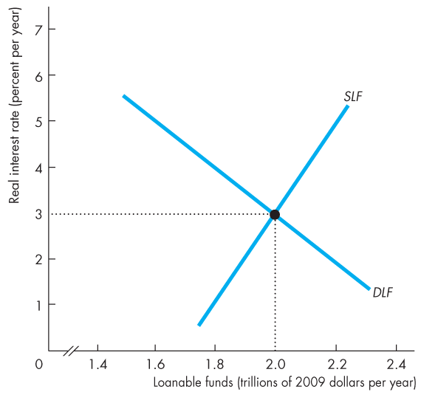
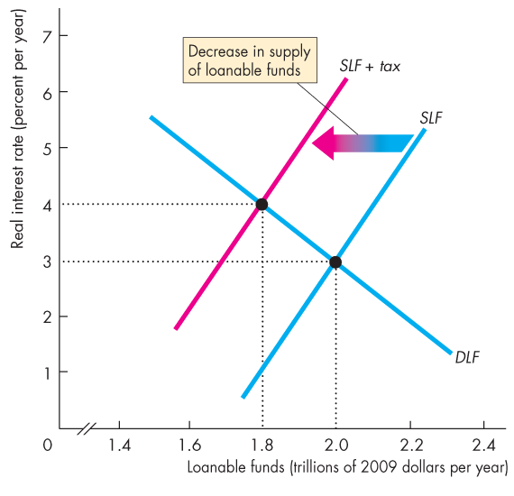
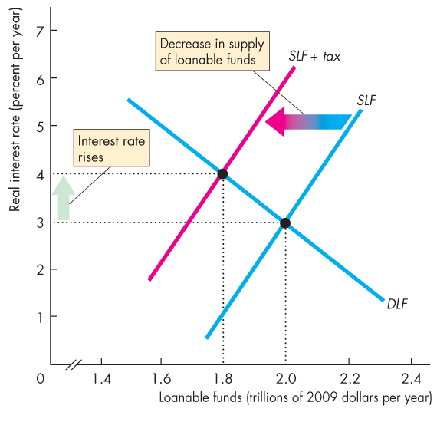
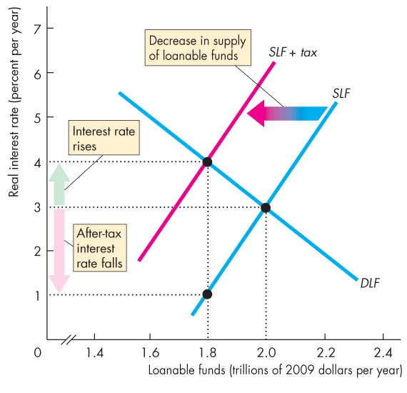
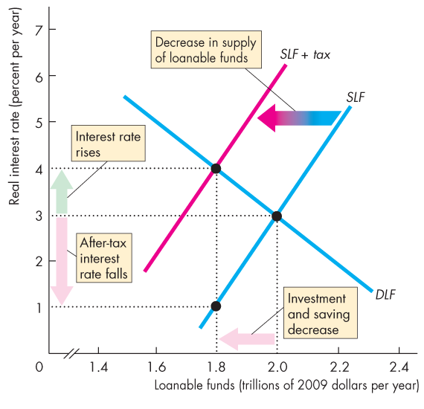
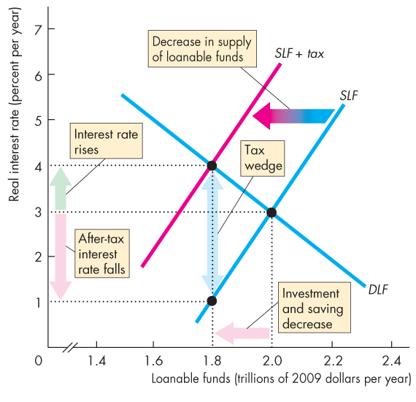
Supply-Side Effects of Fiscal Policy
Figure 13.6 illustrates the effects of a tax on capital income.
A tax decreases the supply of loanable funds.
Investment and saving decrease.
A tax wedge is driven between the real interest rate and the real after-tax interest rate.

Slide 33
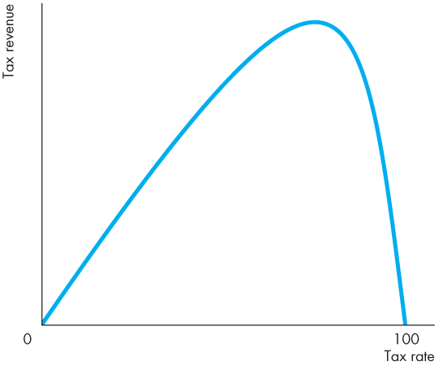
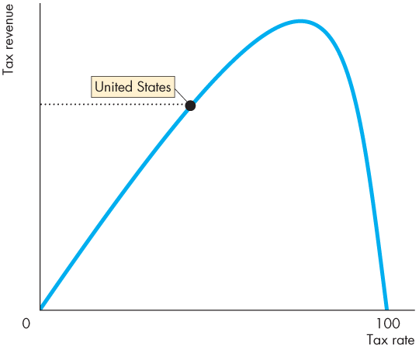
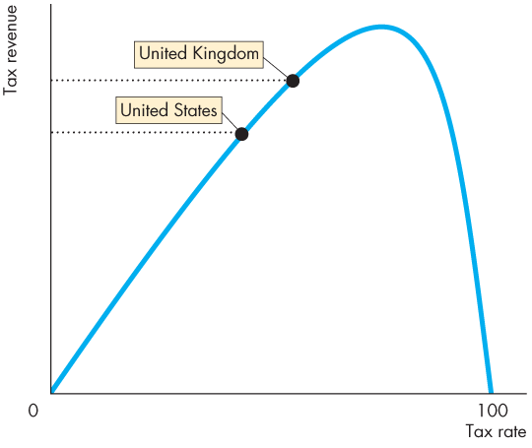
Supply-Side Effects of Fiscal Policy
Tax Revenues and the Laffer Curve
The relationship between the tax rate and the amount of tax revenue collected is called the Laffer curve.

Slide 34
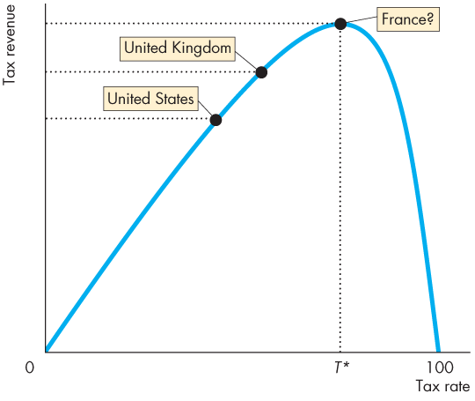

Slide 35
Supply-Side Effects of Fiscal Policy
At the tax rate T*, tax revenue is maximized.
For a tax rate below T*, a rise in the tax rate increases tax revenue.
For a tax rate above T*, a rise in the tax rate decreases tax revenue.

Slide 36
Generational Effects of Fiscal Policy
Is the budget deficit a burden on future generations?
Is the budget deficit the only burden on future generations?
What about the deficit in the Social Security fund?
Does it matter who owns the bonds that the government sells to finance its deficit?
To answer questions like these, we use a tool called generational accounting.
Generational accounting is an accounting system that measures the lifetime tax burden and benefits of each generation.

Slide 37
Generational Effects of Fiscal Policy
Generational Accounting and Present Value
Taxes are paid by people with jobs. Social Security benefits are paid to people after they retire.
So to compare the value of an amount of money at one date (working years) with that at a later date (retirement years), we use the concept of present value.
A present value is an amount of money that, if invested today, will grow to equal a given future amount when the interest that it earns is taken into account.

Slide 38
Generational Effects of Fiscal Policy
For example:
If the interest rate is 5 percent a year, $1,000 invested today will grow, with interest, to $11,467 after 50 years.
The present value (2018) of $11,467 in 2068 is $1,000.

Slide 39
Generational Effects of Fiscal Policy
The Social Security Time Bomb
Using generational accounting and present values, economists have found that the federal government is facing a Social Security time bomb!
In 2008, the first of the baby boomers started collecting Social Security pensions and in 2011, they became eligible for Medicare benefits.
By 2030, all the baby boomers will have reached retirement age and the population supported by Social Security will have doubled.

Slide 40
Generational Effects of Fiscal Policy
Under the existing Social Security laws, the federal government has an obligation to pay pensions and Medicare benefits on an already declared scale.
To assess the full extent of the government’s obligations, economists use the concept of fiscal imbalance.
Fiscal imbalance is the present value of the government’s commitments to pay benefits minus the present value of its tax revenues.
Gokhale and Smetters estimated that the fiscal imbalance was $68 trillion in 2014—4 times the value of total production in 2014 ($17 trillion).

Slide 41
Generational Effects of Fiscal Policy
How can the government meet its Social security obligations?
Gokhale and Smetters consider four alternatives:
Taxes
Raise income and Social Security taxes
Cut Social Security benefits
Cut federal government discretionary spending
Starting in 2003, income taxes would need to be raised by 69 percent, or Social Security taxes raised by 95 percent, or Social Security benefits cut by 56 percent.

Slide 42
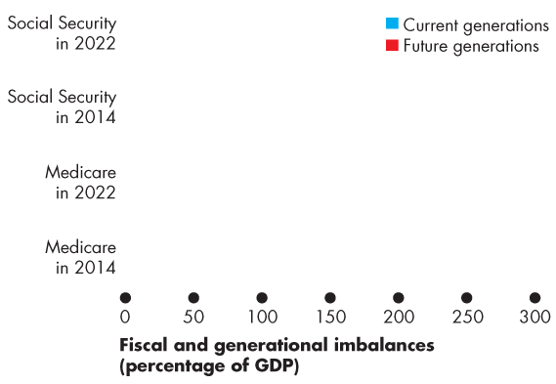
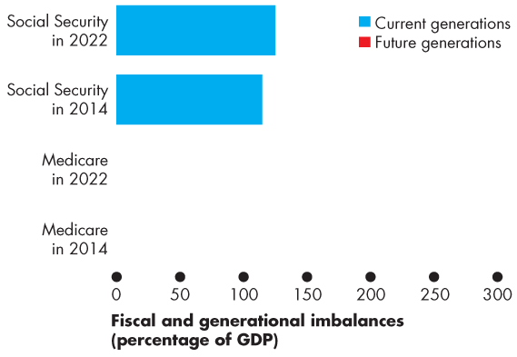
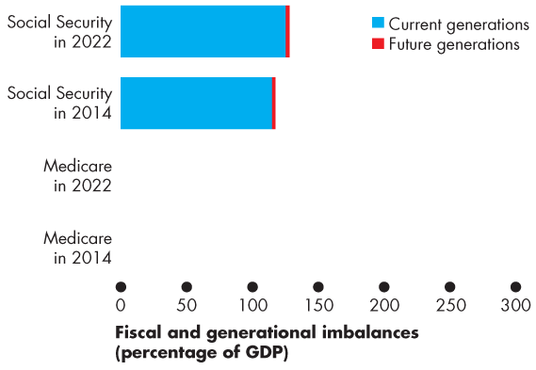
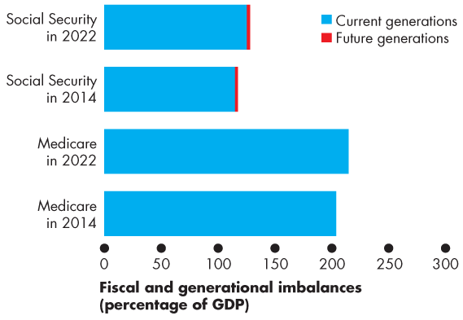
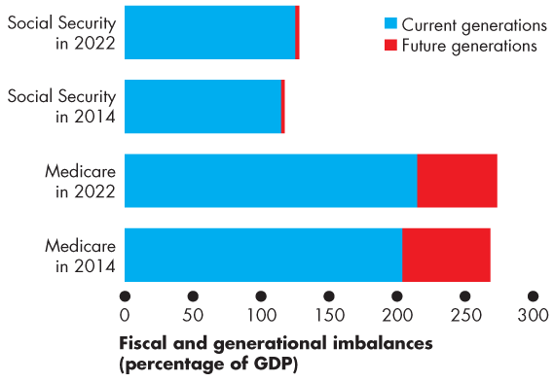
Generational Effects of Fiscal Policy
Generational Imbalance
Generational imbalance is the division of the fiscal imbalance between the current and future generations, assuming that the current generation will enjoy the existing levels of taxes and benefits.
The bars show the scale of the fiscal imbalance.

Slide 44
Generational Effects of Fiscal Policy
International Debt
How much investment have we paid for by borrowing from the rest of the world? And how much U.S. government debt is held abroad?
In June 2017, the United States had a net debt to the rest of the world of $13.6 trillion.
Of that debt, $6.1 trillion was U.S. government debt.
U.S. corporations used $11.0 trillion of foreign funds.

Slide 45
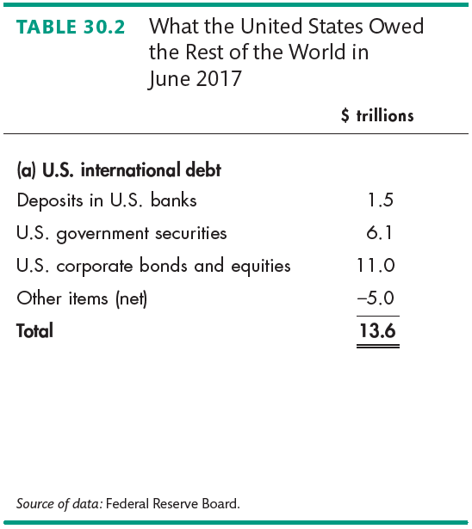
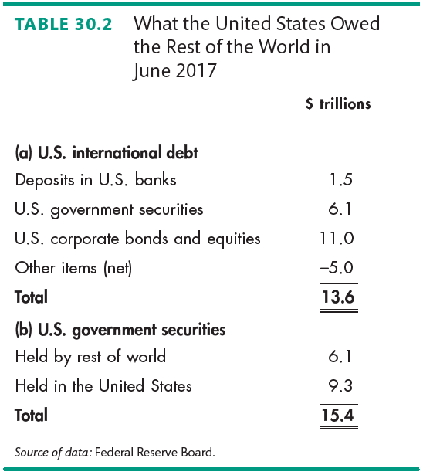
Generational Effects of Fiscal Policy

Slide 46
Fiscal Stimulus
A fiscal stimulus is the use of fiscal policy to increase production and employment.
Fiscal stimulus can be either
Automatic
Discretionary
Automatic fiscal policy is a fiscal policy action triggered by the state of the economy with no government action.
Discretionary fiscal policy is a policy action that is initiated by an act of Congress.

Slide 47
Fiscal Stimulus
Automatic Fiscal Policy and Cyclical and Structural Budget Balances
Two items in the government budget change automatically in response to the state of the economy.
Tax revenues
Needs-tested spending

Slide 48
Fiscal Stimulus
Automatic Changes in Tax Revenues
Congress sets the tax rates that people must pay.
The tax dollars people pay depend on tax rates and incomes.
But incomes vary with real GDP, so tax revenues depend on real GDP.
When real GDP increases in an expansion, tax revenues increase.
When real GDP decreases in a recession, tax revenues decrease.
Notes:
Classroom activity
Check out Economics in the News: Cutting the Corporate Tax Rate

Slide 49
Fiscal Stimulus
Needs-Tested Spending
The government creates programs that pay benefits to qualified people and businesses.
These transfer payments depend on the economic state of the economy.
When the economy is in an expansion, unemployment falls, so needs-tested spending decreases.
When the economy is in a recession, unemployment rises, so needs-tested spending increases.

Slide 50
Fiscal Stimulus
Automatic Stimulus
In a recession, receipts decrease and outlays increase.
So the budget provides an automatic stimulus that helps shrink the recessionary gap.
In a boom, receipts increase and outlays decrease.
So the budget provides automatic restraint that helps shrink the inflationary gap.

Slide 51
Fiscal Stimulus
Cyclical and Structural Balances
The structural surplus or deficit is the budget balance that would occur if the economy were at full employment and real GDP were equal to potential GDP.
The cyclical surplus or deficit is the actual surplus or deficit minus the structural surplus or deficit.
That is, a cyclical surplus or deficit is the surplus or deficit that occurs purely because real GDP does not equal potential GDP.
Notes:
Cyclical and structural budget balances. Cyclical and structural budget balances are a difficult concept for many students, but important because of the appropriate measure of fiscal stance.
An effective way to help students see that revenues and outlays will vary as depicted in Figure 13.9 is to remind them that potential GDP corresponds to full employment, and employment (and so the number of tax payers and recipients of unemployment compensation) changes when real GDP varies.

Slide 52
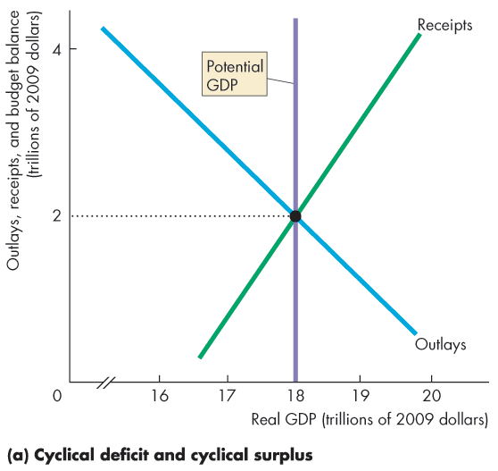
Fiscal Stimulus
Figure 13.9 illustrates a cyclical deficit and a cyclical surplus.
In part (a), potential GDP is $18 trillion.
If real GDP is $17 trillion, the budget is in deficit and it is a cyclical deficit.
If real GDP is $19 trillion, the budget is in surplus and it is a cyclical surplus.

Slide 54
Fiscal Stimulus
In part (b), if real GDP and potential GDP are $17 trillion, the budget is a deficit and the deficit is a structural deficit.
If real GDP and potential GDP are $18 trillion, the budget is balanced.
If real GDP and potential GDP are $19 trillion, the budget is a surplus and the surplus is a structural surplus.

Slide 56
Fiscal Stimulus
U.S. Structural Budget Balance in 2017
Figure 13.10 shows the actual deficit, calculated by the CBO.
In 2017, the budget deficit was $440 billion.
With a recessionary gap of $85 billion, how much of the
budget deficit was a cyclical deficit?
How much was structural deficit?

Slide 58
Fiscal Stimulus
The figure shows the cyclical deficit, calculated by the CBO.
The gap between the cyclical deficit and the actual deficit is the structural deficit.
The cyclical deficit in 2017 was $30 billion.
The structural deficit was $410 billion.
Notes:
.

Slide 59
Fiscal Stimulus
Discretionary Fiscal Stimulus
Most discretionary fiscal stimulus focuses on its effects on aggregate demand.
Fiscal Stimulus and Aggregate Demand
Changes in government expenditure and taxes change aggregate demand and have multiplier effects.
Two main fiscal multipliers are
Government expenditure multiplier
Tax multiplier
Notes:
Classroom activity
Check out Economics in Action: The 2009 Fiscal Stimulus Package

Slide 60
Fiscal Stimulus
The government expenditure multiplier is the quantitative effect of a change in government expenditure on real GDP.
Because government expenditure is a component of aggregate expenditure, an increase in government expenditure increases real GDP.
When real GDP increases, incomes rise and consumption expenditure increases. Aggregate demand increases.
If this were the only consequence of the increase in government expenditure, the multiplier would be >1.
Notes:
Classroom activity
Check out Economics in Action: How Big Are the Fiscal Stimulus Multipliers?

Slide 61
Fiscal Stimulus
But an increase in government expenditure increases government borrowing and raises the real interest rate.
With the higher cost of borrowing, investment decreases, which partly offsets the increase in government expenditure.
If this were the only consequence of the increase in government expenditure, the multiplier would be < 1.
Which effect is stronger?
The consensus is that the crowding-out effect dominates and the multiplier is <1.

Slide 62
Fiscal Stimulus
The tax multiplier is the quantitative effect of a change in taxes on aggregate demand.
The demand-side effects of a tax cut are likely to be smaller than an equivalent increase in government expenditure.

Slide 63
Fiscal Stimulus
Graphical Illustration of Fiscal Stimulus
Figure 13.11 shows how fiscal policy is supposed to work to close a recessionary gap.
An increase in government expenditure or a tax cut increases aggregate expenditure.
The multiplier process increases aggregate demand.

Slide 65
Fiscal Stimulus
Fiscal Stimulus and Aggregate Supply
Taxes drive a wedge between the cost of labor and the take-home pay and between the cost of borrowing and the return on lending.
Taxes decrease employment, saving, and investment and decrease real GDP and its growth rate.
A tax cut decreases these negative effects and increases real GDP and its growth rate.
The supply-side effects of a tax cut probably dominate the demand-side effects and make the tax multiplier larger than the government expenditure multiplier.

Slide 66
Fiscal Stimulus
Magnitude of Stimulus
Economists have diverging views about the size of the fiscal multipliers because there is insufficient empirical evidence on which to pin their size with accuracy.
This fact makes it impossible for Congress to determine the amount of stimulus needed to close a given output gap.
Also, the actual output gap is not known and can only be estimated with error.
So discretionary fiscal policy is risky.

Slide 67
Fiscal Stimulus
Time Lags
The use of discretionary fiscal policy is also seriously hampered by three time lags:
Recognition lag—the time it takes to figure out that fiscal policy action is needed.
Law-making lag—the time it takes Congress to pass the laws needed to change taxes or spending.
Impact lag—the time it takes from passing a tax or spending change to its effect on real GDP being felt.

